Slide 1

Bold Moves: Sustainability Issues in Scholarly Communication
Institutional Mobilization Task Group
November 2017

Slide 2

What is the Problem?
Access to scholarly research is key to innovation and to Canada’s success and competitiveness globally.
The current commercial publishing model is unsustainable, and is jeopardizing access to scholarly research.

Slide 3
How Did We Get Here?
Prior to the 1990s, print-based journals were priced
by title.
Larger institutions had a larger selection of print journals.
Smaller institutions had a limited selection of print journals.

Slide 4
The Internet changed everything.
The Internet and
Digital Distribution
Pricing continues to be based on print models, despite a shift to digital production, distribution, and collection management.

Slide 5
What’s the
“Big Deal”?
Publishers sell journals in packages that bundle all their content, both high and low impact, at one price.
Through consortial purchasing, Canadian universities of all sizes have access to a wider range of content than ever before.
This model ensures a steady and predictable revenue stream for publishers.

Slide 6
The “Big Deal” is Broken
Library acquisition budgets are almost flat.
Mergers and consolidation create an oligopoly in the industry, allowing publishers to increase subscription rates well over the rate of inflation.
  “Five commercial publishers now account for more than half of today’s published journal output in natural/medical sciences and social sciences/humanities”
  - V. Larivière, Canada Research Chair on the Transformations of Scholarly Communication,
  Université de Montréal

Slide 7
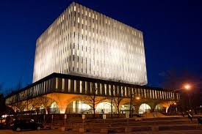
Libraries are Under Pressure to Make Tough Decisions
The “Big Deal” forces libraries to purchase content they may not otherwise choose.
Researchers & students have increasing expectations for access to scholarly content.
Library budgets are flat while journal costs increase, causing libraries to make tough decisions about what content they can afford.
Dana Porter Library, University of Waterloo
Libraries form consortia and have successfully leveraged collective buying power, but it’s not enough.
Notes:
Feel free to swap out this picture for your favourite library

Slide 8
Library Acquisitions: a Declining % of
Total University Revenue
Notes:
The low Canadian dollar is exacerbating declining library budgets; but an increase in the loonie will not solve the bigger problem.

Slide 9
What is CRKN Doing?

Slide 10

Institutional Mobilization Toolkit
CRKN has developed a toolkit for members to utilize in communications with their internal stakeholders on the issues of negotiation priorities, to raise awareness and support on a national level within and beyond the university.
Access the toolkit at https://www.crkn-rcdr.ca/en/imtg

Slide 11
IM Toolkit: Examples
Understanding the Scholarly Publishing Challenge
Evolution of Journal Pricing

Slide 12
IM Toolkit: Examples
Scholarly Publishing Models
Gold OA Models

Slide 13
What Can You Do?

Slide 14
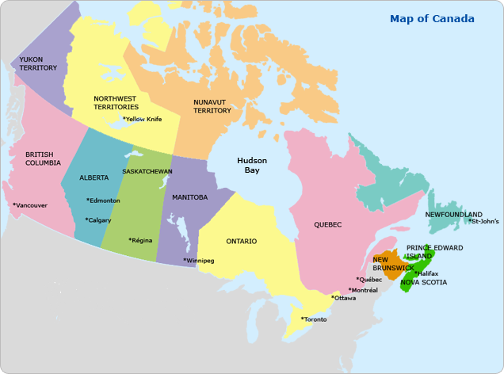
Action #1:
Nation-wide Collaboration
University libraries collaborate nationally, in negotiations, through consortia. Presidents and Provosts who understand the issues in scholarly communication can support negotiations at their institutions and at a national level to increase the amount of influence and negotiating power libraries have with publishers.

Slide 15

Action #2
Support Alternative Publishing Models
Consider:
Open Access Models
Creation and maintenance of Institutional Repositories
Library-supported publishing platforms
Recognizing OA publishing in P&T criteria

Slide 16

Let’s Get Bold!
Let’s Get Organized!
Talk to your
University Librarian.
Canadian Research Knowledge Network
Institutional Mobilization Task Group
imtg@crkn.ca

Slide 17
Sources
Canadian Research Knowledge Network. 2016. “Institutional Mobilization Toolkit.” Canadian Research Knowledge Network. Accessed March 3. http://crkn.ca/imtg.
Larivière, Vincent, Stefanie Haustein, and Philippe Mongeon. 2015. “The Oligopoly of Academic Publishers in the Digital Era.” PLOS ONE 10 (6): e0127502. doi:10.1371/journal.pone.0127502.
Whitehead, Martha, and Brian Owen. 2016. “Canadian Universities and Sustainable Publishing (CUSP).” Ottawa, ON: Canadian Association of Research Libraries. http://www.carl-abrc.ca/uploads/pdfs/Can_Univ_Sustainable_Publishing_2016.pdf.

