Slide 1
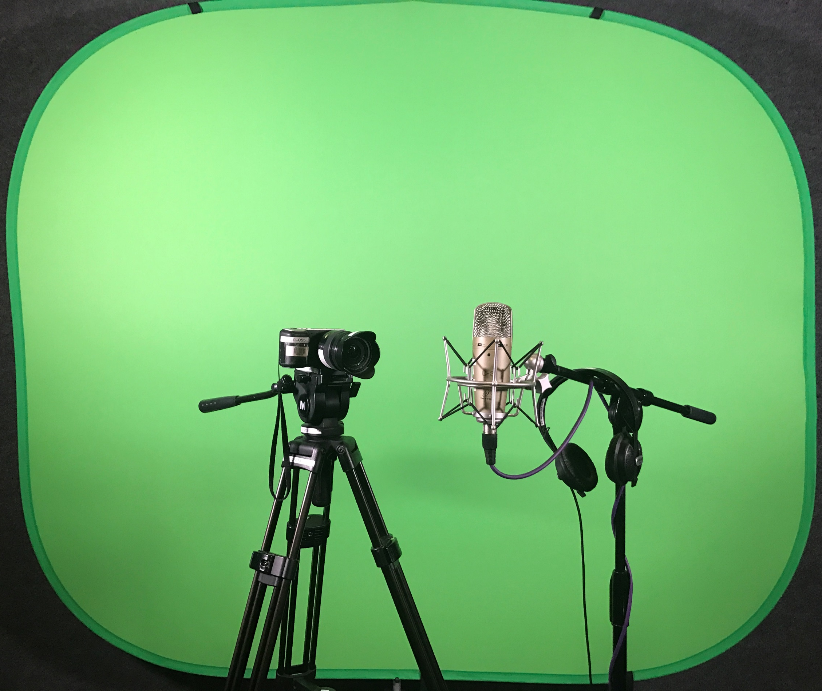
Building community through sharing history and stories
Christina de Castell
Vancouver Public Library
Notes:
Stories reaffirm our shared cultural values, establish community, give children a sense of place and history.
Description: When we support local creativity and the sharing of ideas, we support building community. Every library and memory institution has an opportunity to increase understanding of our history, the experiences of our neighbours and the value of individual stories. We can discover the voices of the present that aren’t being heard, and find ways to support authors, creators and storytellers.

Slide 2
Community offers the promise of belonging and calls for us to acknowledge our interdependence. To belong is to act as an investor, owner and creator of this place. To be welcome, even if we are strangers. As if we came to the right place and are affirmed for that choice.
Peter Block, Community: The Structure of Belonging, 2009

Slide 3
…our survey found that too many people seem to have retreated from civic life and do not participate in the many neighbourhood or community activities that are available. We were surprised to learn that the most cited reason is that people think they have little to offer.
Connections & Engagement, Vancouver Foundation, 2012

Slide 4
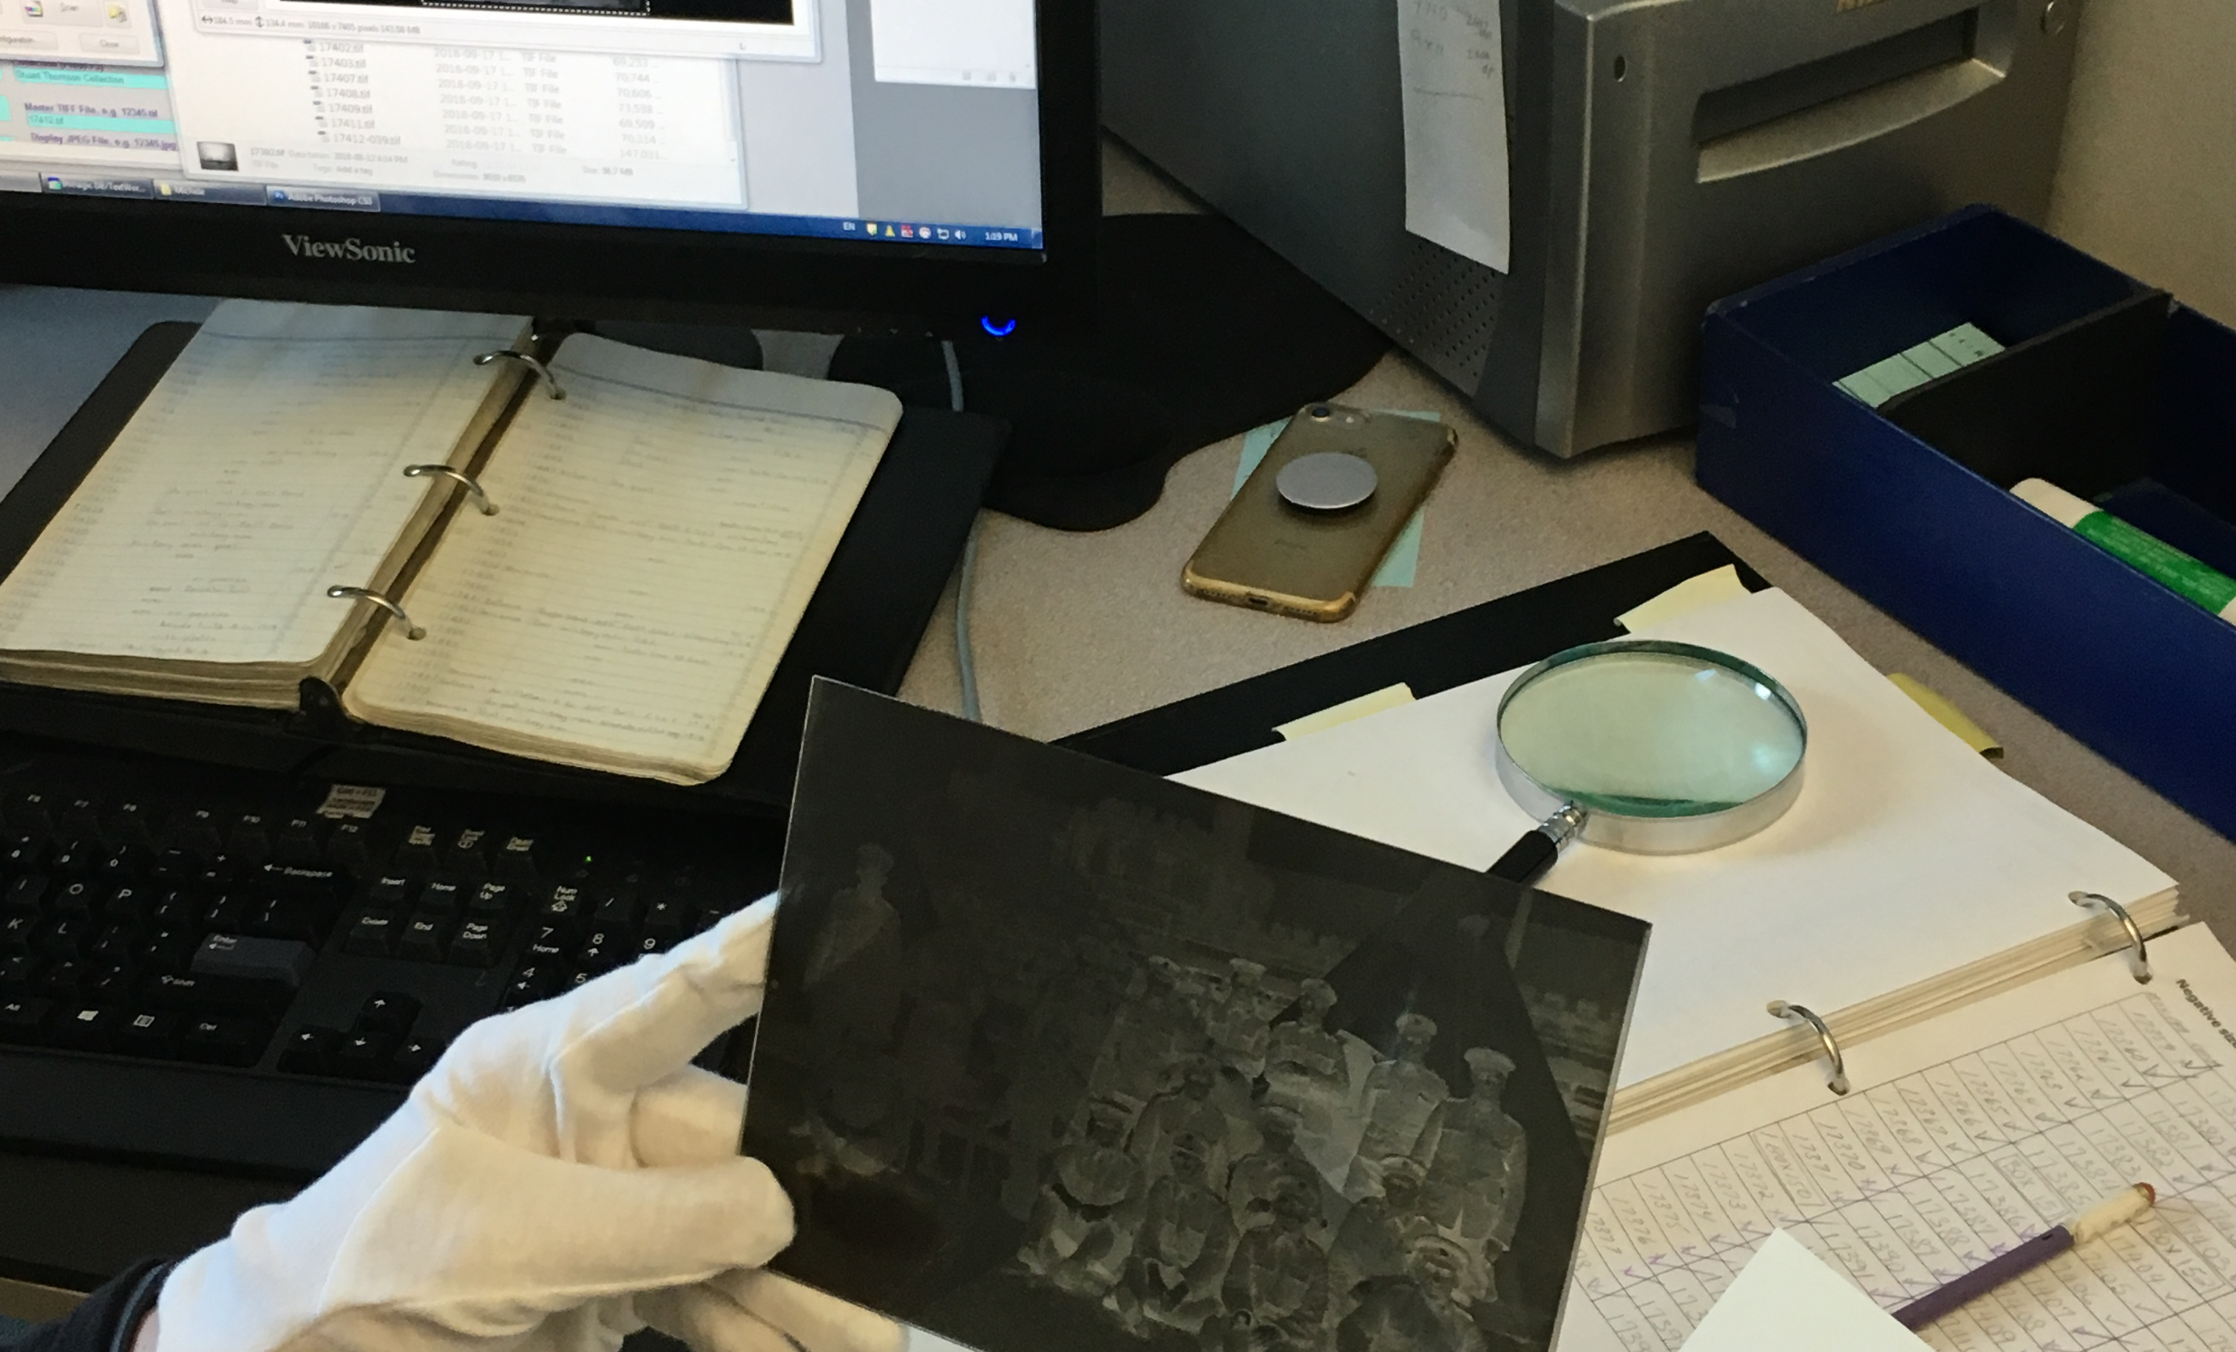
Notes:
We had been digitizing community history for many years, but we realized there was more we could do, that there is a place for us in finding the history and the stories that aren’t in our Special Collections, and aren’t being captured by digitization projects

Slide 5
Build a sense of belonging by gathering and sharing history and stories
Notes:
We began with the idea that the people of Vancouver do have something to offer to their community – their stories and history. The act of asking people for their stories so that they can be part of our library’s collection contributes to their sense of belonging. The other side of our work is enabling anyone who has to a story, an idea or a creative expression to share with their communities to make that happen. We provide the tools and the learning opportunities to make this happen.

Slide 6
Gathering stories
Notes:
For our story gathering projects, we provide staff support to build a history being shared by the library.

Slide 7
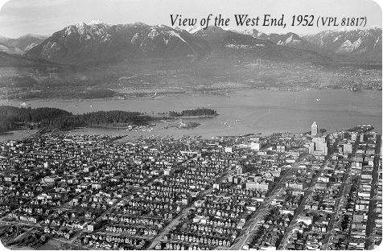
Notes:
We had the idea, and then in 2013 a group of seniors approached us with their West End Memories Project, wanting to celebrate the 100th anniversary of the King George Secondary School by describing life in the West End over those years, and needing assistance with their project. They needed help recording and digitizing, and this met both our objectives for the community digital initiatives team and our general digital literacy goals. We worked with them to record their stories in June 2014. Through the project, we began to understand the kinds of support that community groups need to digitize and record their stories.

Slide 8
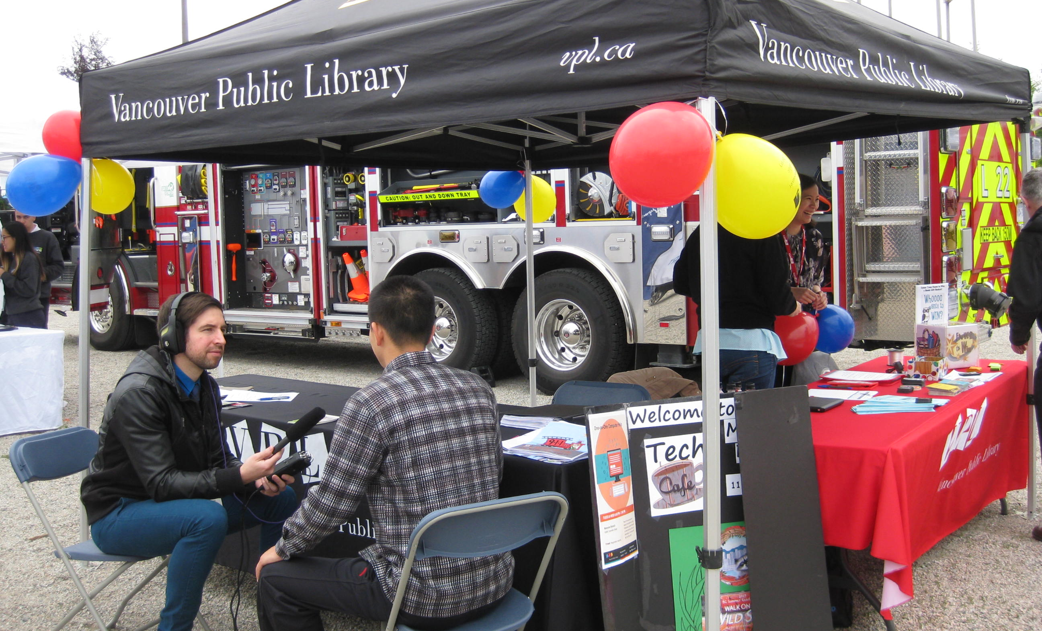
Notes:
This meant that our staff needed to develop new skills, in recording on the street and wherever our projects took us – which was at times to retirement facilities, and at times at community events. It also meant learning to edit sound, and the difficult decisions about how to curate the stories.

Slide 9
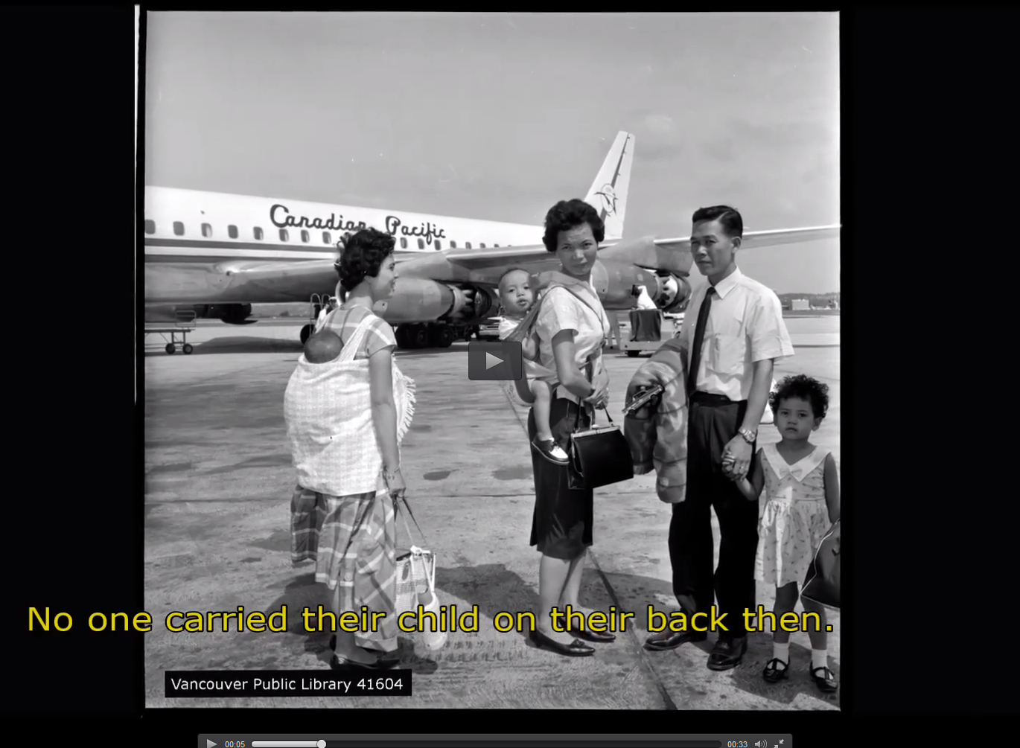
https://thisvancouver.vpl.ca/islandora/object/islandora:158
Notes:
After the West End Memories project, a community leader in Chinatown approached us, and this grew into Chinatown Stories, working with Chinese elders to share history of the area. This is my favourite video, where she goes on to say, “in my hometown, this was how it’s done…You can’t carry a baby in your arms all the time. How do you get any work done?”. Launch was incredible for the conversations that connected people in April 2016. They shared an appreciation for the history of the neighbourhood and identified that now, people are proud that they live in a multicultural city.

Slide 10
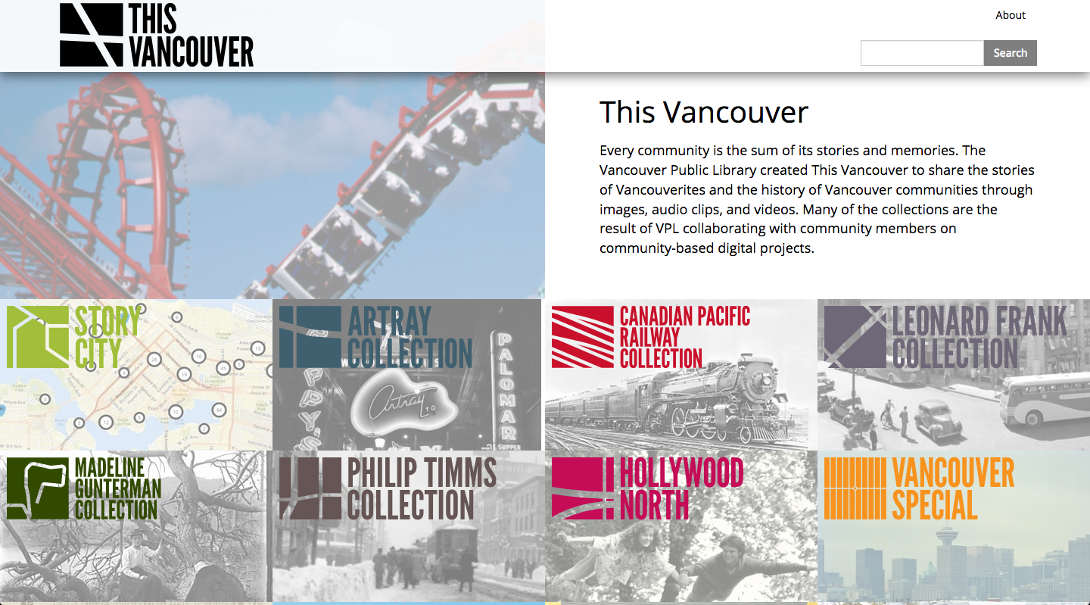
Notes:
We built a repository in Islandora to hold our stories, whether audio, video, or our traditional photographs. And began to see more opportunities.

Slide 11
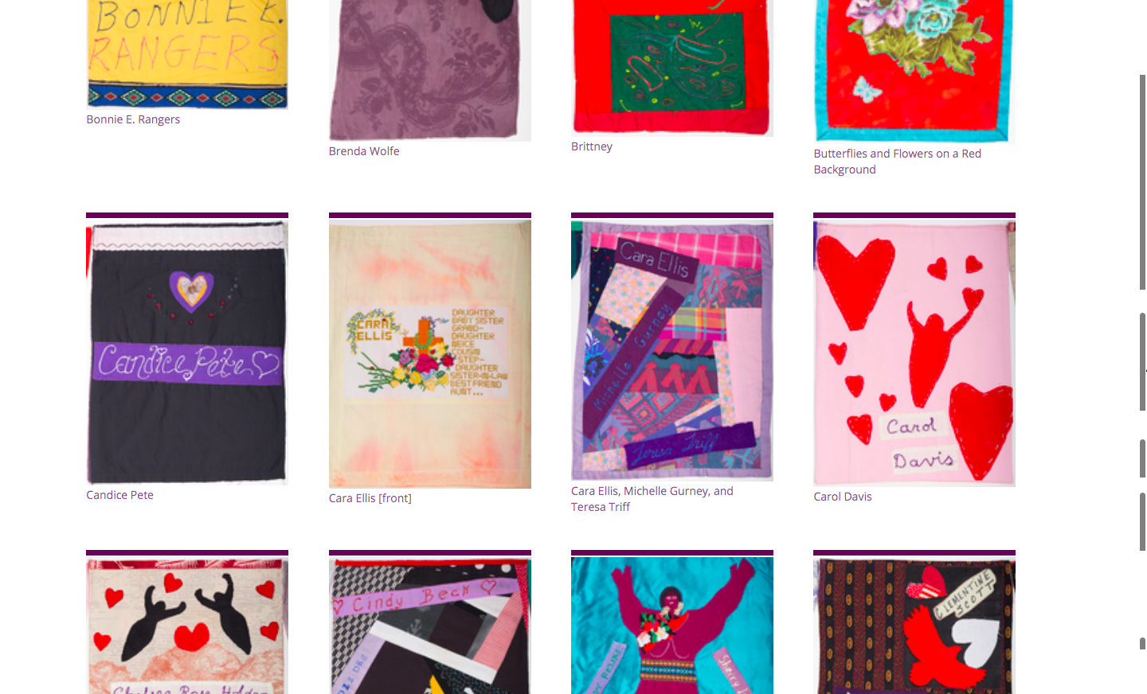
Notes:
From 2015 to March 2017. In the DTES, each year on Feb 14 since 1991, there has been a march to honour the memory of all women from the Downtown Eastside (DTES) who have died due to physical, mental, emotional, and spiritual violence. Each year since 2005 the Women's Memorial March Quilt is carried by dozens of people during that march. Diane Wood of the Women’s Memorial March Committee worked with VPL over several months to carefully photograph each of the hand-sewn and hand-decorated panels for the online exhibit, Remembering our DTES Women: Stories Behind the Women’s Memorial Quilt.
They created a quilt with each square representing the memory of one of these women. We were approached because they wanted to display the quilt in the library so that it could be seen beyond the march itself, and one of our staff saw that we could do more, by digitally preserving the quilt squares and by asking friends and relatives to share their memories. This was an incredibly hard, emotional project, but one where we created a place for voices that had long been ignored.
This quilt was created by the collaboration of family members, friends, and community members over many years. Each panel honours the love, hopes, and dreams for the women who have been murdered or gone missing in the DTES. Since 2015, the Vancouver Public Library and the Women's Memorial March Committee have been working together to digitize the 120+ beautiful panels that form the Women's Memorial March Quilt. Our intention is to preserve the images of the panels in high quality photographs, and then with the families' approval display the images in this online gallery.

Slide 12
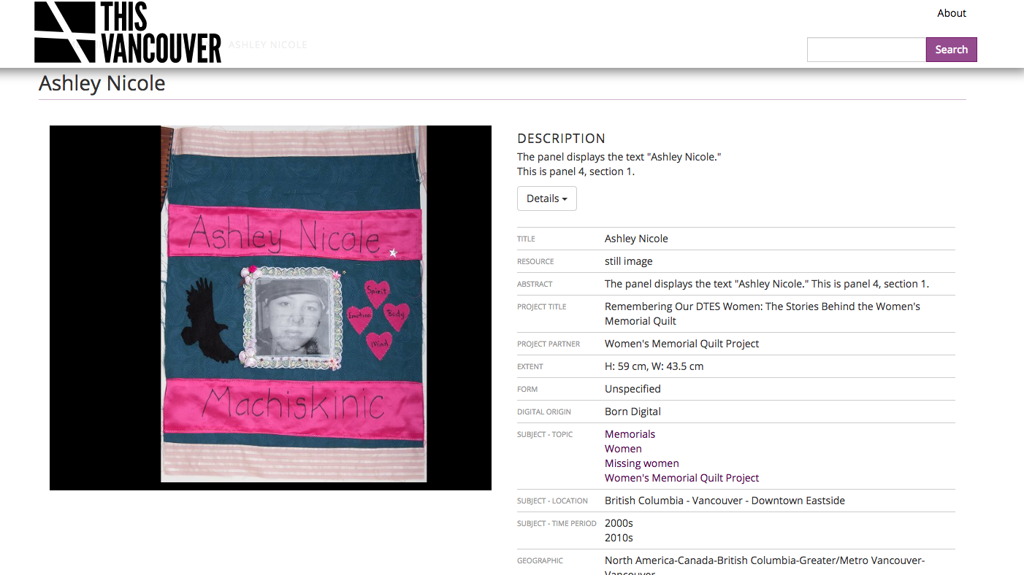

Slide 13
Our intention is to preserve the images of the panels in high quality photographs, and then with the families' approval display the images in this online gallery. If you are a family member of one of the women commemorated in the quilt panels and you have questions or concerns about the content presented in the Remembering Our DTES Women collection that relates to your family member, please contact cdi@vpl.ca at any time.
Notes:
Here we learned how to tackle difficult or controversial content – being very up front about our willingness to remove content upon request.

Slide 14
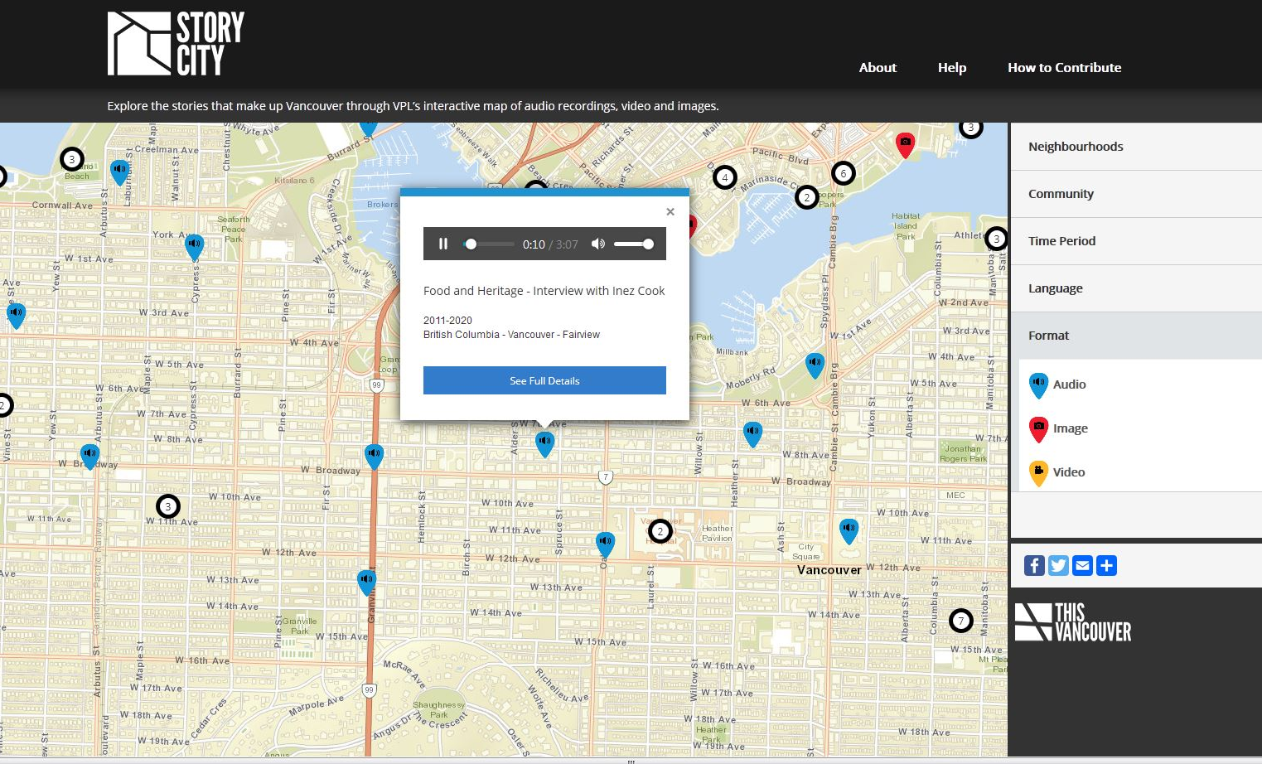
Notes:
Through Canada 150+, we explored another way to share stories, connecting people to their neighbourhoods, gathering stories by working with each community. This was amazing - community groups enthusiastically participated, wanting the stories of their perspectives on Vancouver shared in the library. This map we worked with Digital Echidna, who built it on our Islandora platform using Leaflet. We wrote the agreement with the developers to ensure they would share the code freely with the Islandora community. The launch was fun, fascinating and emotional, bringing people from seniors homes together with new immigrants.

Slide 15
Enabling stories
Notes:
For those projects, we provided staff support and we’re building a history to be told by the library. The other side of our work is enabling anyone who has a story, an idea or a creative expression to share with their communities to make that happen, in digital forms. We provide the tools and the learning opportunities. This extends the idea of digitization in the hands of our community members.

Slide 16
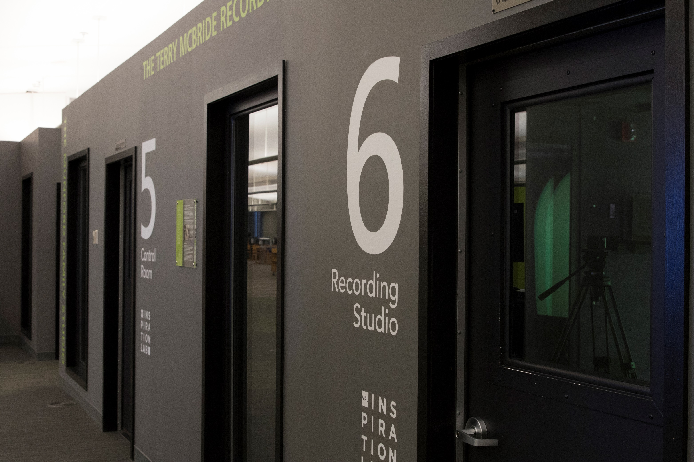
Inspiration Lab photo
Notes:
We opened the Inspiration Lab in May 2015. This was in the period when people were installing fab labs and 3D printers, but we saw Vancouver as a place to explore ideas and stories through film, sound, music and built recording studios. This space cost us about $600,000 to build, and we added 2 small studios at our NCS branch in 2017. Funded through past gifts, City’s innovation fund and donors.

Slide 17
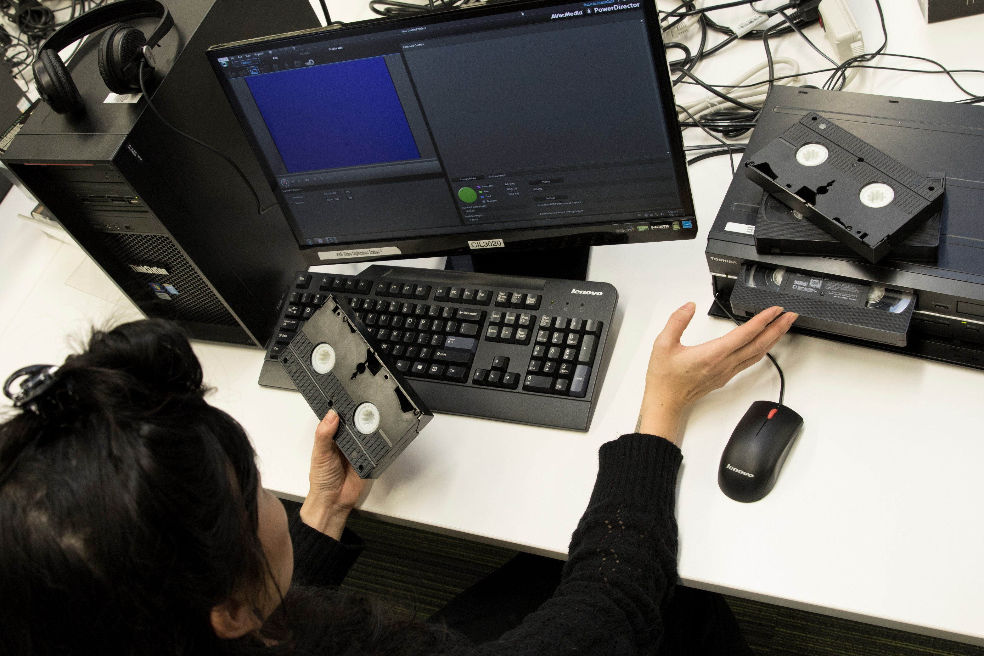
Notes:
5400 hours of digitization time. 11,000 patrons used recording studios

Slide 18
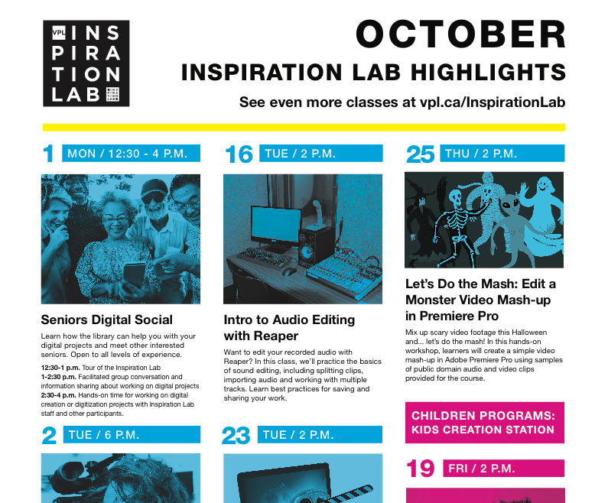
Notes:
Teaching courses so people can learn to record and preserve. Hosting digital experts in documentary filmmaking, sound editing, storyboarding.

Slide 19
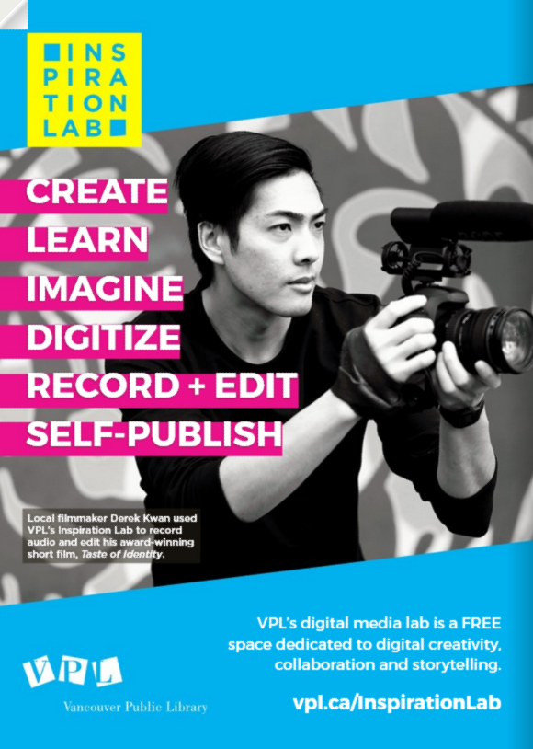
https://www.youtube.com/watch?v=KnVzUzEVvL0&feature=youtu.be
Notes:
Taste of Identity, Derek Kwan. A candid look into the lives of four families, with origins from four different countries, coexisting along a single street in Vancouver. Taste of Identity explores the traditions of culture and cuisine in Canada, examining what defines the identity of a city. It was in the lab that he did much of his editing and recorded much of the film’s narration, and then he set about promoting Taste – which went on to win awards for best Canadian short and best documentary at the 2015 Canada Shorts Film Festival.

Slide 20
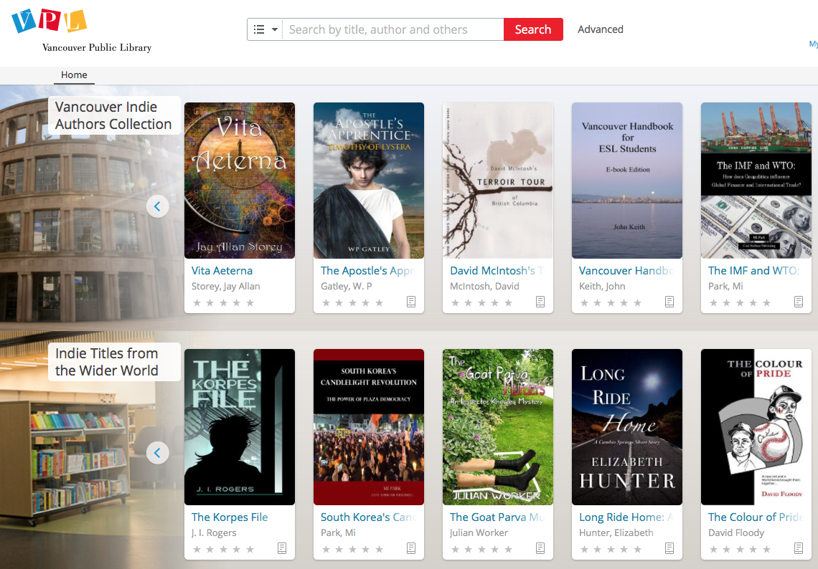
Notes:
At the same time, we maintained the traditional side of libraries, and supported people in creating self-published books, and lending them, both digitally and in print. These are voices of Vancouver’s people that have not been subject to the rules of the market. Everyone has a chance to be heard in self-publishing, and niche markets can freely develop. I love the excitement of an author who proudly shares that their book is held by Vancouver Public Library.

Slide 21

No Subsidiary Rights
VPL will only make available electronic versions of the eBook and has no other
subsidiary rights to the work including print editions, audio editions, serial rights, or media rights other than the electronic version distributed in VPL’s collection.

Slide 22
Through providing technology and offering support, libraries have the capacity to promote and enable the creation of local content and to ensure its preservation.
Principles on Public Access in Libraries, IFLA & others, Dynamic Coalition on Public Access in Libraries, UN Internet Governance Forum 2015
https://www.ifla.org/node/10781

Slide 23

“Of the more than 7,000 existing languages, only a few hundred are recognized as being in use for content pages on the Internet.”
Languages used on the Internet, Wikipedia

Slide 24
Notes:
In Africa, in 2015, I worked with library leaders from 13 countries to identify priorities for their work to 2030. Just as we do in Vancouver, they identified that supporting local content creation was a priority. Local voices weren’t being heard.
Wikipedia project or UN SDGs?

Slide 25
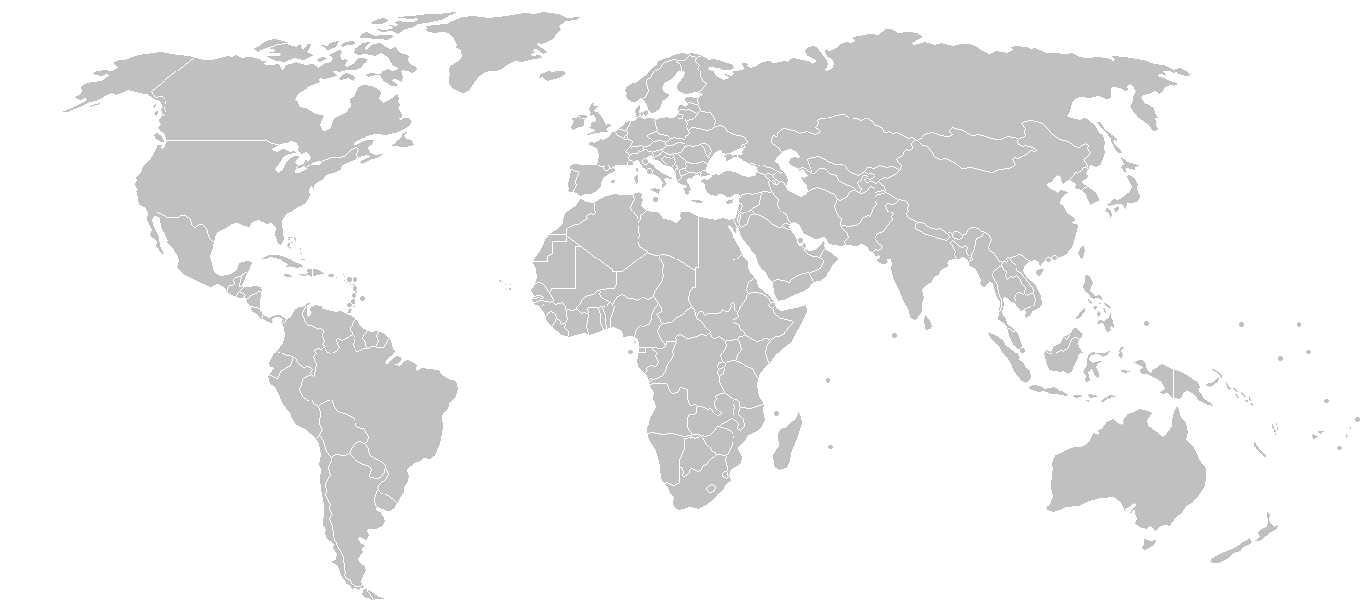
Self-published ebooks represent 24-34% of all ebook sales in English-language markets
AuthorEarnings.com

Slide 26
Connecting and engaging are not just personal challenges – it is up to all of us to create the community connectivity and supportive conditions that enable everyone to thrive. Let’s weave the ties that allow us to enjoy each other’s company, adapt, and lean on each other in times of need. Let’s also shape our physical, political, social, legal, economic and cultural context to support connecting and engaging.
Dr. Vanessa Timmer, Executive Director, One Earth

Slide 27
Thank you christina.decastell@vpl.ca

