Slide 1
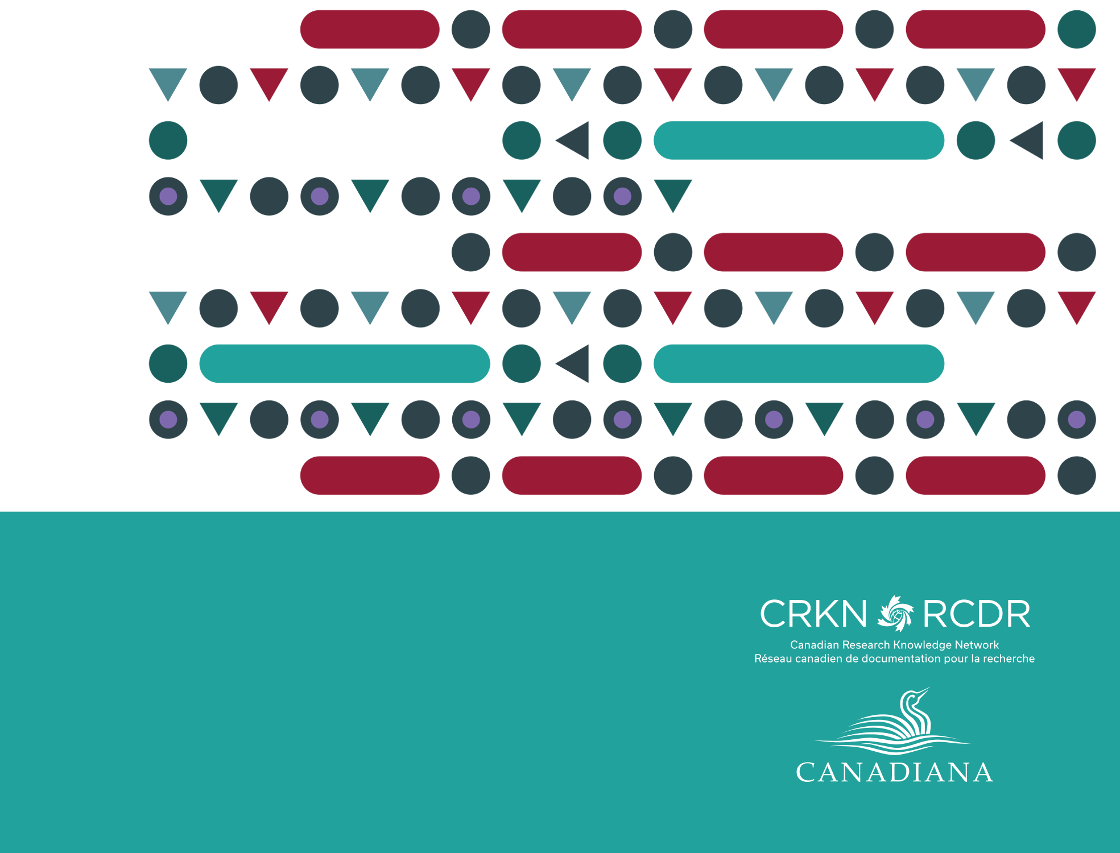
Overview & Update on Recent Canadiana Activities
Clare Appavoo, Executive Director, CRKN

Slide 2
CRKN & Canadiana
The Canadian Research Knowledge Network (CRKN) is a partnership of Canadian universities, dedicated to expanding digital content for the academic research and teaching enterprise in Canada.
Areas of focus:
Expanding access through licensing commercially published research content
Supporting open access initiatives
Supporting best practices in collection strategy
Supporting digital research infrastructure
History & Context
Notes:
Brief overview of CRKN
CRKN is a partnership of 75 Canadian universities, dedicated to expanding digital content for the academic research and teaching enterprise in Canada.
On behalf of our members, we undertake large scale content acquisition and licensing activities. We negotiate and manage over 50 licenses with Canadian and international publishers to provide essential research and teaching content in Canada’s universities.
In addition to licensing, we also provide a number of tools and services that are designed in consultation with members with a focus on:
Sustainable scholarly communication
Open access initiatives
Evidence-based collection management
Digital research infrastructure

Slide 3
CRKN & Canadiana
Canadiana.org began in 1978 as the Canadian Institute for Historical Microreproductions (CIHM). Canadiana preserves Canada’s heritage, making it accessible for future generations through digitization, access, and preservation.
Canadiana Collections
  Early Canadiana Online
  Héritage
  Canadiana Online
Canadiana Trustworthy Digital Repository (TDR)
The Canadiana access platform hosts 3 portals for the main Canadiana collections & 6 portals for client collections
History & Context
Notes:
Canadiana has been preserving Canada’s documentary heritage for over 40 years. Working with partners and stakeholders, Canadiana digitizes, preserves and makes accessible its own collections and it also provides digitization, access and preservation expertise and services to institutions and organizations in Canada.
Canadiana has digitized over 70 million pages.
Canadiana Online (2018- )
Héritage (2013- )
Early Canadiana Online (1999-2017)
Canadiana also has one of only six certified Trustworthy Digital Repositories

Slide 4
CRKN and Canadiana.org Merge as Combined Organization
On April 3, 2018, CRKN and Canadiana.org announced a merger of the two organizations, which are now under the leadership of CRKN.
Notes:
As many of you know, in April of this year, CRKN and Canadiana.org merged as a combined organization. This was the conclusion of over two years of discovery, discussion, and planning.

Slide 5
CRKN & Canadiana
Vision:
A combined organization would enable our collective community to do more together than we could achieve apart.
Leveraging shared resources:
Work toward shared goals
Leverage the TDR to support members
Advance open access
Shared membership:
22 institutions that were members of both CRKN and Canadiana
53 CRKN members subscribing to ECO
Today
Notes:
As a combined organization, we have the opportunity to work collectively toward shared goals of digitization, preservation and access to our digital documentary heritage. There is also the opportunity to leverage Canadiana’s TDR to support CRKN’s members and to advance open access and expand access to digital collections.
CRKN and Canadiana also had a overlapping membership - as a combined organization, we can develop programs and services to meet the needs of our members and our expanded stakeholder community.
Through the combination, a number of efficiencies and economies of scale have been realized – making us more available to respond to shifting and developing member and community needs.
Opportunities to centralize administration and governance
Ability to develop cross-functional teams to meet the needs of members

Slide 6
CRKN
Canadiana.org
Combined organization
CRKN
Administration & Operations
Licensing
Digitization & Heritage Collections
Platform Development
Notes:
The integration of the Canadiana services through the digitization program and platform development program are in addition to our core licensing services and all groups are supported a centralized management and administration team.

Slide 7
CRKN & Canadiana
Expanding access to Canadiana Collections
Expanding digitization for Canadiana Collections, CRKN members, and third-party clients
Platform development to meet common standards
Engaging the stakeholder community to identify opportunities
Leadership and guidance from the Preservation and Access Committee
Today
Notes:
Since the merger, we have worked on a number of priorities:
Expanding access to the Canadiana Collections
No charge to users as of January 1, 2019
Developing a content strategy to identify digitization priorities
Ongoing digitization for Canadiana Collections, CRKN members, and third-party clients
Platform maintenance development to meet emerging standards
Vast majority of platform built in-house
Platform originally built to house ECO content (books, periodicals) now also comprising archival materials, parliamentary records, newspapers
Access component of the platform was built to support subscription model for Canadiana’s collections, with ability to host new portals for client collections
Separating access and preservation platforms
Working toward integration of IIIF and Archivematica
Connecting with our expanding stakeholder community and user groups to identify opportunities
Leadership and guidance from the Preservation and Access Committee

Slide 8
Announcing access to the Canadiana Collections at no charge to users
As of January 1, 2019, 60 million pages of Canadian digital documentary heritage will be available at no charge to users.
Notes:
As of January 1, 2019, 60 million pages of Canadian digital documentary heritage will be available at no charge to users.
The Canadiana Online Terms of Service will also be updated to reflect this and we will be working with the Preservation and Access Committee to determine rights statements for the content.
The removal of the subscription paywall and user fee does not mean that there are no longer costs associated with the continued maintenance and development of this content.
Ongoing costs and support for Canadiana collections comes from CRKN members who have made a three-year commitment to fund the development of the collections and access platform.
In the coming year, CRKN is looking to make critical updates to its platform, increasing the ability to find and use Canadiana content. CRKN also plans to eventually make the Canadiana collections available as open access which would entail a review and implementation of user rights statements.
These developments will once again increase ease of use and access to the collections, eventually making them more readily available in research settings and to the general public.

Slide 9
CRKN & Canadiana
Understanding future goals and opportunities, as defined by end users and community
Ongoing platform development
Developing a digitization strategy and contributing to the National Heritage Digitization Strategy
Partnering with key stakeholders
Looking to the Future
Notes:
As we look to the future, one of our main goals is to get to know our expanded stakeholder community of archivists, members of the GLAM community, researchers, and the individuals using the Canadiana platform and accessing the Canadiana collections.
We want to better understand what you’d like to see in the future and what we can work collectively on – as we contribute to Canada’s national strategy of digitization, preservation and access with all of our partners in the room today.
Under the leadership of our Preservation and Access Committee, we are working on our digitization priorities, both for adding to the Canadiana collections and for providing digitization services to our community. We are also doing so much needed updating to our access and preservation platform, putting in the building blocks to integrate common standards and be ready to develop features and tools, as directed by our users.
Throughout this process, we are also partnering with key stakeholders, and as part of our AGM this week, the CRKN members will be voting on a motion to include LAC, BAnQ, and TPL as CRKN members. Throughout the late summer and fall I have been meeting with funders, partners, and other key stakeholders and the energy and excitement surrounding the opportunities of expanding and increasing access to digital documentary heritage is palpable.

Slide 10

Notes:
And this is where you come in. As we continue to build and plan for the future we are also engaging in strategic planning.
We are holding an open consultation in November (invitation to come next week) and we hope to hear from you. If you would like to participate in strategic planning, let Rebecca know.

Slide 11
Questions?
Notes:
Thanks for your time
Looking forward to the discussions today

