Slide 1
PIDs 101
Part 1 of a 6-Part Webinar Series
Mark Leggott, Maude Laplante Dubé, Eugene Barsky

Slide 2
Agenda
Welcome and Housekeeping (CRKN - 5 minutes)
The New RDC PIDs Document (Mark - 10 minutes)
Context and Impact of PIDs (Maude - 15 minutes)
Implementation of PIDs (Eugene - 15 minutes)

Slide 3
The New RDC Persistent IDs Document
Mark Leggott

Slide 4
RDC PIDs Document - Version 1
1st version published in 2016 by Research Data Canada
  Working Group of the Standards and Interoperability Committee (SINC)
  Goal to promote adoption of best practices for PIDs with all stakeholders
Overview, common PIDs, emerging PIDs, and recommendations
  Researchers
  Objects
  Organizations
  Equipment
Recommendations targeted specific stakeholders
  Funders
  Universities & Research Centres
  Government Departments
  Repositories and Publishers
  Researchers
  Canadian Research Data Management organizations

Slide 5
RDC PIDs Document - Version 2: New PID Discussions
New Working Group struck in 2020 to update the document
Overviews updated, and more PID sections added
  Researcher Identifiers
  Research Outcome Object Identifiers
  Publications
  Datasets
  Research Software
  Organization Identifiers
  Funding Identifier
  Research Project Identifier
  Equipment Identifiers
  Physical Sample Identifiers (Geo, Bio, Health)
  Other Identifiers

Slide 6
RDC PIDs Document - Version 2: New Sections
New Sections added
  The PID Framework
  The PID Landscape
  The Future of PIDs
  Governance and Sustainability
Recommendations section updated and expanded
  Updates on original Recommendations
  Additional Recommendations and Stakeholders - NDRIO
Open feedback stage
  We are looking for broad community review and feedback by April 16/21

Slide 7
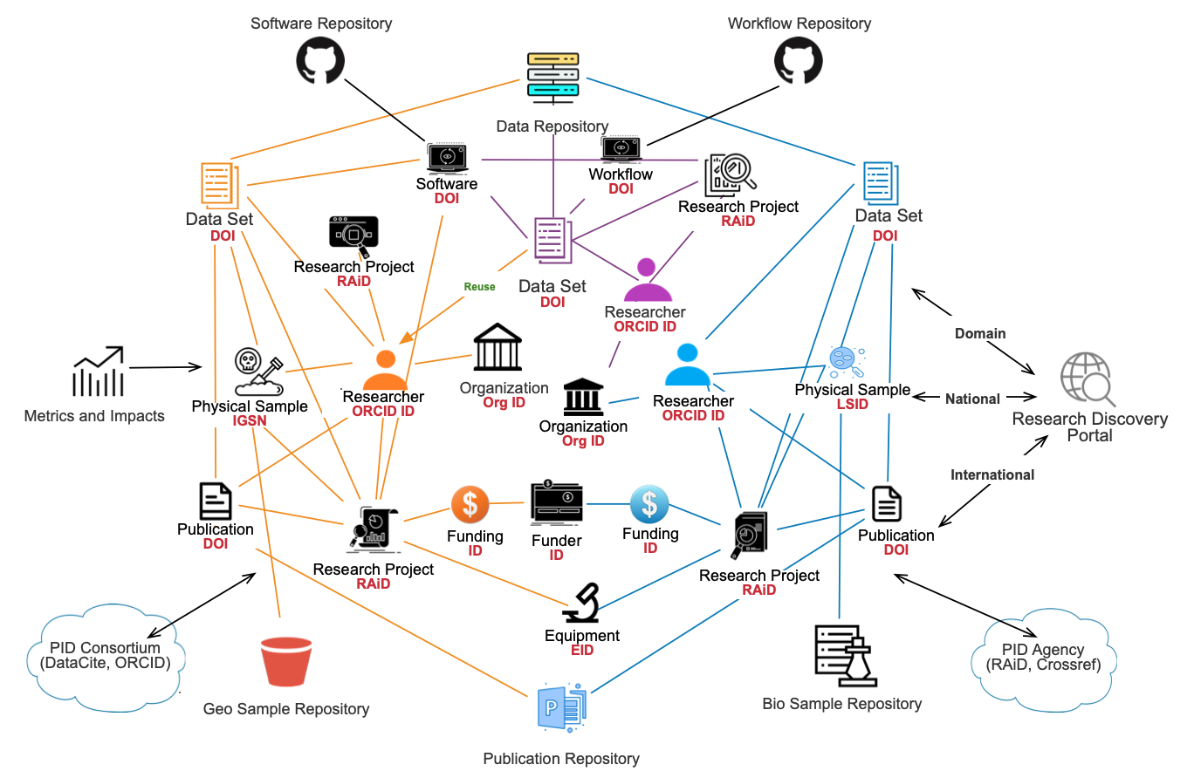
PIDs - A Complex Ecosystem

Slide 8
http://bit.ly/rdc-pids-report

Slide 9
Context and Impact of PIDs
Maude Laplante Dubé

Slide 10
A Brief Introduction to Persistent Identifiers, Their Uses and Their Potentiel for the Research Ecosystem
What is a PID?
A few words about persistence
Types of PIDs
Uses and potentiel of PIDs, illustrated

Slide 11
A Brief Introduction to Persistent Identifiers, Their Uses and Their Potentiel for the Research Ecosystem
A few terminological and linguistic comments
English: Persistent Identifier = PID
French:
  Identifiant persistant?
  Identifiant pérenne?
  Identifiant permanent?
  IDP?

Slide 12
What is a PID?
An IDentifier
A string of unique characters that identify an entity (digital or real-world)
  https://doi.org/10.2519/jospt.1986.7.5.273
  https://orcid.org/0000-0001-8339-2959
Persistent
The ID itself, but also access to information about the identified entity
  Metadata
Long-lasting reference
Exploitable
Mechanism that leads to the resource and its metadata
  URL

Slide 13
A Few Words About Persistence
Not inherent to PIDs
Depends on services from, and the long-term viability of, the agencies that register them and maintain their registries
  Recognized?
  Broad membership base?
  Sustainable and interoperable infrastructure?

Slide 14
Sample DOIs
DOI = ISO standard, under the authority of the International DOI Foundation (IDF)
DOIs are registered by IDF-approved agencies
  CrossRef, Datacite, etc.
CrossRef
DOIs mainly for scholarly publications
Infrastructure for registration and long-term maintenance of a DOI resolver
Requests metadata during registration
Makes metadata available via a public API
Offers other services based on its resolver
  Similarity Check
  CrossMark

Slide 15





Types of PID, by entity identified
ORCID iD, Scopus ID, ISNI, QID, etc.
DOI, PubMed ID, ArXiv ID, etc.
ROR, GRID, Ringgold, ISNI, QID
RaID
Notes:
ROR - Research Organization Registry

Slide 16
Types of PID, by registration system
System-specific PIDs | Non system-specific PIDs
ScopusID - Elsevier | ORCID iD - ORCID
ArXiv ID - ArXIV | DOI - CrossRef, Datacite
PubMed ID - PubMed | ROR - California Digital Library/CrossRef/Datacite

Slide 17
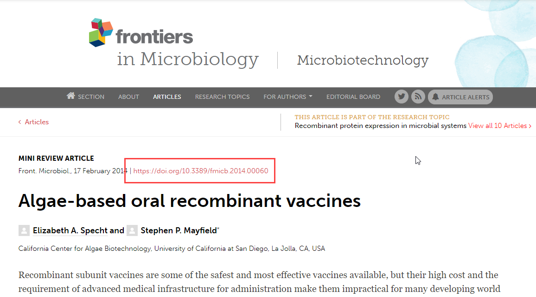
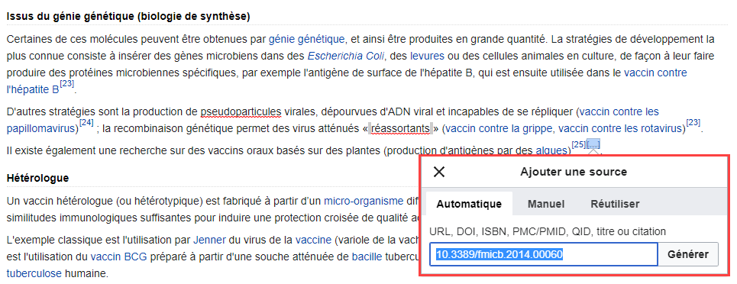
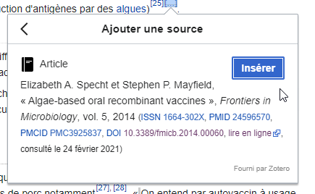
Use and potentiel of PIDs – Quality citations and long-term access
Notes:
https://www.crossref.org/blog/where-do-doi-clicks-come-from/

Slide 18
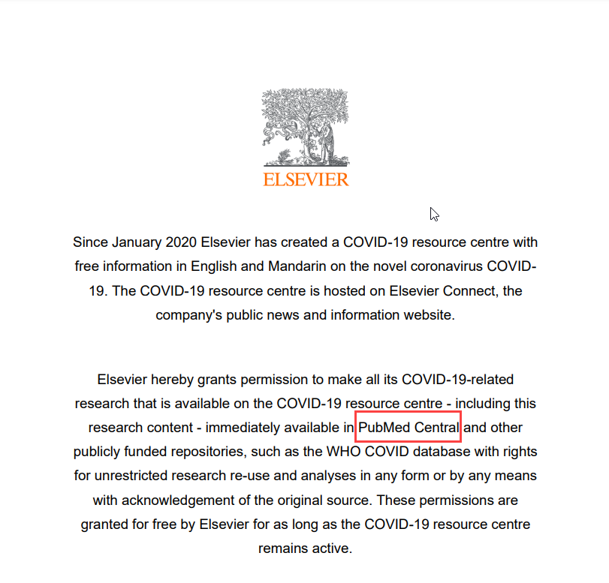
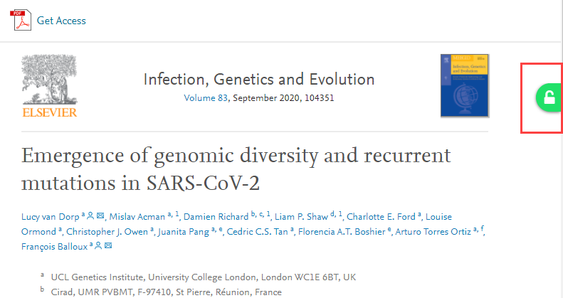
Use and potentiel of PIDs – Facilitating retrieval

Slide 19
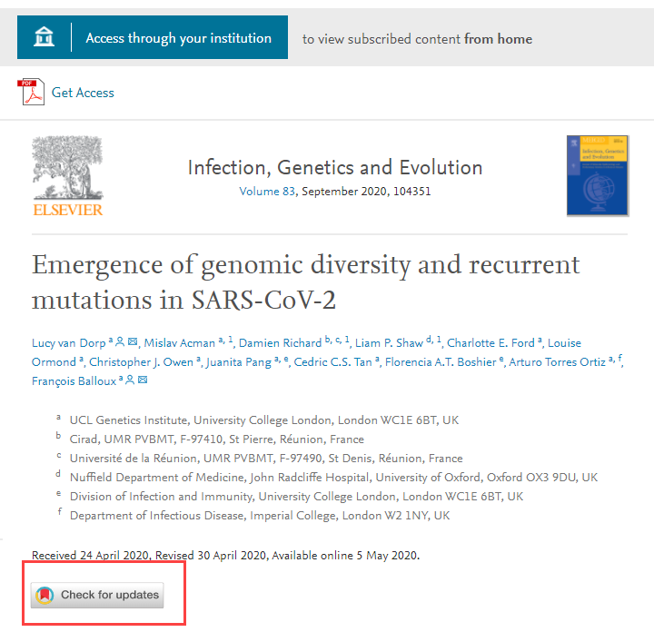
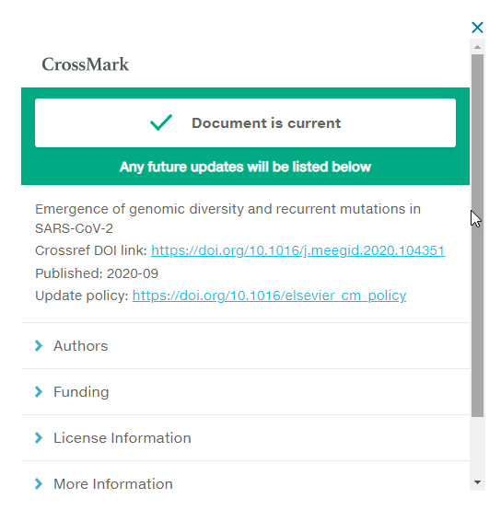
Use and potentiel of PIDs – Version control

Slide 20
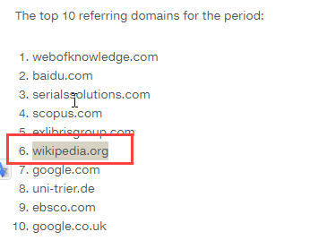
Use and potentiel of PIDs - Measuring impact
Notes:
https://www.crossref.org/blog/where-do-doi-clicks-come-from/

Slide 21
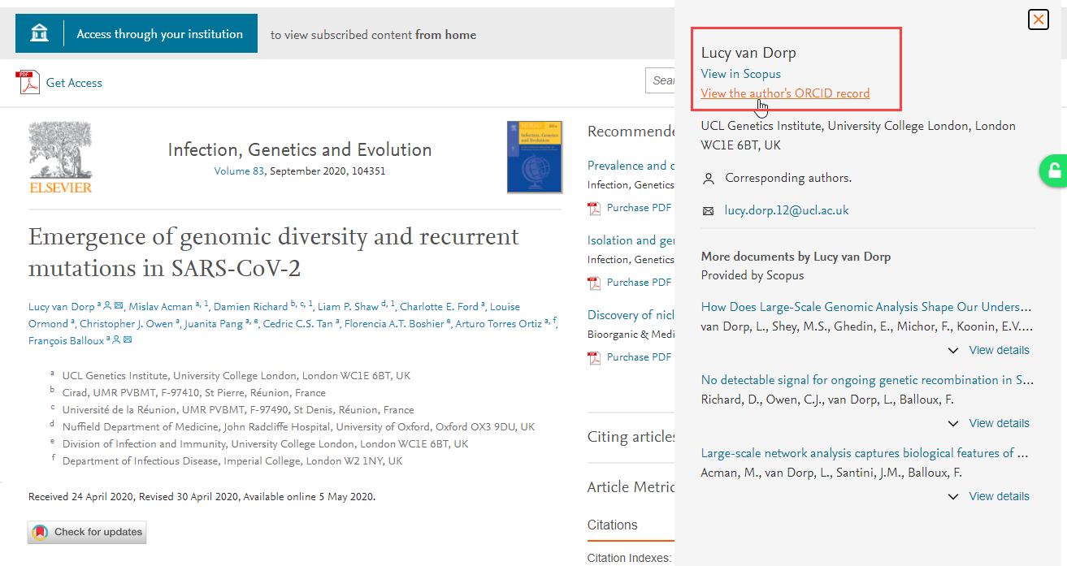
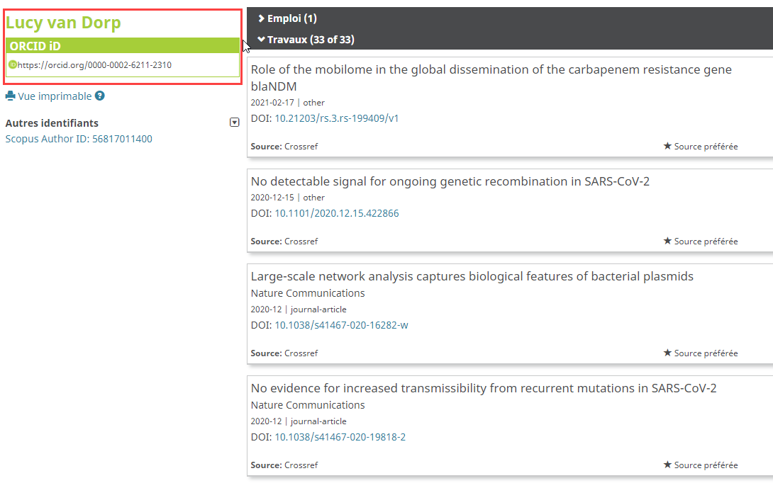
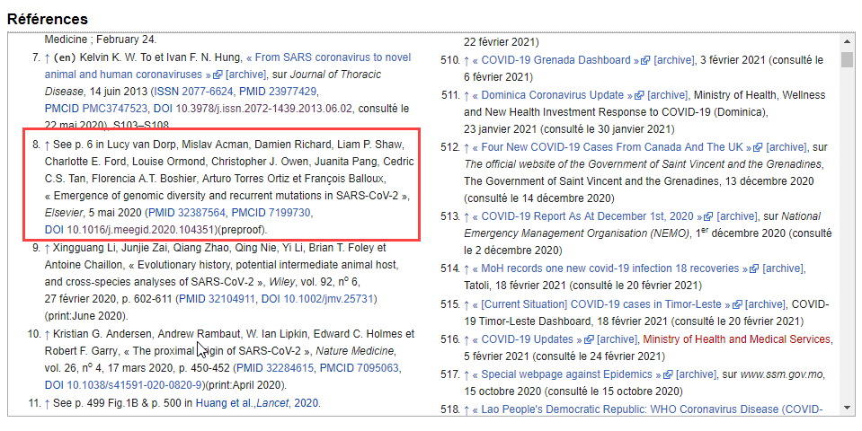
Use and potentiel of PIDs – Disambiguation of resources
L. V. Dorp
Lucy V. Dorp
Lucy Van Dorp

Slide 22
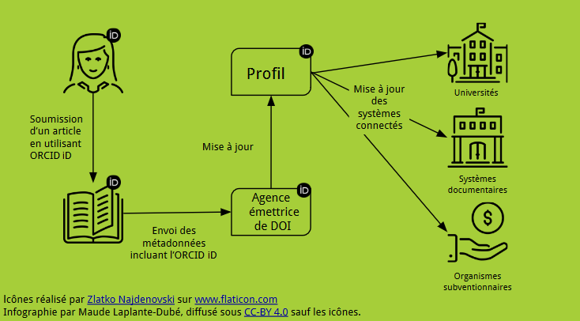
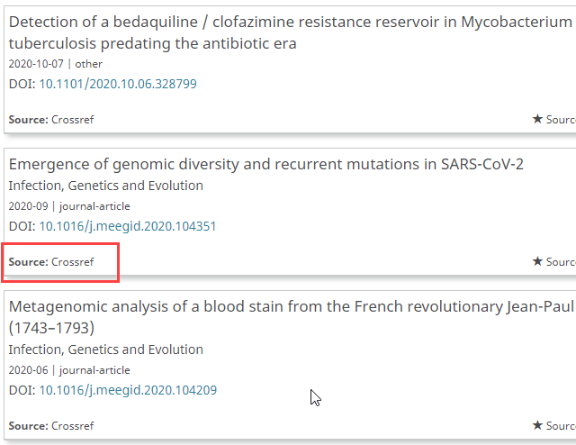
Use and potentiel of PIDs – Facilitating re-use

Slide 23
Advantages of PIDs for the research ecosystem
Facilitate discovery, re-use, interoperability
Help to measure impact more accurately
Reduce time required to retrieve information from different systems
Facilitate data transfer between platforms

Slide 24
A Brief Introduction to Persistent Identifiers, Their Uses and Their Potentiel for the Research Ecosystem
A few terminological and linguistic comments
English: Persistent Identifier = PID
French:
  Identifiant persistant?
  Identifiant pérenne?
  Identifiant permanent?
  IDP?

Slide 25
Implementation of PIDs
Eugene Barsky

Slide 26

Implementation of PIDs
First thing to know...it is always harder than it initially seems
Case studies for implementing:
Handles,
DOIs,
ORCIDs,
RORs
Image by https://www.flickr.com/photos/40032755@N06/

Slide 27
Implementing Handles
Purpose: Handles are persistent URL (and unlike DOIs come without associated metadata)
Usually some repositories (Dspace, Dataverse, OJS) will have these built-in
You still need to run a server to resolve handles and it could be a problem in large quantities
Handles could be useful for unique use cases, in our example @UBC with licenced data access via Abacus Dataverse
Handles are very cheap (around $50 a year for a prefix)

Slide 28
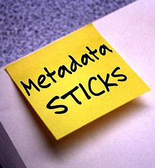
Implementing DOIs (1)
Purpose: DOIs are persistent identifiers with metadata attached allowing great systems interoperability
Some systems come with DOIs built-in, e.g. OJS or Dataverse, but you still have to pay for them
DataCite Canada Consortium is managing DOIs services in Canada (CRKN/Portage), partially sponsored by NDRIO
Minting DOIs makes your materials findable in ORCID, Google (if crosswalked to schema.org), and many others...
Image - https://www.flickr.com/photos/wakingtiger

Slide 29
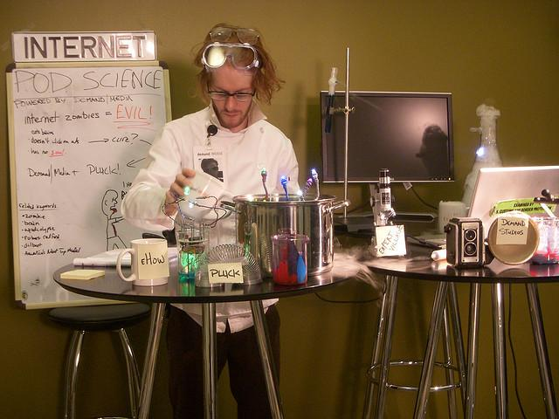
Implementing DOIs (2)
Custom DOIs minting is not cheap, although Datacite Fabrica goes a long way now
DOIs are not panacea and require monitoring, especially if your institutions mints a lot
In the UBC case, we have more than 260,000 DOIs minted and we spend some time weekly to fix the metadata that does not validate
Image - https://www.flickr.com/photos/jdhancock/

Slide 30
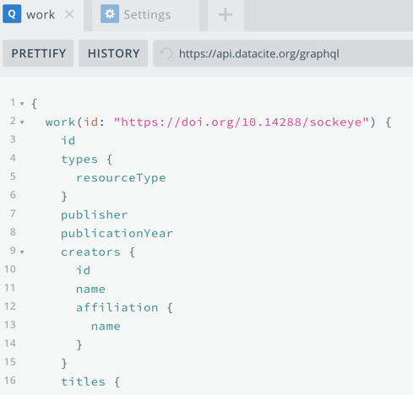
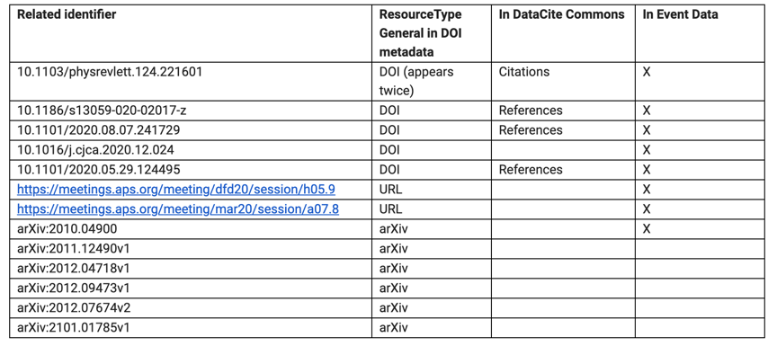
Implementing DOIs (3)
It is brilliant to see the DataCite GraphQL API to query across PIDs systems (Datacite, ORCID, Crossref)
I wish that it would be that simple of course :(

Slide 31

Implementing ORCIDs (1)
Purpose: PID for researchers that records professional activities and disambiguates one researcher from another.
Even less intuitive to implement, focus on systems interoperability
Can embed in Dataverse, DSpace, and others, but the real value is by embedding in research information systems to allow interoperability and even populating faculty pages directly from ORCID
McMaster Library worked hard in this direction , by integrating with Symplectic Elements (@Jay Brodeur)
* Image - https://www.flickr.com/photos/wwworks/

Slide 32
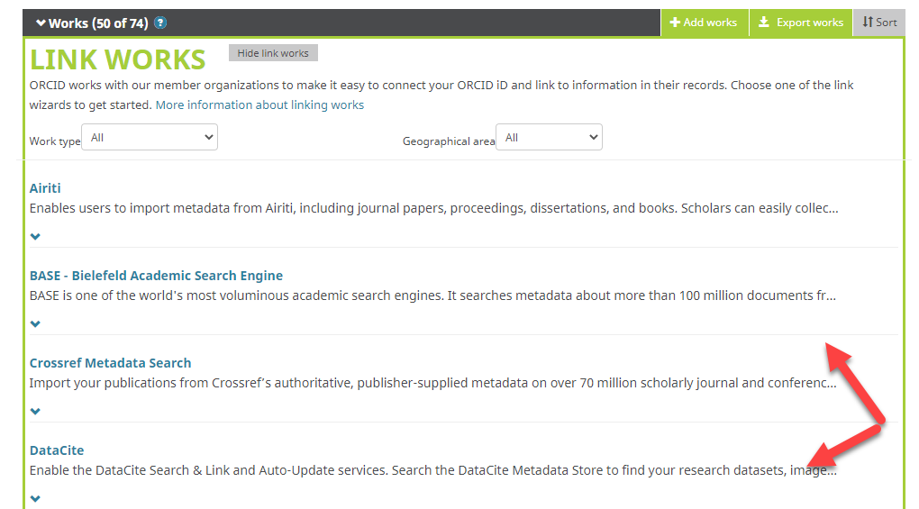
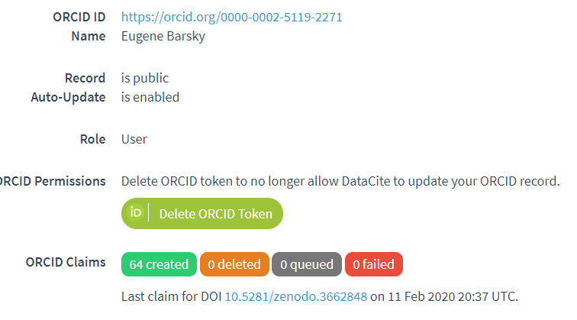
Implementing ORCIDs (2)
Quite useful on an individual level, managing scholarly work

Slide 33
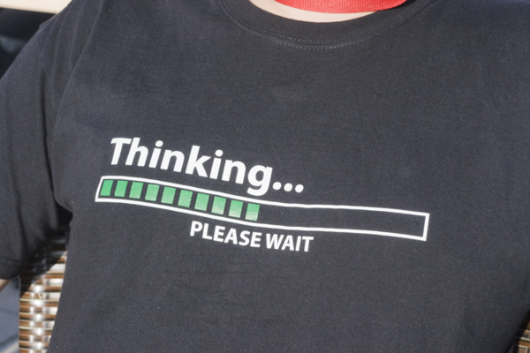
Implementing RORs
Purpose: Globally-unique, stable, discoverable, and resolvable identifiers for research organizations, e.g. UBC - https://ror.org/03rmrcq20
Image - https://www.flickr.com/photos/karola/
Works well with GRIDs
Only a few implementations so far that I am seeing
I like the one by Dryad. It allowed us to build a pipeline for UBC-authored datasets to be stewarded in our own repositories. We could only do it with RORs implemented, couldn’t do it before).

Slide 34
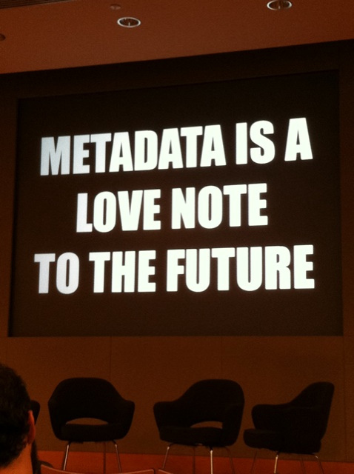
Summary comments
PIDs are the backbone for scholarly publishing
They tend to interoperate quite well (e.g. DOIs, ORCIDs, RORs)
It is not perfect in any way, as anyone working in this area could confess
But it will only get better!
Image - https://www.flickr.com/photos/centralasian/

