Slide 1


It’s (perpetually) Complicated:
Tracking Perpetual Access Rights from
Consortial License Agreements
Courtney Bremer
eResources Access Manager, University of Waterloo
Chair, CRKN Knowledge Base Entitlements Sub-Committee (KBESC)
Émilie Lavallée-Funston
Licensing and Member Services Officer, CRKN

Slide 2
Agenda
CRKN At-A-Glance
Project Context and Scope
Perpetual Access (PA) Rights Report
Workflow
Next Steps
Q&A

Slide 3
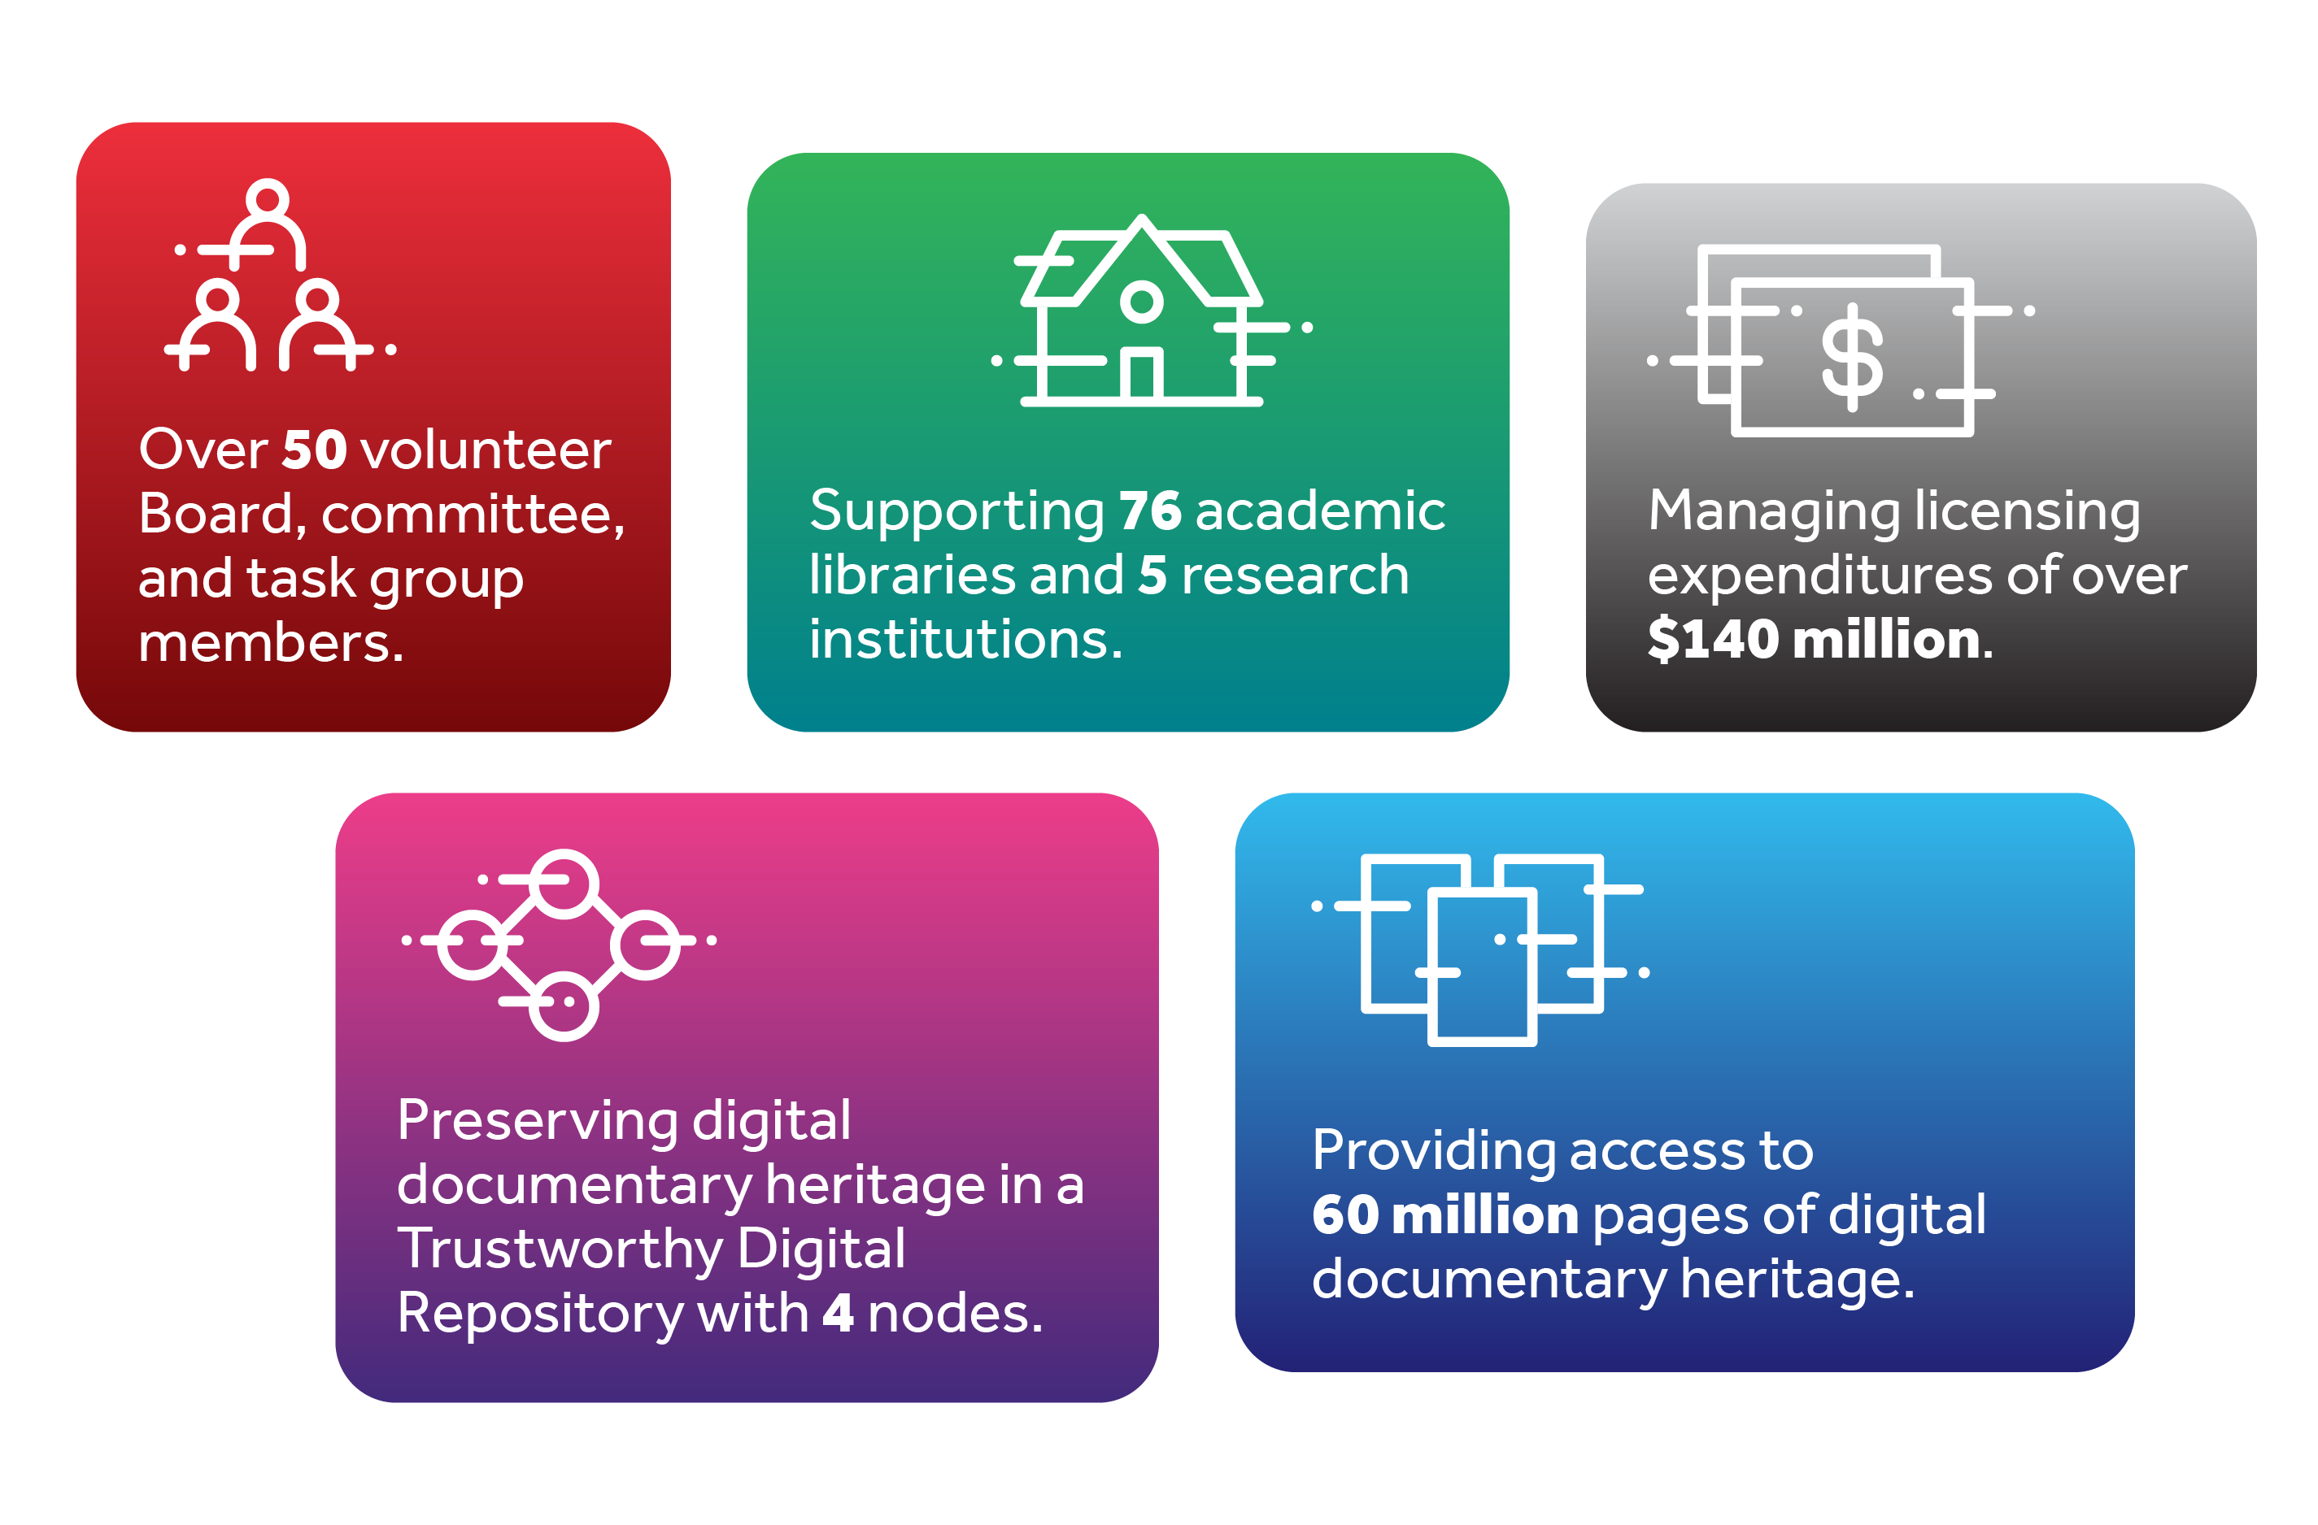
CRKN At-A-Glance

Slide 4
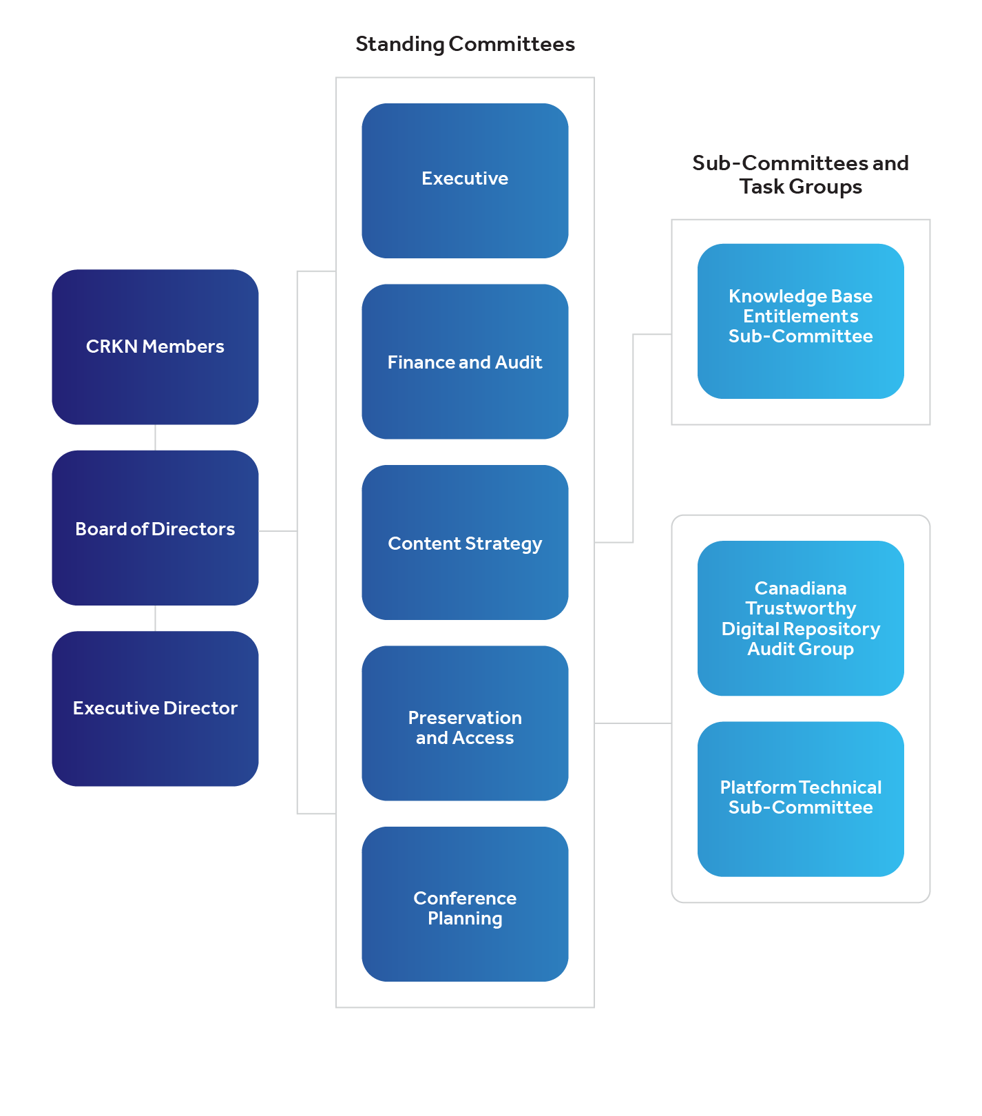
CRKN At-A-Glance
KBESC
Work with vendor-supplied title lists to ensure accuracy for members
Maintain our own collections in library services platforms (incl. updates)

Slide 5
Project Context and Scope

Slide 6
Project Context and Scope
Objective
Identify and record perpetual access (PA) entitlements for each member
Title- and year-level data
Institution-specific data
Publishers
ACS
Canadian Science Publishing (CSP)
Cambridge University Press (CUP)
Elsevier
Institute of Physics Publishing (IOPP)
Oxford University Press (OUP)
Royal Society of Chemistry (RSC)
SAGE
Springer
Taylor & Francis
Wiley
Scope
Rights acquired through CRKN serials agreements
  via Subscriptions (annual accrual)
  via Purchases (one-time accrual)

Slide 7
Perpetual Access Rights Report

Slide 8
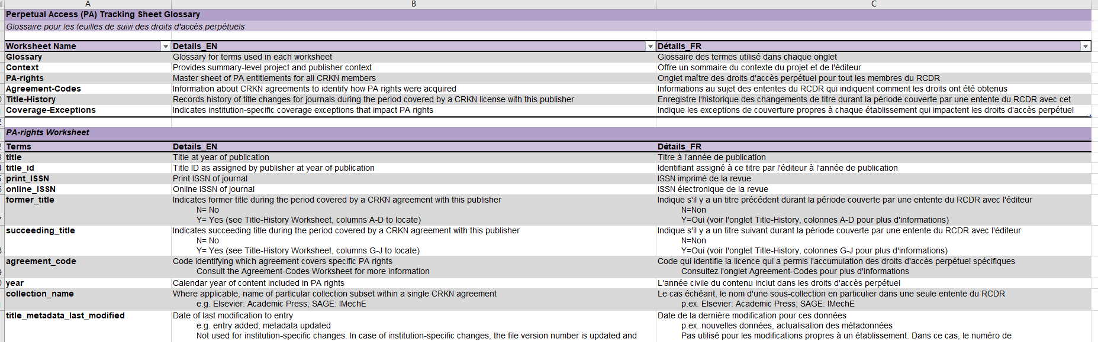
Perpetual Access Rights Report
Glossary
Define tabs and fields in report
Standard across all reports

Slide 9
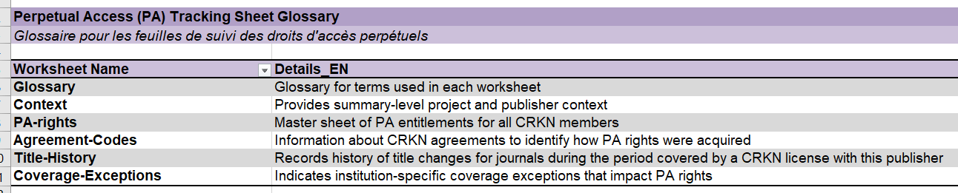
Perpetual Access Rights Report
Glossary
Define tabs and fields in report
Standard across all reports

Slide 10
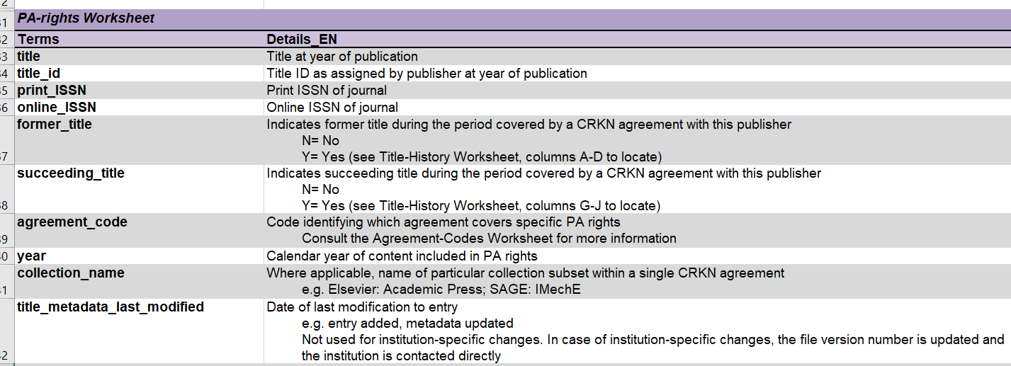
Perpetual Access Rights Report
Glossary
Define tabs and fields in report
Standard across all reports

Slide 11
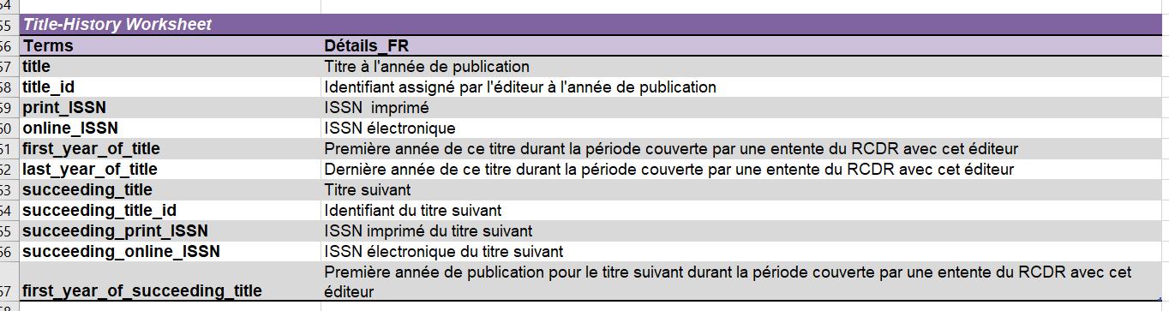
Perpetual Access Rights Report
Glossary
Define tabs and fields in report
Standard across all reports

Slide 12
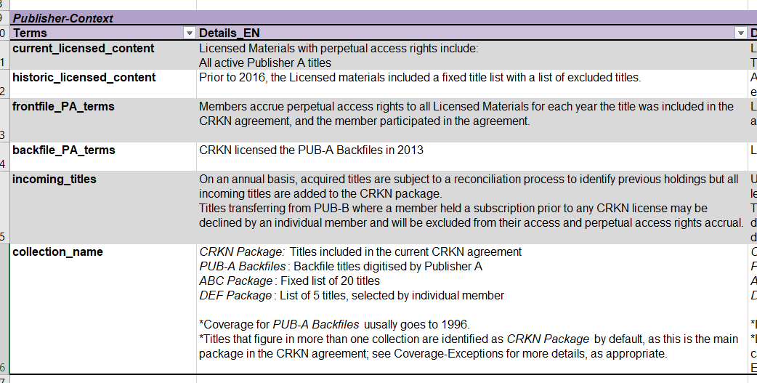
Perpetual Access Rights Report
Publisher-Context
Description of licensed content and current terms for PA rights
Identification of separate collections (where applicable)

Slide 13
Perpetual Access Rights Report
Agreement-Codes
Each CRKN license with PA rights assigned a code
PA-Rights tab: Used to identify why a member has PA rights for a certain title
Agreement-Codes tab: Provides coverage details, notes, and URL to CRKN website

Slide 14
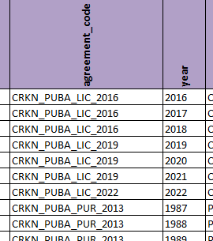
Perpetual Access Rights Report
Agreement-Codes
Each CRKN license with PA rights assigned a code
PA-Rights tab: Used to identify why a member has PA rights for a certain title
Agreement-Codes tab: Provides coverage details, notes, and URL to CRKN website

Slide 15
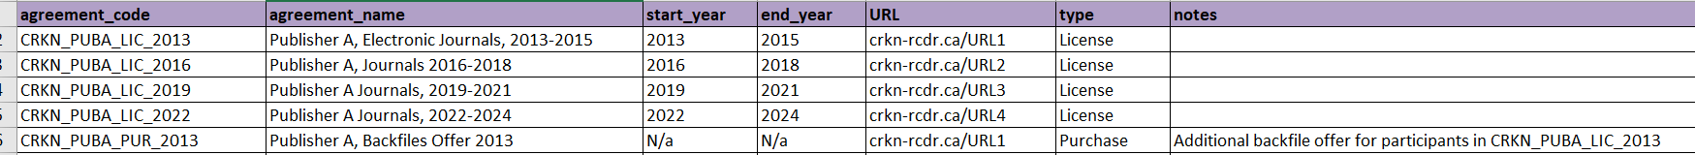
Perpetual Access Rights Report
Agreement-Codes
Each CRKN license with PA rights assigned a code
PA-Rights tab: Used to identify why a member has PA rights for a certain title
Agreement-Codes tab: Provides coverage details, notes, and URL to CRKN website

Slide 16
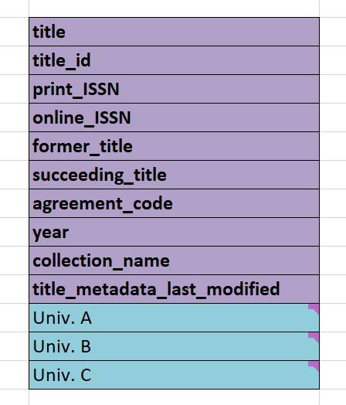
Perpetual Access Rights Report
PA-Rights Tab
  Title metadata interoperable with KBART-compliant title lists
  Certain fields defined in other tabs
    e.g. agreement_code, collection_name
  Each institution has a unique rights column
    Individual coverage exceptions are recorded here

Slide 17
Workflow

Slide 18

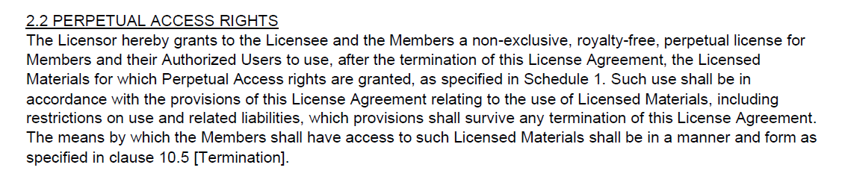
Workflow
1. Rights Clauses
Current Model License clause

Slide 19

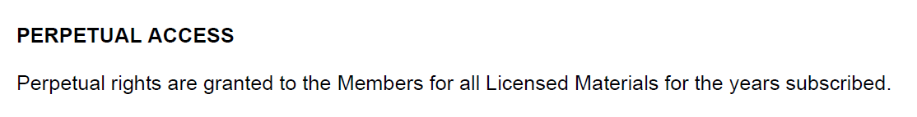
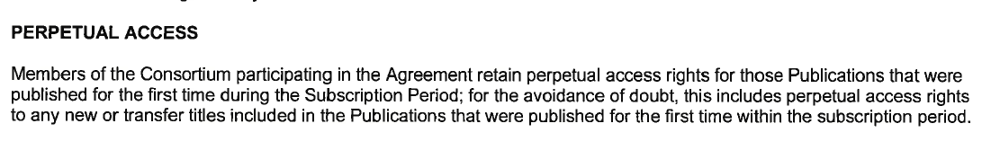
Workflow
1. Rights Clauses
Publisher-specific language in Schedule 1 – Licensed Materials (Current Model)

Slide 20

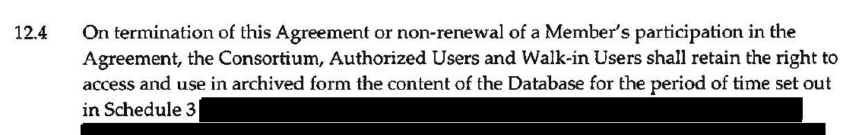
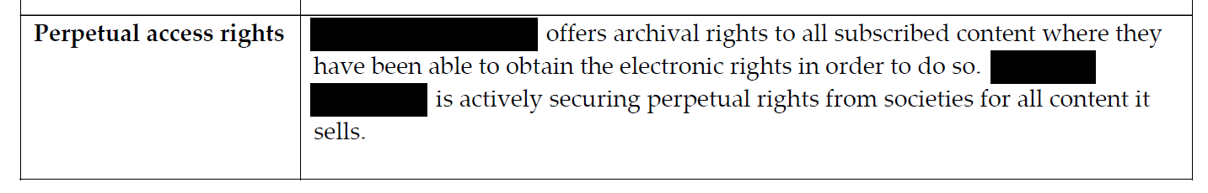
Workflow
1. Rights Clauses
Earlier agreements usually include PA clause, but no specific language in schedules
Consider additional records and/or verifying with publishers

Slide 21

Workflow
2. Title Lists
Publisher-specific language in Schedule 1 – Licensed Materials (Current Model)

Slide 22
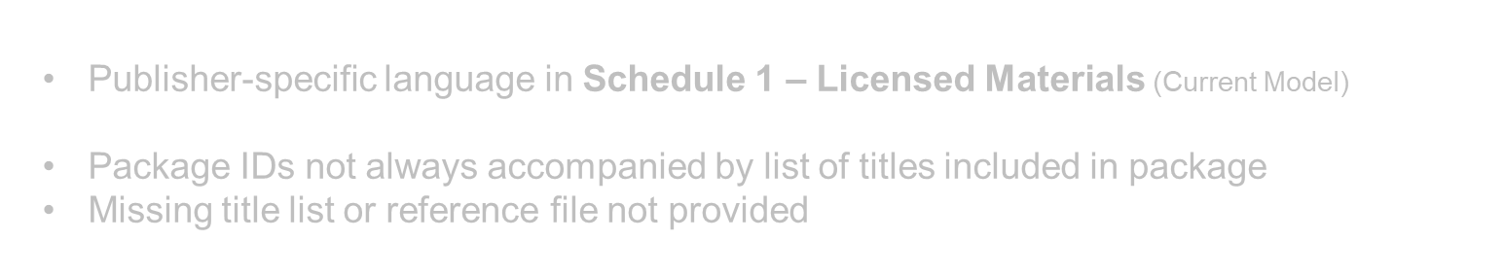
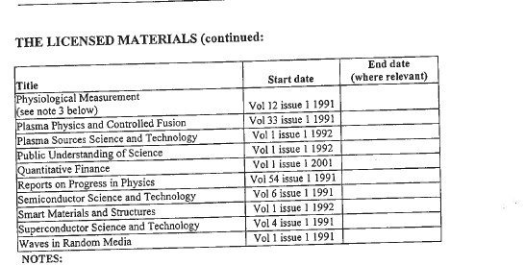
Workflow
2. Title Lists
Missing ISSN or Title IDs

Slide 23
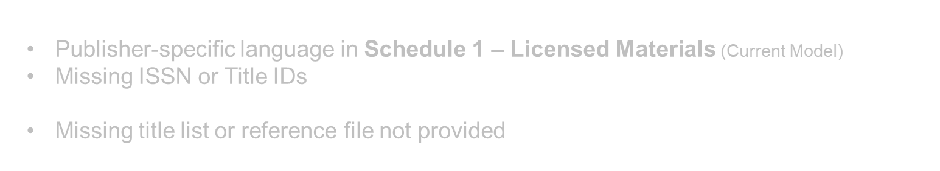
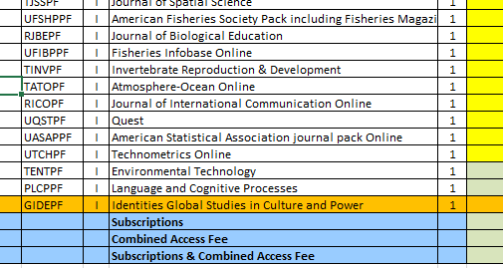
Workflow
2. Title Lists
Package IDs not always accompanied by list of titles included in package

Slide 24
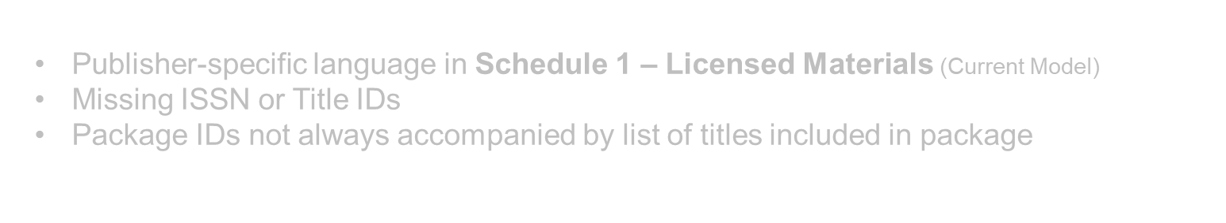
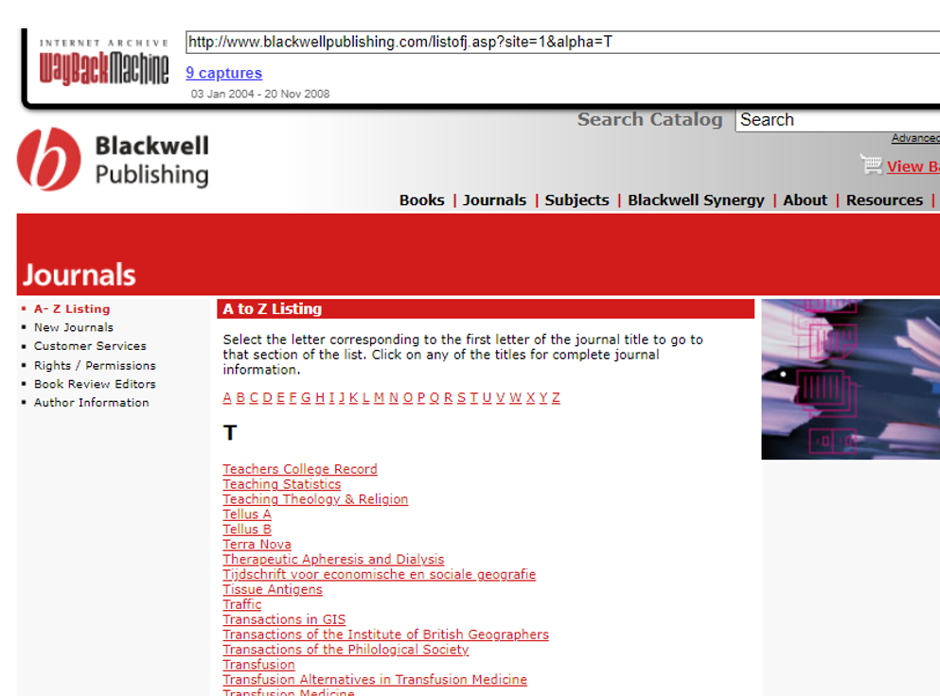
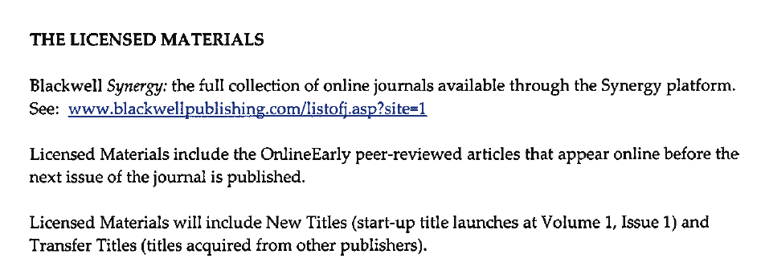
Workflow
2. Title Lists
Missing title list or reference file not provided

Slide 25

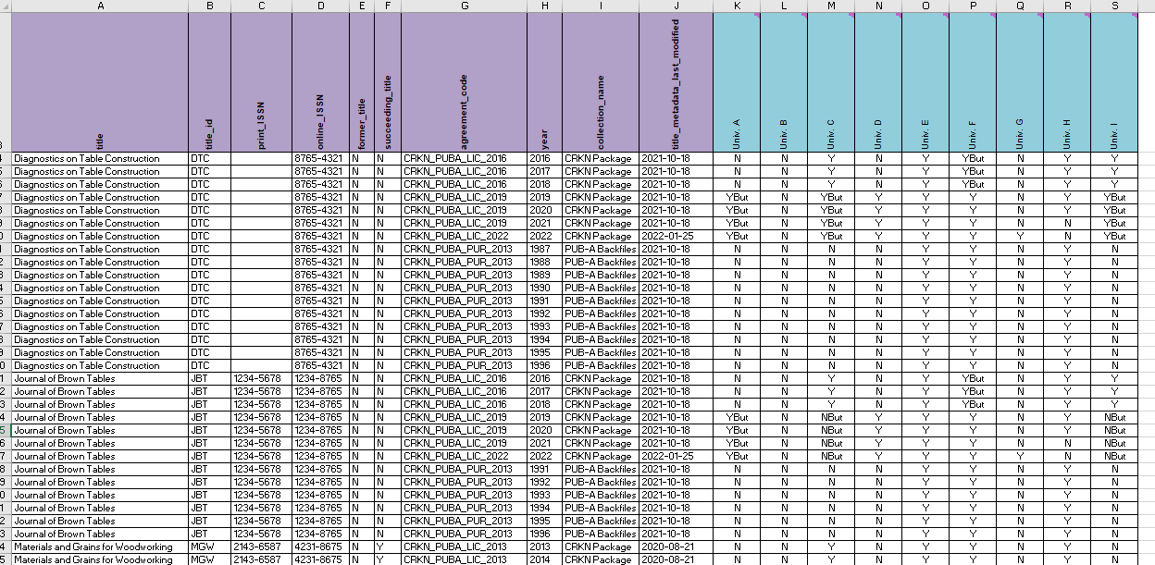
Workflow
3. Collections
Identify separate collections in licensing history (and identify titles in PA-rights tab)

Slide 26

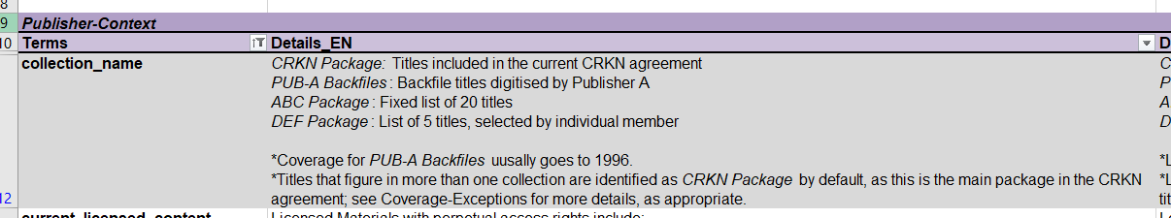
Workflow
3. Collections
Identify and define additional collections that may not appear in the PA-Rights tab*
*used in step 5. Participation

Slide 27

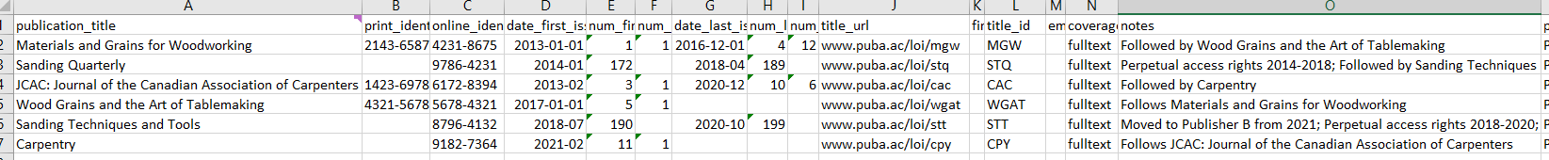
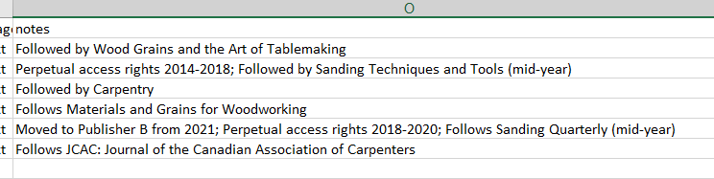
Workflow
4. Title History
Cross-reference with KBART files maintained by CRKN

Slide 28

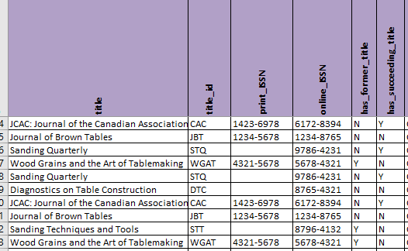
Workflow
4. Title Lists
PA-Rights tab: indicate former or succeeding title with Y/N

Slide 29

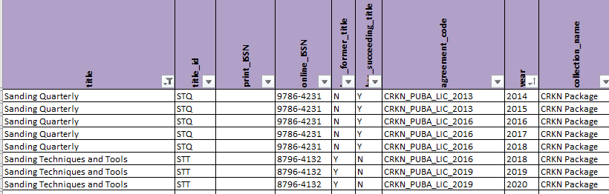
Workflow
4. Title Lists
Title-History tab: provide additional metadata about title history (within report)

Slide 30

Workflow
5. Participation
Compile list by year for license participation

Slide 31

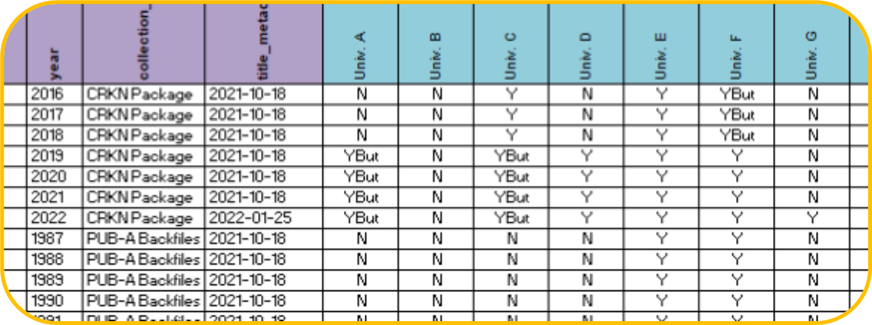
Workflow
5. Participation
Compile list by year for license participation (mindful of amendments, late joiners, etc.)
Examples
Univ. B: Never participated
Univ. D: Joined in 2019
Univ. E: Joined in 2013,
purchased backfiles in 2013
Univ. G: Joined in 2022

Slide 32

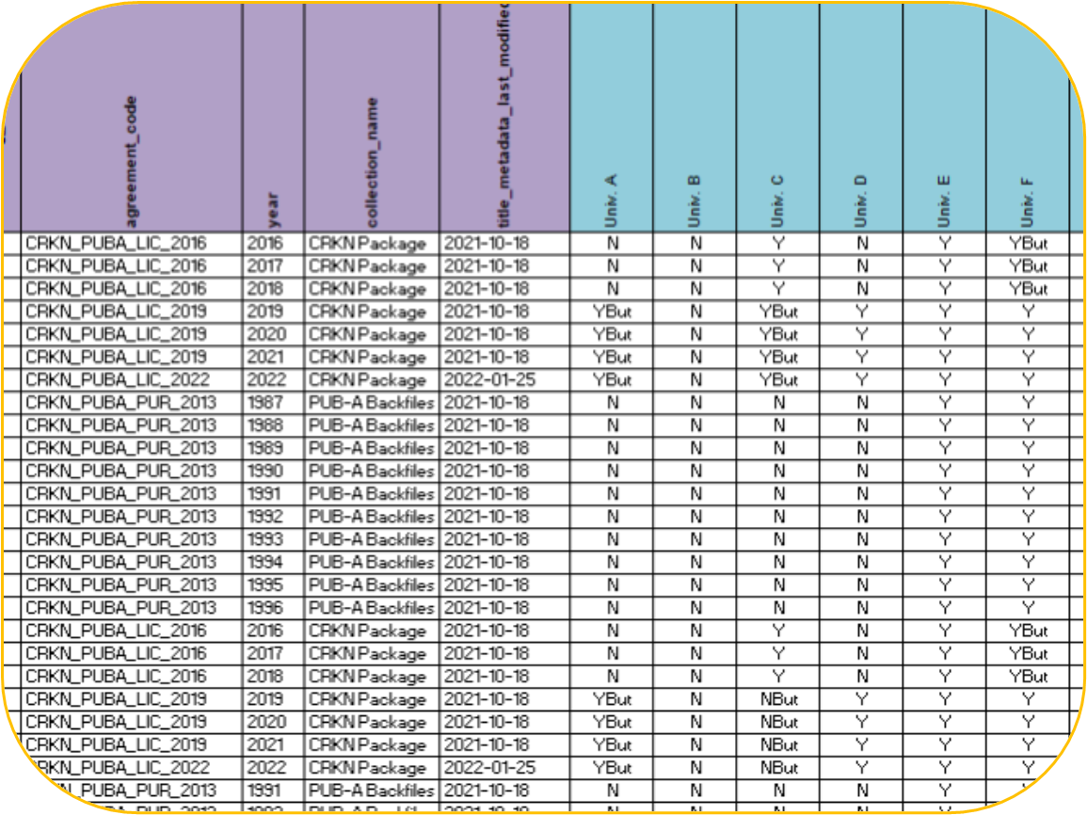
Workflow
5. Participation
PA-Rights tab: record any exceptions to rights using YBut/NBut, where applicable
Examples
Univ. A: Joined in 2019, with
a subset package only
Univ. C: Joined in 2013, changed to subset package in 2019
Univ. F: Did not participate 2016-2018
Purchased missing rights in 2019, when rejoining

Slide 33
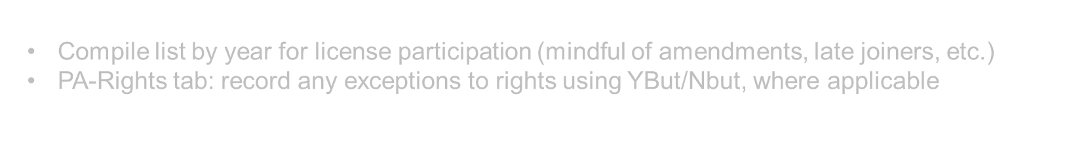
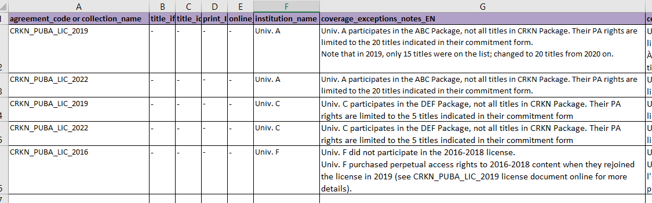
Workflow
5. Participation
Coverage-Exceptions tab: provide additional information on nature of exception

Slide 34
Next Steps

Slide 35
Verification & Distribution
Verification
Distribution
Pilot phase with several members to receive and integrate initial feedback
KBESC members review final files
  Verify against their own entitlements’ records
  Test several use cases
Distributed to vendors
  Information purposes only
Available to members via CRKN website

Slide 36
Member Support & Searchable Interface
Member Support
Searchable Interface
Ongoing maintenance of records
(file naming convention to easily
identify updates)
KBESC and Member-led collaborative sessions
Template and guidelines for recording non-CRKN entitlements
University of Prince Edward Island computer science students
  Capstone class project
  Open source code
Searchable interface will:
  automatically ingest updated information from CRKN
  allow members to integrate additional entitlements data to same tool (if locally hosted)

Slide 37
Thank you
Live Q&A Chat
Wednesday, 16 March 2022
10:00 – 11:30 a.m. ET
via ER&L chat
Contact us at info@crkn.ca

