Slide 1

FUELING A MOVEMENT:
An update on the National Heritage Digitization Strategy
Joint NHDS & CRKN Workshop on Documentary Heritage
Martha Whitehead
Chair, National Heritage Digitization Strategy Steering Committee
and
Dr. Guy Berthiaume
Librarian and Archivist of Canada
October 2018

Slide 2
Our history
Announced in 2016 based on best practices from New Zealand, Netherlands, Sweden, European Union, the United States etc.
Aims to establish a coordinated approach to the digitization of Canadian memory institutions’ collections. Includes access, discovery and preservation.
Covers published and unpublished digitized material from the collections of archives, libraries, museums and other memory institutions.
Focus efforts
Share knowledge and experience
Avoid duplication
Protect documentary heritage most at risk
Explore funding opportunities
Identify standards
Objectives

Slide 3
Our vision
The National Heritage Digitization Strategy (NHDS) envisions a future in which digital access to Canada’s diverse documentary heritage is comprehensive, ubiquitous, and has a profound impact on Canadian culture, education, research and innovation.

Slide 4
Our mission and principles
The strategy engages the Canadian library, archive and museum community and Canadian creators in sharing expertise, to facilitate the digitization, preservation and discovery of Canadian documentary heritage.
Our principles
Representativeness and inclusion
Collaboration
Quality-based efforts
Access and openness
Impact
Sustainability
Intellectual Freedom
Flexibility
The NHDS website: nhds.ca

Slide 5


















Who we are
Notes:
Steering Committee includes organizations from across GLAMs;
Significant input and interest from broader community;
Working groups been created. More planned.

Slide 6
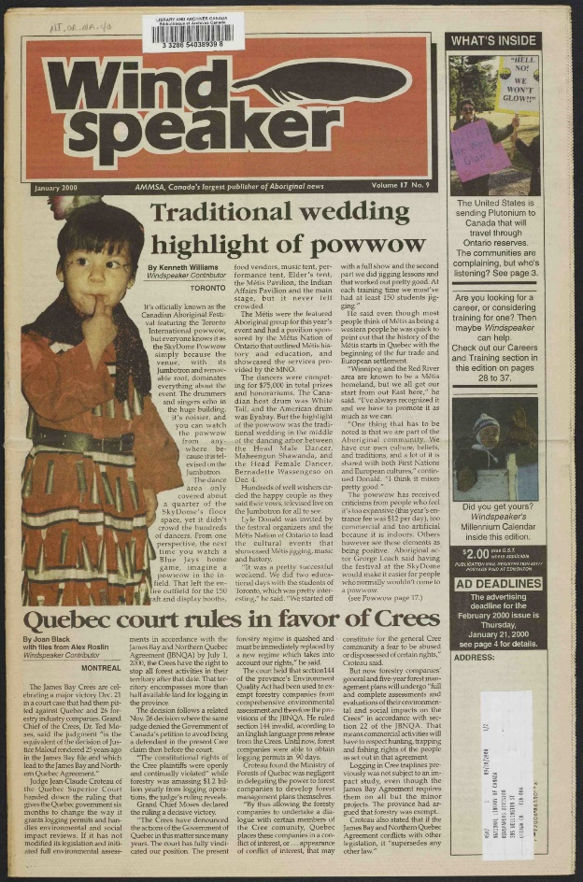
Growing the national digitized collection
Survey launched to GLAM community to help prioritize content.
Content strategy defines scope and priorities.
Indigenous newspapers digitized in collaboration with publishers.
Funding call provides $1M to Canadian memory institutions to digitize content.
Windspeaker: one of the titles
digitized under the NHDS
Notes:
Funding:
$1M from private donor to be distributed to Canadian GLAMs to digitize their collections.
Call open April to June.
213 applications received. An external experts evaluated proposals. 21 projects chosen for funding.

Slide 7
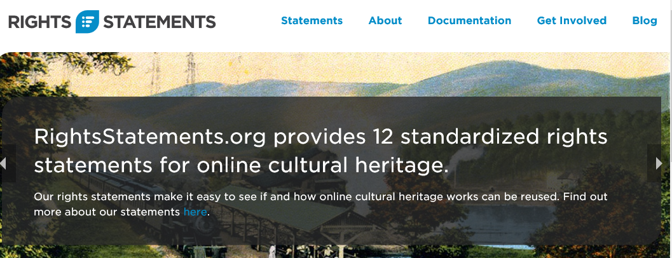
Developing national, collaborative, distributed technical infrastructure and expertise
NHDS Secretariat named vice-chair of RightsStatements.org consortium led by the Digital Public Library of America (DPLA) and Europeana.
Metadata model drafted and prototype discovery tool developed.
Technical infrastructure workshop held to set collaborative goals.
Notes:
Discovery tool part of LAC commitment to NHDS
To gather metadata of open digitized collections across Canada and across GLAMs
Based on examples (Canadiana, CNDHI, GovReg, DigitalNZ, DPLA, Europeana …)
To develop index of open digitized collections across Canadian GLAMs to:
Provide access;
Encourage innovation;
Coordinate efforts;
Provide broader view of Canadian history;
Invite ways to discover content.
Small budget set aside to build prototype.

Slide 8
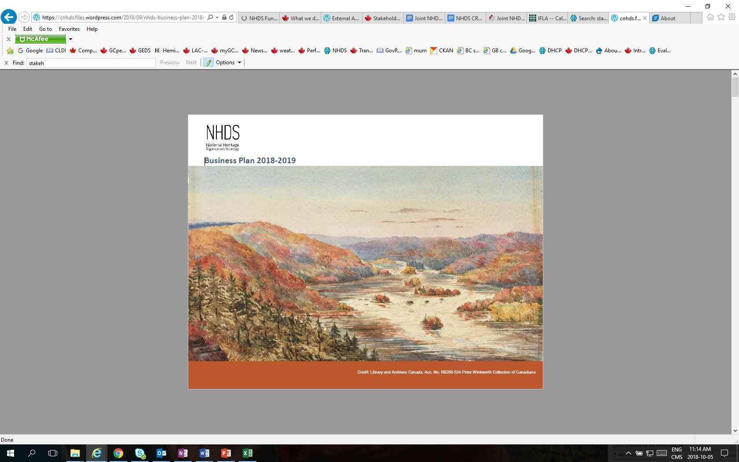
Engaging the community and building a solid foundation
Pledges of support: 68 individuals from 63 GLAMs.
Broad-based Steering Committee with minutes available at nhds.ca.
Business plan developed to articulate vision, mission and goals.
Three working groups created: content, technical and communications.
Communication plan developed to raise awareness and encourage investment.
NHDS business plan 2018-2019

Slide 9

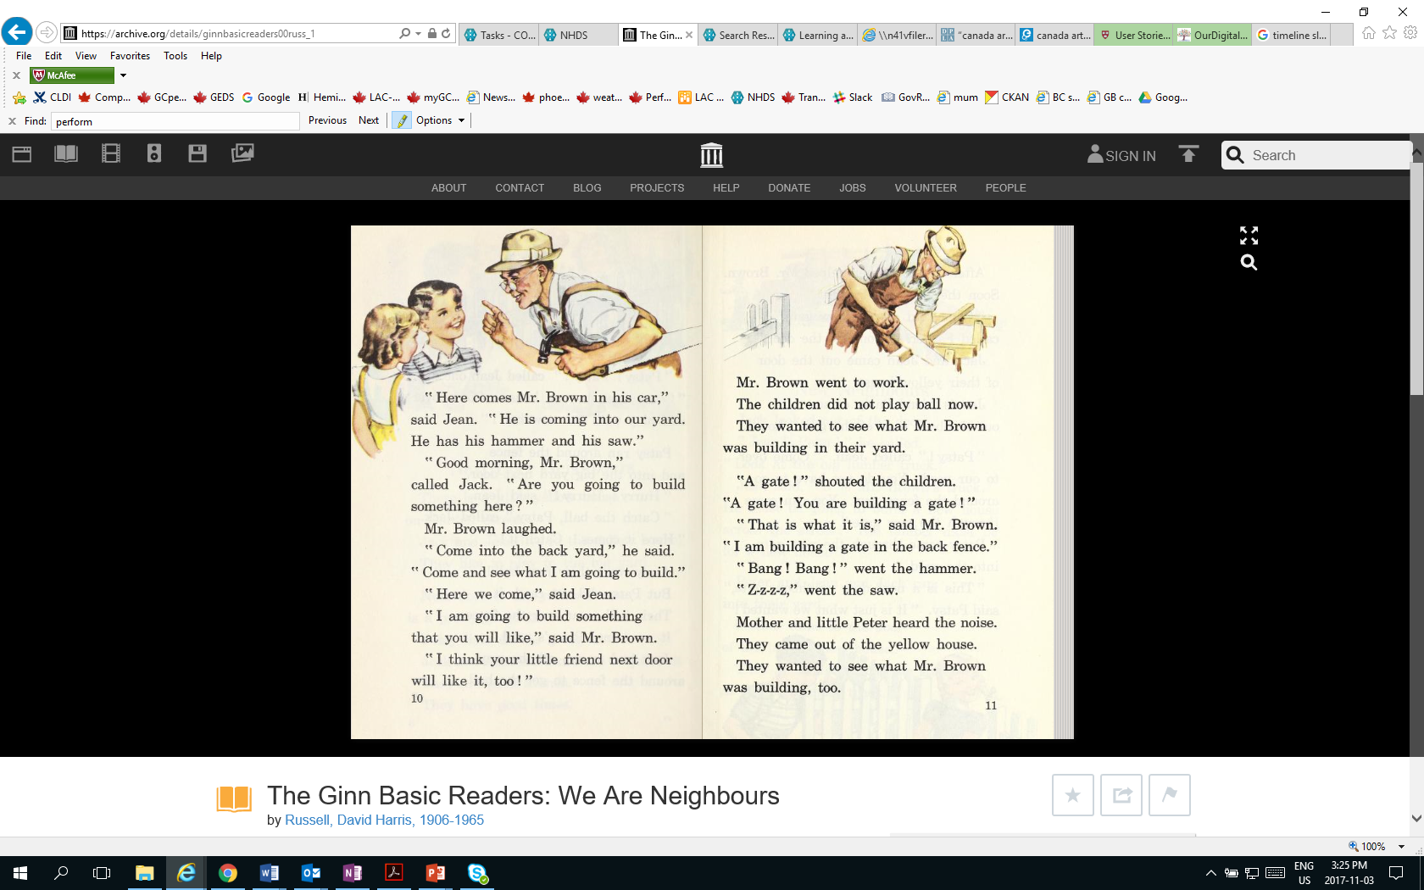
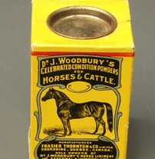
What’s next?
  Secure additional funding.
  Continue to identify and fund digitization.
  Facilitate content digitization and preservation in open networked repositories across the country.
  Develop mechanisms to enhance discovery and utilization of content.
  Build expertise/capacity across the country.
  Build relationships and awareness, nationally and internationally.

