Slide 1

Adventures in Funding Metadata
Mike & John , CRKN Virtual | 2026

Slide 2
hullo!
one super nice thing about spending a significant portion of the last few years talking about persistent identifiers is that people are getting the message.
the tri-agency are gradually massaging identifiers into grant application workflows. we've got a freshly released national pid strategy.
we can look at the barcelona declaration and say, "great, we're doing our part!" we're on the road to sensible pid adoption!
on the other hand, we have a lot of room to grow when it comes to literacy, adoption, metadata transparency, logistics, and execution.

Slide 3
in theory
it's possible:
for a grant to have a doi
for an author to include that doi, their orcid, and their ror in submission metadata (and the ror of the funder!)
for a publisher to register that metadata with a pid registration agency
for versions of that work to assert relational metadata
for an granting agency to hit an api and see these relationships asserted against the doi they registered, and have an eagle eye view of the lifecycle of a grant-funded publication
in theory, anything is possible! but what's likely is that somewhere in this workflow, the trolly comes off the tracks.
this session is meant to give you a bit of an idea where we've been with funding metadata, the hot new metadata that's sweeping the nation.
what's happened so far, and what challenges still require solutions.

Slide 4




Persistent Identifiers (PIDs) in Canada
ORCID Canada Consortium
63 members (all U15)
  SSHRC, NSERC, CFI, FRQ
95 system integrations
180K of 280K active iDs (.ca)
DataCite Canada Consortium
  95 members (including CFI)
  126 repositories
  >775,000 DOIs
Notes:
John – FR
Le RCDR gère deux consortiums canadiens qui soutiennent l'adoption à l'échelle nationale des identifiants pérennes (PID), lesquels (comme beaucoup d'entre vous le savent) constituent des références numériques durables / pérennes désignant différentes entités dans l'écosystème de la recherche (personnes, lieux, objets) et permettant de lier ces entités et leur métadonnées à travers le temps, l'espace, les domaines de recherche et les systèmes logiciels – en d'autres termes, ils sont essentiels à la désambiguïsation, à l'interconnexion et à l'interopérabilité des entités de recherche.
Le RCDR gère le consortium ORCID-CA (financer en partie par l’Alliance de recherche numerique du Canada) depuis 2017 ;
Le RCDR et l'Alliance gèrent conjointement le consortium DataCite Canada depuis 2020.
ORCID est un organisme international à but non lucratif qui aide les chercheurs à s'identifier et à éviter toute ambiguïté grâce à l'utilisation des identifiants ORCID (un identifiant unique pour les personnes). ORCID-CA compte 63 membres - soit 9 de plus qu'en mai de l'année dernière. Notamment, cette année, nous avons franchi le seuil important de 60 membres, ce qui nous permet de réduire les frais pour tous les membres d'ORCID-CA de 15 %. Les 63 membres d'ORCID-CA comprennent toutes les universités de l'U15. Notamment, la tendance des bailleurs de fonds à rejoindre ORCID-CA et à adopter et mettre en œuvre les PIDs continue, incluant l'FRQ, le CRSNG et le CRSH (NSERC/SSHRC), l'FCI et la société canadienne du cancer. De plus, l’IRSC (CIHR) a l’intention d’adhérer d’ici 2027.
Du côté DataCite, une agence d'enregistrement des identificateurs d'objets numériques (DOI) qui permet l'enregistrement de DOI (un PID pour les objets – p.ex. les ensembles de données), DataCite Canada compte maintenant 95 membres, soit une augmentation significative de 10 membres depuis mai 2025 – et, à ce jour, plus de 775 000 DOI ont été enregistrés au sein de DataCite Canada.
John – EN
CRKN administers two Canadian consortia that support the national adoption of Persistent Identifiers (PIDs), which (as many of you know) are long-lasting digital references to different entities in the research ecosystem (people, places, things) that connect research information across time, space, research domains, and software systems – in other words, they are foundational for disambiguation, connection, and interoperability of research entities.
CRKN acts as administrative lead and has hosted the ORCID-CA Consortium since 2017;
CRKN and the Digital Research Alliance of Canada (the Alliance) have co-managed the DataCite Canada Consortium since 2020.
ORCID is a global not-for-profit that helps scholars identify and disambiguate themselves through the use of ORCID iDs (a PID for People). ORCID-CA is the Canadian national ORCID consortium, administered by CRKN, that supports Canadian institutions to integrate ORCID into their local systems and to promote the use of ORCID by scholars. We have 63 members across 9 provinces – including all members of the U15 – 95 member integrations, and roughly 180,000 active ORCID iDs out of 280,000 associated with email addresses ending in .ca. These 63 members are 9 more than in May of last year. This is a significant milestone for ORCID-CA, as we have surpassed the 60-member threshold for the 2026–2027 licensing year, which reduces fees for all ORCID-CA members by 15%.
The 63 members of ORCID-CA include a large portion of the CARL membership as well as all U15 universities. Notably, the trend of funding agencies joining ORCID-CA and adopting and implementing PIDs continues. As you know, NSERC and SSHRC joined ORCID-CA in early 2024 (and, of course, in 2022, the Fonds de recherche du Québec became our first funding agency member). Since last year, we recruited CFI and the Canadian Cancer Society (our first non-profit, non-governmental funding agency). Additionally, CIHR has informed us of its intention to join sometime hopefully this fiscal.
Similarly, DataCite is a global Digital Object Identifier (DOI) registration agency that enables the registration of DOIs – a PID for research outputs like datasets. The DataCite Canada Consortium ensures that Canadian institutions can be supported sustainably to register DOIs with DataCite. We have 95 members with 126 repositories, and roughly 775,000 total DOIs have been registered by members.

Slide 5
Canadian PID Strategy
Why a national strategy?
Development
  CRKN, Alliance, CPIDAC (2021–Present)
  Community Consultations
  Initial Report (Phase I)
  Comms Toolkit (Phase II)
  Priority PID Entities (Phase II)
  PID Selection Matrix (Phase III)
  Vision, Mission, Principles (Phase III)
  Final Report/Recommendations (Phase III)
  Collaborative and Community-driven
  National funding to support centralized initiatives
  National policies (Open Science)
Implementation
  Key Final Documents
    Stakeholder Actions
    Checklist for Success
    Canada’s PID Strategy
Next Steps
  Eight (8) Entity-by-Entity Action Plans
    Monitor emerging PIDs
Notes:
Why a national strategy? The point of PIDs is that they connect everything together. We can’t make that happen without a community-driven and a community-focused approach. This requires significant collaboration across all sectors of research – universities (including both libraries and research offices), government departments, funders, publishers, researchers, etc. Furthermore, ensuring national support, guidance, and funding for these initiatives will benefit Canadian research overall and support institutions to meet some of their goals for open science or open access. A few years ago, the Canadian government issued guidance and requirements for government research on Open Science and PIDs figure into the under-development action plans. Ultimately, local resources and policies require a national response to PIDs, even though they are essentially international endeavors.
3 phases of development: Community consultations to develop a number of outputs: reports, recommendations, PID selection matrix, Engagement toolkit (documents with clear intentions that can be used to advocate for PIDs in your institution and can be adapted to different audiences as needed). All available on Zenodo (with DOIs of course).
The elaboration of the PID Strategy Vision, Mission, and Principles also enabled us to move from strategy development to implementation in the past year or so.
Implementation: Through our work with the Alliance & CPIDAC, we developed additional documents to support the implementation of a national PID strategy
Next Steps:
Though this entire process, Eight priority entities were identified – the kinds of research entities that Canadian stakeholders want PIDs for (e.g., researchers, publications, software) – and the next steps will primarily involve identifying which PIDs and PID integrations to focus on to support those community-prioritized research entities, through also the development of individualizaed action plans.

Slide 6
Entity-by-Entity Action Plans
Priority Entities | Candidate PIDs | Maturity | Next Steps: PIDs Recommended in Report
People | ORCID ISNI | Established Established | Recommend the use of ORCID iDs for current scholars – we do this already. ISNI might be a helpful use case for historical or cultural figures – to study. Scopus does not respond to the PID Matrix Selection Criteria/Principles.
Outputs | Crossref DOIs DataCite DOIs ARKs | Established Established Established* | Metadata schema should guide the choice of DataCite vs Crossref. *ARKs depend on resolver context. Evaluate ARKs with DOIs to see when needed.
Organizations | ROR ISNI | Emerging Established | ROR is an emerging PID, but likely the candidate of choice. ISNI requires study. Ringgold does not respond to the PID Matrix Selection Criteria/Principles.
DMPs | DataCite DOIs | Established | Recommend the use of DataCite DOIs.
Grants | Crossref DOIs DataCite DOIs | Established Emerging | Careful comparison of use cases; Crossref used by some CA funders.
Projects | RAiD | In Development | RAiD is the only candidate, but still in early stages of development. To watch.
Software | SWIHDs | Emerging | SWIHDs show promise, but low maturity and adoption. To watch and study.
Facilities, Instruments, Equipment, Resources | ROR DataCite DOIs RRIDs | N/A | Too much complexity in this space – some options exist (RRIDs for biological resources, ROR for some facilities, DOIs for some instruments), so it is recommended to watch and study.
Notes:
We know that ORCID is the PID for People, DOIs are for Outputs, and RORs are for Organizations – this is now easy to endorse and recommend.
However, we are now excited to present on emerging PIDs and their current situation in Canada. This includes DOIs for Funding and RAiDs for Projects.

Slide 7
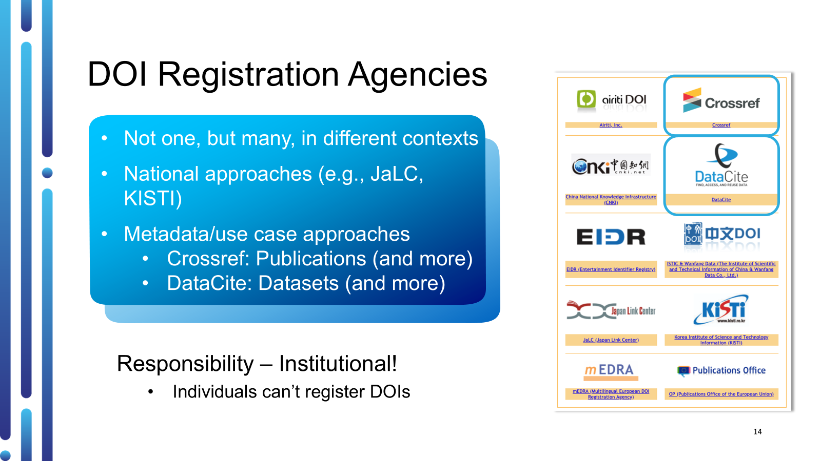

Slide 8
DOIs for Grants/Awards
Entity: Grants/Awards
PID of Choice: DOIs
PID Provider: Crossref vs DataCite
  Crossref (direct member): FRQ
  DataCite Canada: CFI (forthcoming)
Maturity: Early stage PID use case
  200K DOIs with Crossref since 2019; 48 organizations
  8K DOIs with DataCite since late 2024; 10 organizations
Notes:
The two PID registration agencies that provide DOIs for grants in Canada are Crossref and DataCite.
Both are relatively new services: Crossref beginning in 2019 with now forty-eight (48) organizations having registered close to 200 thousand Grant IDs, and DataCite in 2024 with now a little over 8 thousand DOIs registered only by 6 organizations, 99% of which were registered by California Digital Libraries (CDL) as part of a pilot project. Still new service, and seeing more interest and uptick, but Caanda would definitely be at the forefront of this initiative.

Slide 9

PIDs and Canadian Funders
ORCID-CA
NSERC, SSHRC, FRQ, CFI, and the Canadian Cancer Society
NSERC/SSHRC
Tri-Agency integrated ORCID into the Convergence platform
+8,600 Connected ORCID iDs = #1 connected system in Canada
FRQ launched a full ORCID integration in FRQNet
+3,700 Connected ORCID iDs = #2 connected system in Canada;
+50 Records Updated
FRQ
Notes:
Concretely, what that means in Canada?
Back in 2024, ORCID/CRKN/CFI/FRQ/Tri-Agency were exploring next steps and opportunities for PIDs for funding - what can be done, how?
What came out of this was initial developments of PID integrations to either connect to funding platforms and/or push fundings into ORCID records.
In the Spring 2025, the Tri-Agency integrated ORCID into the Convergence platform. This platform aims to help scholars collect information from ORCID Records to help fill out the application form (i.e., Employment/Affiliation, Education, Funding). 3,000 Connected ORCID iDs within the first few months aligned with competition cycles, and is now well over 8, 500 = #1 connected system in Canada already.
In the Summer 2025, FRQ launched a full ORCID integration in FRQNet. This integration enables scholars to collect information from their ORCID Records to help fill out the application for (all metadata) and push their grants (with Grant IDs) and funding review information to their ORCID Records via their FRQNet account.
Rapidly had 2,000 Connected ORCID iDs became the third most connected system in Canada; and growing to over 3,500 becoming the second connected system in Canada, with now over 50 Records Updated with funding. FRQ is also a global leader in PIDs for funders, as it has registered over 26 thousand Crossref Grant IDs going back to 2019, making FRQ the second largest minter of Grant IDs in the world – behind the Publications Office of the European Union (53,925). Most of FRQ’s Grant IDs also include ROR IDs.
CFI and Canadian Cancer Society have plans to do something similar to FRQ in their own funding workflows; and we've seen lots of development on that front in the past year.
TGMS eventually but no timeline or clarity on narrative CV connection.
So now we have two major funders, one federal, one provincial, in the top spots.
Canada is at the frontier of PID implementation in the funder space, with FRQ taking an early lead in implementing PIDs for grants via Crossref Grant IDs (including pushing Grant IDs to ORCID); the Tri-Agencies are considering next steps; and CFI will be presenting today their use case with DataCite DOIs for Awards.

Slide 10
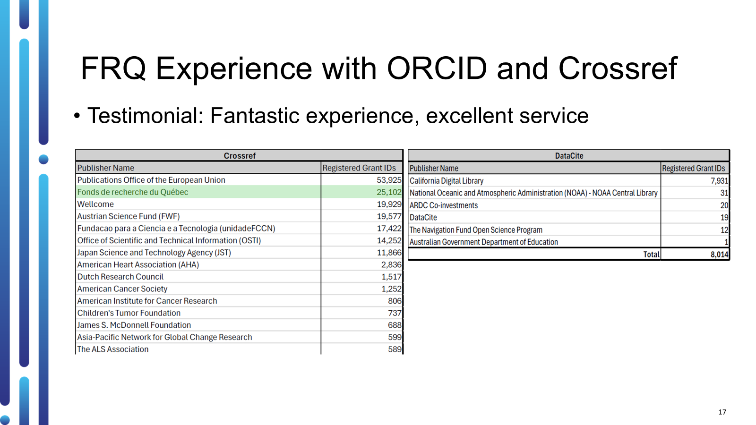

Slide 11
"in theory"
i'm deeply thrilled that folks have thrown their support behind the possibilities of pids. they are, though, not magic.
we're going to walk through the life-cycle of a publication and gesture towards potential pitfalls or obstacles that could prevent the realization of a research products panopticon.
it's possible:
for a grant to have a doi
for an author to include that doi, their orcid, and their ror in submission metadata (and the ror of the funder!)
for a publisher to register that metadata with a pid registration agency
for versions of that work to assert relational metadata
for an granting agency to hit an api and see these relationships asserted against the doi they registered, and have an eagle eye view of the lifecycle of a grant-funded publication

Slide 12
dois for grants
this is true! you can register a doi for a grant. crossref even just added a new metadata element in their article schema for grant doi.
but, not all funders do this. we're actually a little bit ahead of the curve here (and even then, pid adoption isn't universal for all canadian research funding). instead, many funders around the world have bespoke systems that assign unique (or, sometimes actually not unique) "Grant IDs" to each grant.
a "grant id" might be tied to metadata on the funder side. it also might not!
it's possible:
for a grant to have a doi

Slide 13
pids in submission metadata
a lot can go wrong here. the most obvious of which is that a corresponding author might not include these things in their submission metadata. but, also:
they might miss the field in a submission platform, but put it in the full text
a submission platform might not have these metadata elements enabled
a submission platform might not support ORCID or ROR unless a journal or publisher requested them.
a submission platform might not support ORCID or ROR at all
it's possible:
for a grant to have a doi
for an author to include that doi, their orcid, and their ror in submission metadata (and the ror of the funder!)
the journal might need to update their platform to support this, and don't have access to that support
the corresponding author doesn't actually know the grant id or doi, because they're not the pi.

Slide 14
just a brief aside here too that sometimes people try to evaluate metadata completeness and will perceive a gap in funding metadata as a failure to collect it. but, it's a useful reminder that not all research publications are grant-funded.

Slide 15
registration
we're doing pretty well in this front, broadly. many journals register their dois with either crossref or datacite as a matter of course, and we do our best to support this.
however, that a publisher has dois does not mean they send all the metadata they collect to a registration agency.
it's possible:
for a grant to have a doi
for an author to include that doi, their orcid, and their ror in submission metadata (and the ror of the funder!)
for a publisher to register that metadata with a pid registration agency

Slide 16
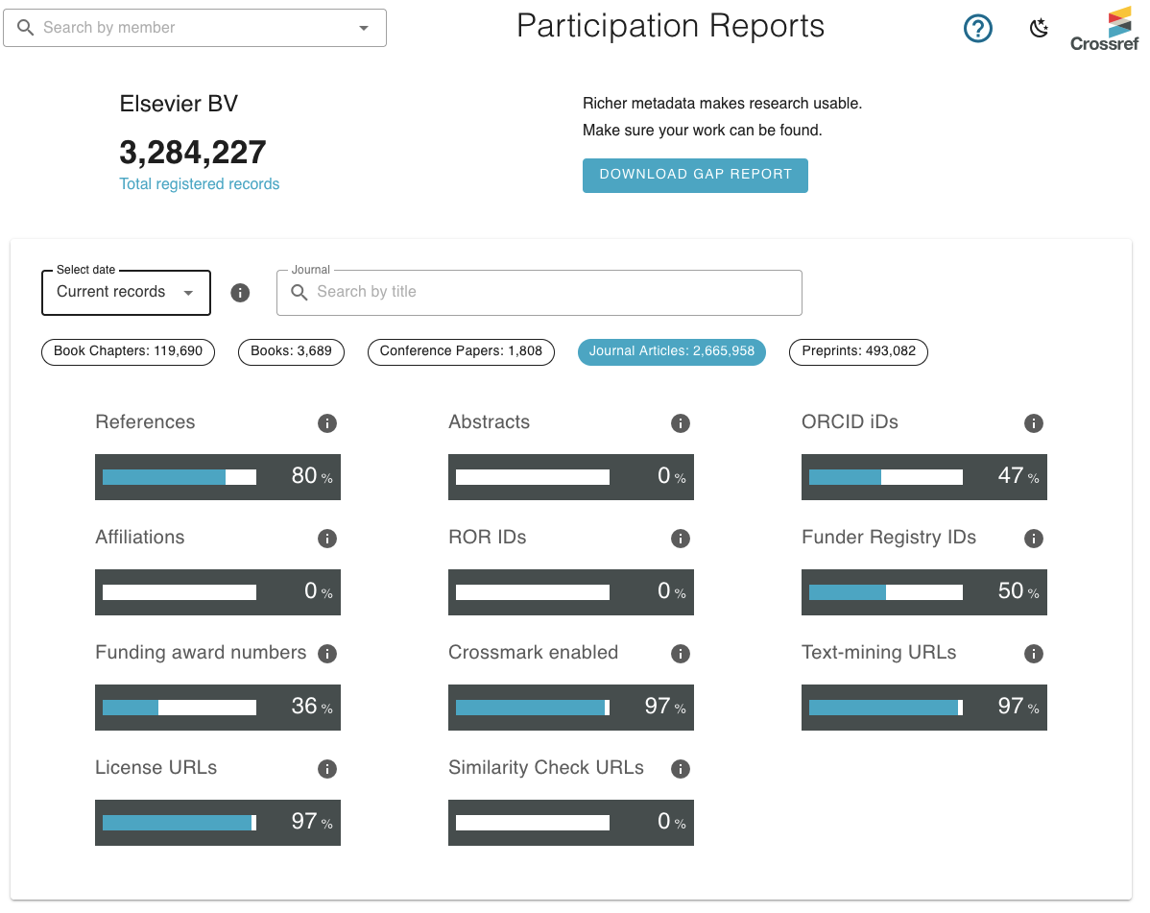
registration
crossref has this feature they call "participation reports". in them, you can see how metadata completeness stacks up.
these aren't reports of what metadata a publisher has. they're reports of what metadata crossref isn't receiving from publishers.
you and i both know that elsevier has abstract and affiliation metadata. but elsevier also wants to sell you tools that let your institution collect that information. here we can see that elsevier just doesn't bother sending affiliation and abstract metadata to crossref.

Slide 17
registration
a publisher, title, or platform might have this metadata and not push it to a pid registration agency.
this might not seem like a big deal. but if metadata isn't in crossref, it's probably also not in ORCID. and it might not make it to OpenAlex or OpenAIRE.
if that metadata isn't sent downstream, it limits our ability to scoop it up.
it's possible:
for a grant to have a doi
for an author to include that doi, their orcid, and their ror in submission metadata (and the ror of the funder!)
for a publisher to register that metadata with a pid registration agency

Slide 18
relational metadata
now we're really in the weeds!
let's say i publish and article, post a pre-print, share a copy of an accepted manuscript in a repository, and post a dataset.
in each case, will i be able to:
provide orcid/ror identifiers
provide pids for other versions
assert a funder using ror or plain text,
provide a grant id or grant doi
and, will all of this metadata be reliably registered with whatever agency those platforms are using
it's possible:
for a grant to have a doi
for an author to include that doi, their orcid, and their ror in submission metadata (and the ror of the funder!)
for a publisher to register that metadata with a pid registration agency
for versions of that work to assert relational metadata

Slide 19
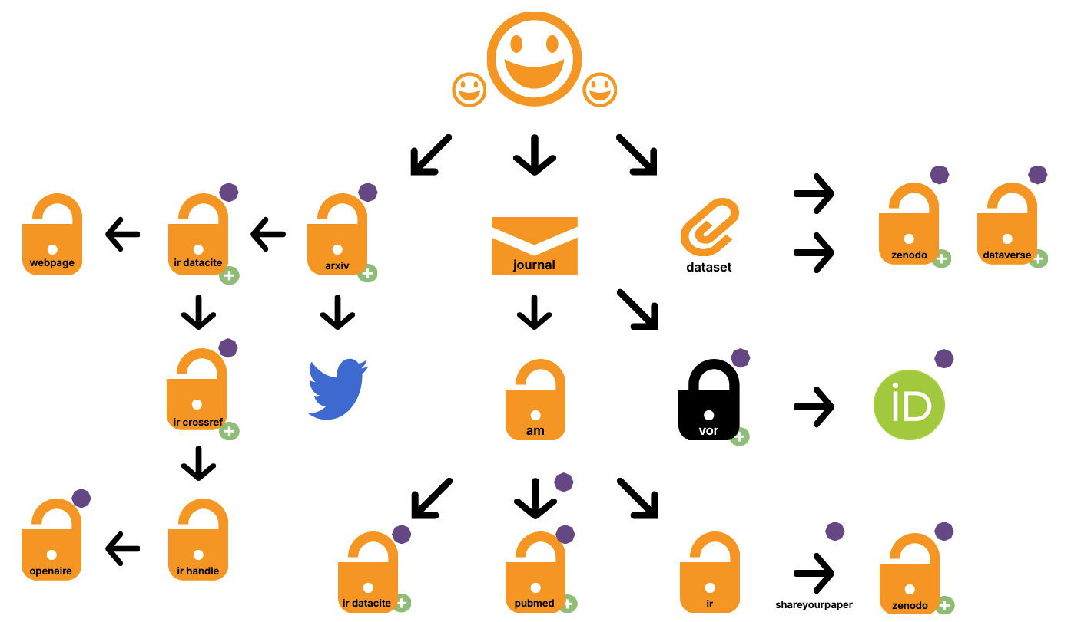

Slide 20
it would be a pretty daunting task to have each of these endpoints know about the other. i'm not even sure that's necessary. but, it's instructive to remember that even if we've made it to a point where an author and some platforms did everything right, there's still some parts of the narrative we won't have.
the authors might not even have it.

Slide 21
reporting
ultimately, a big part of the push for pid adoption is that we leave a lot of metadata on the cutting room floor. we don't totally know what happens to all funded research and its products.
what does finding this metadata in the wild even look like? what's available?
it's possible:
for a grant to have a doi
for an author to include that doi, their orcid, and their ror in submission metadata (and the ror of the funder!)
for a publisher to register that metadata with a pid registration agency
for versions of that work to assert relational metadata
for an granting agency to hit an api and see these relationships asserted against the doi they registered, and have an eagle eye view of the lifecycle of a grant-funded publication

Slide 22
reporting
ok so, if i have an orcid, i can hit the crossref api and see what comes up. let's get weird with it for a second:
this is a crossref api query for a researcher at my institution against his orcid.
https://api.crossref.org/v1/works?filter=orcid:0000-0003-1166-6206
and if i'm at all good at api queries (which i am not), i can check specific orcids against specific funder dois.
it's possible:
for a grant to have a doi
for an author to include that doi, their orcid, and their ror in submission metadata (and the ror of the funder!)
for a publisher to register that metadata with a pid registration agency
for versions of that work to assert relational metadata
for an granting agency to hit an api and see these relationships asserted against the doi they registered, and have an eagle eye view of the lifecycle of a grant-funded publication

Slide 23
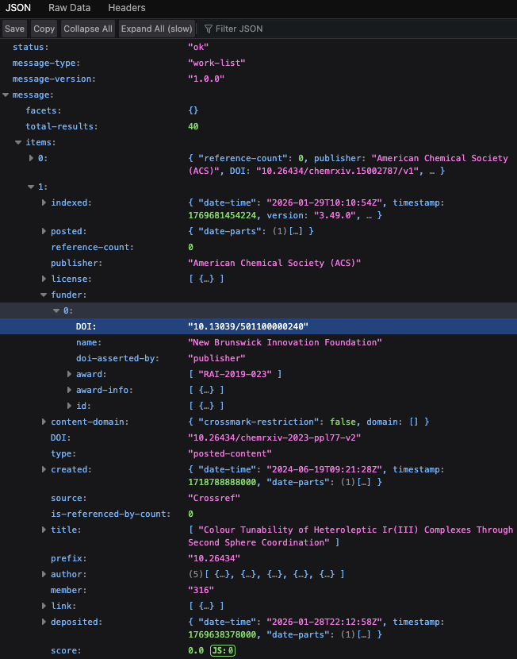
reporting
this is kind of a best case scenario, because barry is very good at this. i can see his funder id and information (likely populated by crossref funder registry metadata).
here, we have a:
doi for the funder
grant id
no doi for the grant

Slide 24
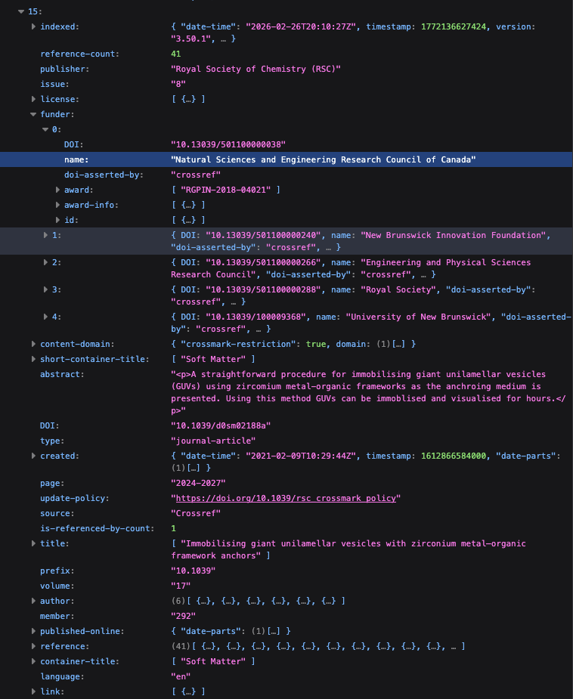
reporting
here's a second example with NSERC funding, but also reported funding from a bunch of other institutions as well
here, we have a:
doi for the funder
grant id
but also, check this out…

Slide 25
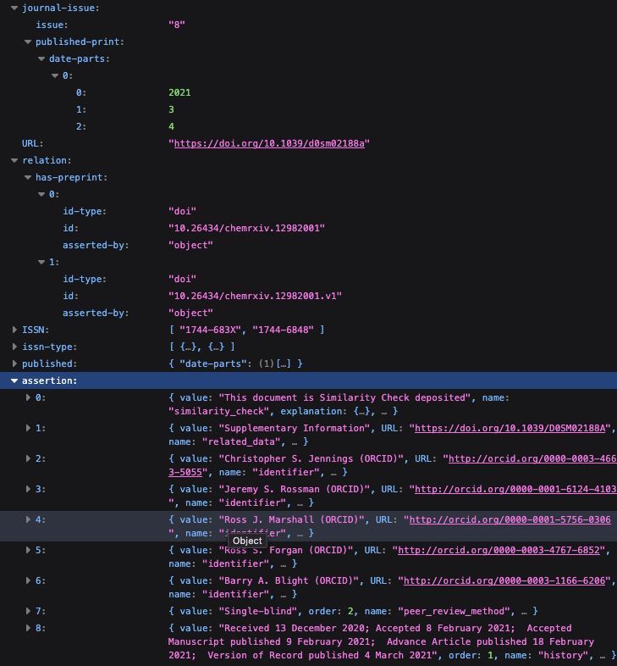
reporting
further below, we see a few things here… one is that this work has two versions of a preprint that have been related with metadata… another is that we can see this work went through crossref's similarity check service, which includes fields related to submission, acceptance, and publication metadata.
we can tell a lot! but you know what isn't here? a link to the data set! and I know that exists because barry always posts those.
in fact, i have no dataset information. to get that, i have to hit the datacite API.

Slide 26
the point here is that for this metadata to be useful to us, funding agencies, institutions, whatever… it has to have been collected, registered/shared, connected, and then locatable in its disparate locations via open scholarly infrastructure.

Slide 27
some people have said things to me like, "we just need to educate faculty about funding metadata in their submissions."
that's not untrue, really!
but the full story is that we also need to support open infrastructure and make sure researchers or publishers can provide this kind of metadata in the first place.

Slide 28
the barcelona declaration
the barcelona declaration is an international initiative to promote and facilitate openness and transparency in research publishing.
there are other organizations working in this space as well, but the important thing to know is that there's significant movement throughout the industry to improve metadata distribution and practice.
"Open research information enables science policy decisions to be made based on transparent evidence and inclusive data. It enables information used in research evaluations to be accessible and auditable by those being assessed. And it enables the global movement toward open science to be supported by information that is fully open and transparent."
- https://barcelona-declaration.org/

Slide 29
the barcelona declaration
they've identified a huge variety of inflection points for their work with a wide range of task forces, research projects, and working groups.
the objectives here are actionable recommendations and potential support to facilitate infrastructure rising to meet the potential of widespread pid adoption.
and they're doing great research:
de Jonge, H., & Kramer, B. (2026). Manuscript submission systems and metadata completeness in Crossref: Patterns and associations. PloS One, 21(3), e0345417. doi:10.1371/journal.pone.0345417
Journal Article and Book Metadata
Metadata of Research Outputs in Repos
Funding Metadata
  … in publication metadata
  grant metadata sharing by funders
  expanding funding metadata practices across regions
  entity-relationship models
Replacing Closed Systems
Sustaining Infrastructures
Evaluating sources of open research information
Evaluating Benefits

Slide 30
comet
crossref
comet is an initiative spearheaded by california digital libraries. they're advocating for tools and infrastructure that would allow community-driven improvements to pid metadata (external to publisher or platform intent).
they're supporters of the barcelona declaration, but they're also trying to find ways to make improvements to metadata that aren't so low-to-the-ground. they're looking at machine learning and nlp solutions also.
over the last few years, crossref have been hugely invested in promoting metadata hygiene and have thrown significant support to organizations that can help.
in partnership with pkp, for example, they've been working together to create resources for – and widespread promotion of – upgrading ojs software to improve metadata functionality. they know upgrading is sometimes a hurdle, and they're doing their best to help pkp provide more resources.

Slide 31
so, what's the take-away?
this is a multivalent challenge. responsibility for better metadata around funding and reporting is shared across a huge range of folks.
pid registration agencies
research funders
institutional research offices
authors
publishers
platform developers and maintainers
librarians
communities of practice

Slide 32
i often liken this open infrastructure to a municipal water system. i think, probably, it's a bit more apt to compare it to a bunch of sort of connected liquid systems that don't all work the same way and in some cases aren't compatible and in other cases are maintained by people who want us to drink worse water… and uhh…
i guess what i'm saying is that being able to drink from the hose doesn't mean the water is clean.

Slide 33
it is important we govern our expectations.

Slide 34
even if we had 100% pid adoption today, on the other side we'd still come out the other side with a deeply tangled string of christmas lights with many missing bulbs. what's vital here, is that we keep abreast of the conversation, and lend a voice of support to open infrastructure providers and developers where we can!

Slide 35
thank you! questions?!

