Slide 1
Building Momentum in Open Science through Persistent Identifiers:
The Final Outcomes of the ORCID Implementation Pilot at the University of Waterloo
Laura Bredahl, Bibliometrics and Research Impact Librarian

Slide 2
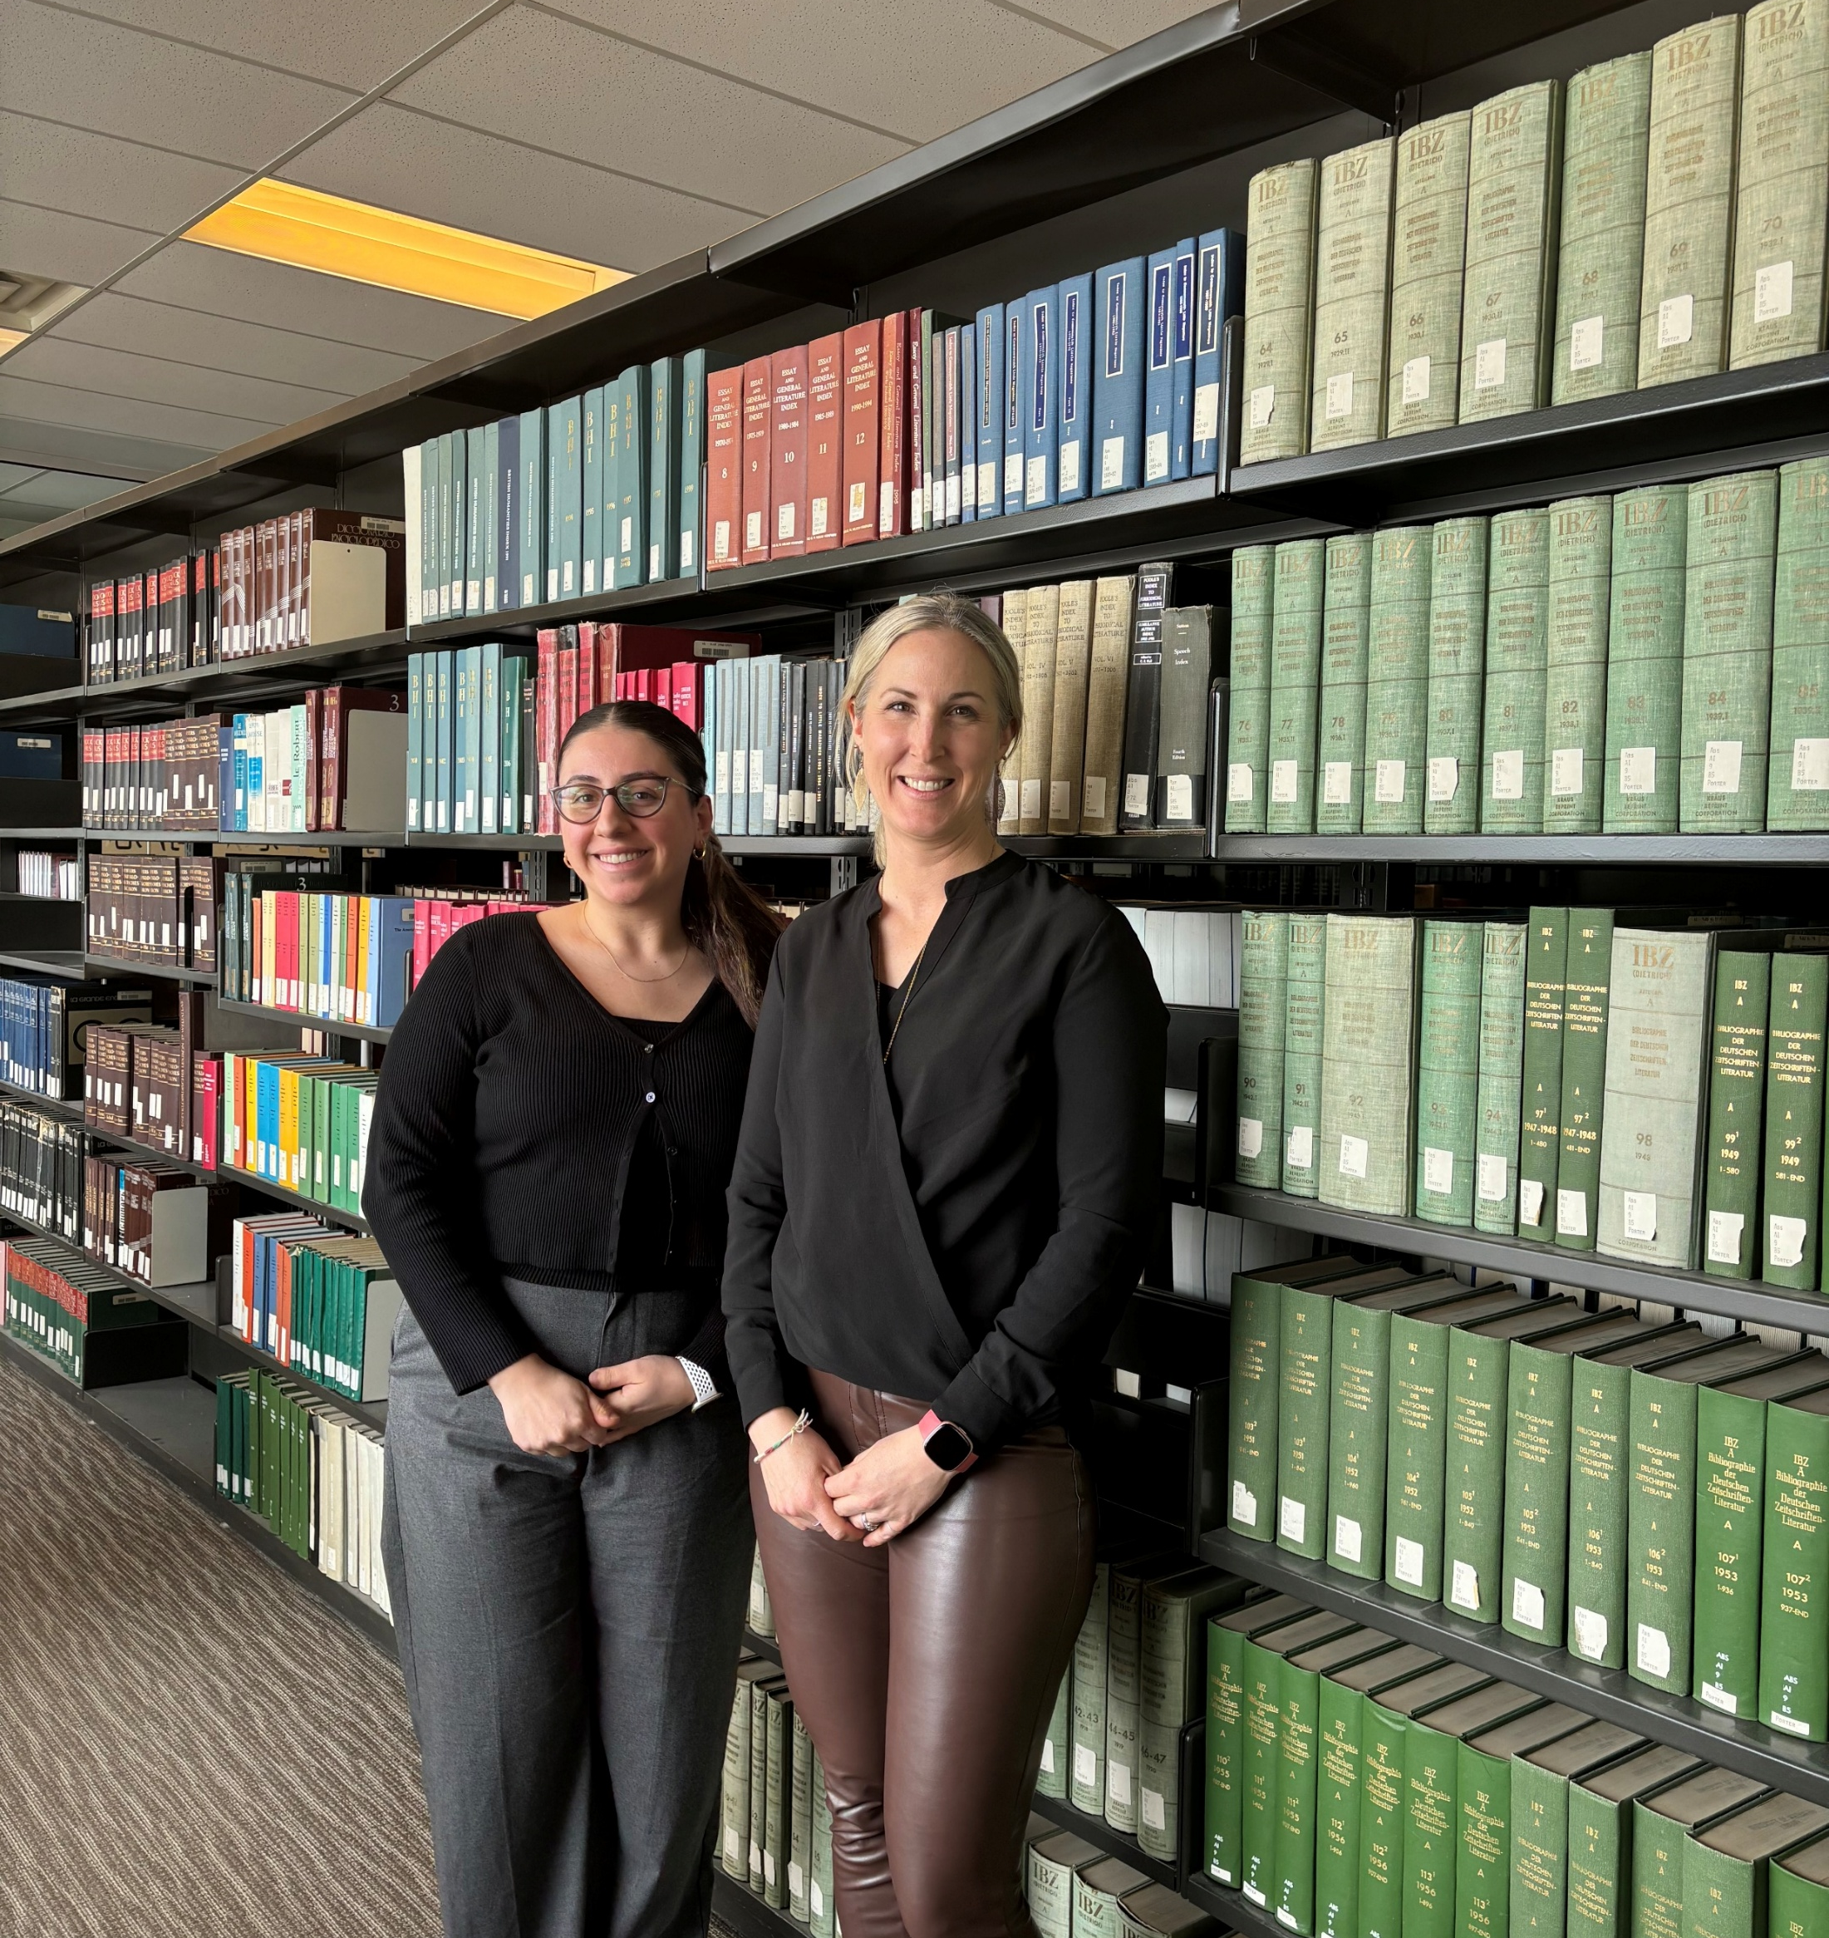
ORCID Team at the Library
Mary Ochana, Research Intelligence Project Analyst
Laura Bredahl, Bibliometrics and Research Impact Librarian

Slide 3
Presentation at a glance
Project summary
ORCID Assertions
Outputs
Engagement
Next Steps

Slide 4
Project Summary

Slide 5
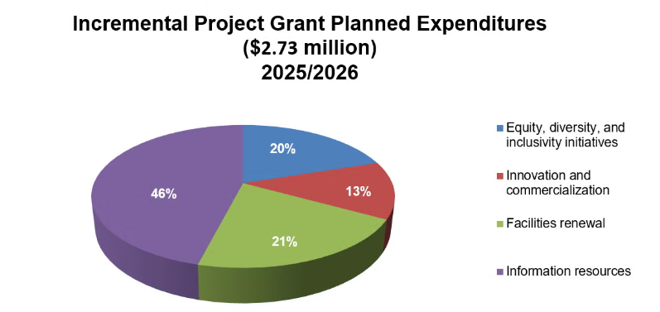
Library
Working Group on Bibliometrics
Office of Research
Notes:
Project support: Incremental Project Grant
Applied in 2022
Approved in 2023
Hiring in Fall 2023
Mary started Jan 2024

Slide 6
Library
Working Group on Bibliometrics
Office of Research
Performance Objectives
Performance Indicators
Target Outcomes
Create an ongoing data framework and workflow to capture institutionally specific author level research impact data
Create an institutional wide ORCID integration and workflow
Implement the ORCID Affiliation Manager and develop a maintenance pathway
Integrate ORCID into existing analytical workflows
Understand the research impact of graduate student through research fund distribution and publication output
Notes:
Performance indicators
Percent of current graduate students with an ORCID
Complete report on the research impact of graduate student at Waterloo
Establish an accessible and integrated dataset with author, departmental, and publication level research impact metrics.
Number of communications delivered to stakeholders and target audience (faculty and graduate students)
Target outcomes
A report which explores future system integration needs for long-term uptake
Percent of current graduate students with an ORCID
Report submitted to GSPA
Dataset completed
3 presentations to senior leaders groups, 4 campus wide communication (news, website updates etc.)

Slide 7
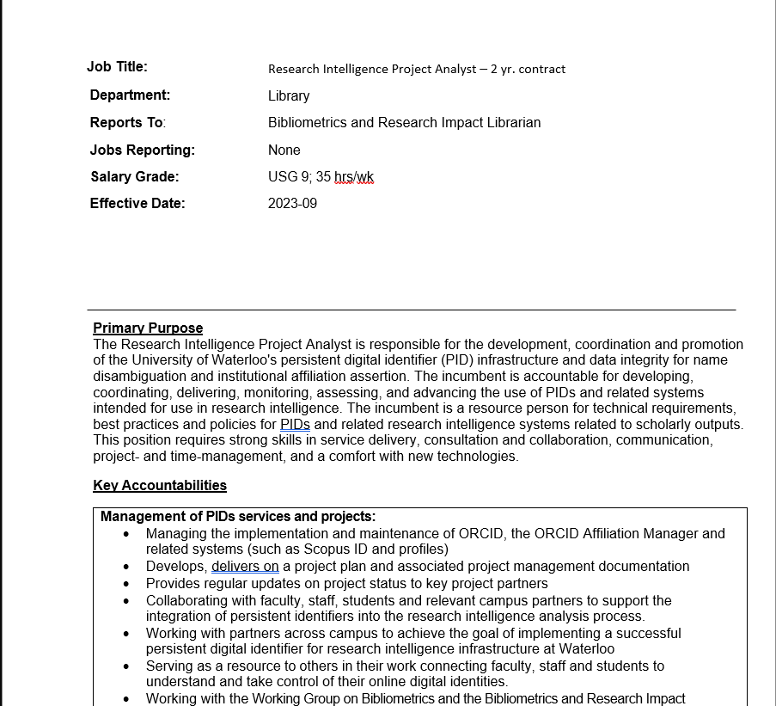
Library
Working Group on Bibliometrics
Office of Research

Slide 8
Project summary
Library
Graduate Students and Post-Doctoral Affairs
January 2024 to January 2025
A Campus Partnership:
  University of Waterloo Libraries: Project Owner
  Office of Research: Project/Grant Approval
  Graduate Studies and Postdoctoral Affairs (GSPA): Participant group
Why PhDs and Post Docs?
  Evolved from a request around graduate student research impact from GSPA
  High learning potential for solving challenges for a difficult group
Project Purpose
  To facilitate and increase the adoption of PIDs
  To better understand the contributions and impact of Waterloo researchers
  To better understand the workflows of a campus wide implementation
Notes:
Pilot:
January 2024, that ended January 2026
Managed by the library
Partnership with the office of research and GSPA
PhD students and postdocs:
because the project actually evolved from a request by GSPA to better understand graduate student research impact in 2020. This request was extremely difficult to fulfill, as the only way to identify graduate students at the time was manually.
unique challenges when it comes to tracking and managing research outputs, so there was a lot of learning potential in starting here.
Goals:
Our broader goals are first, to increase the adoption of persistent identifiers, or PIDs;
to better understand the contributions and impact of Waterloo researchers, especially graduate students who publish
to learn more about what a campus-wide implementation really involves — from workflows to coordination across departments.
How:
To “implement” ORCID on campus we are asking PhDs and post-docs to affiliate with UW on ORCID
To do this we are using the Affiliation Manager, which is an out of the box tool provided by ORCID to ORCID member institutions

Slide 9
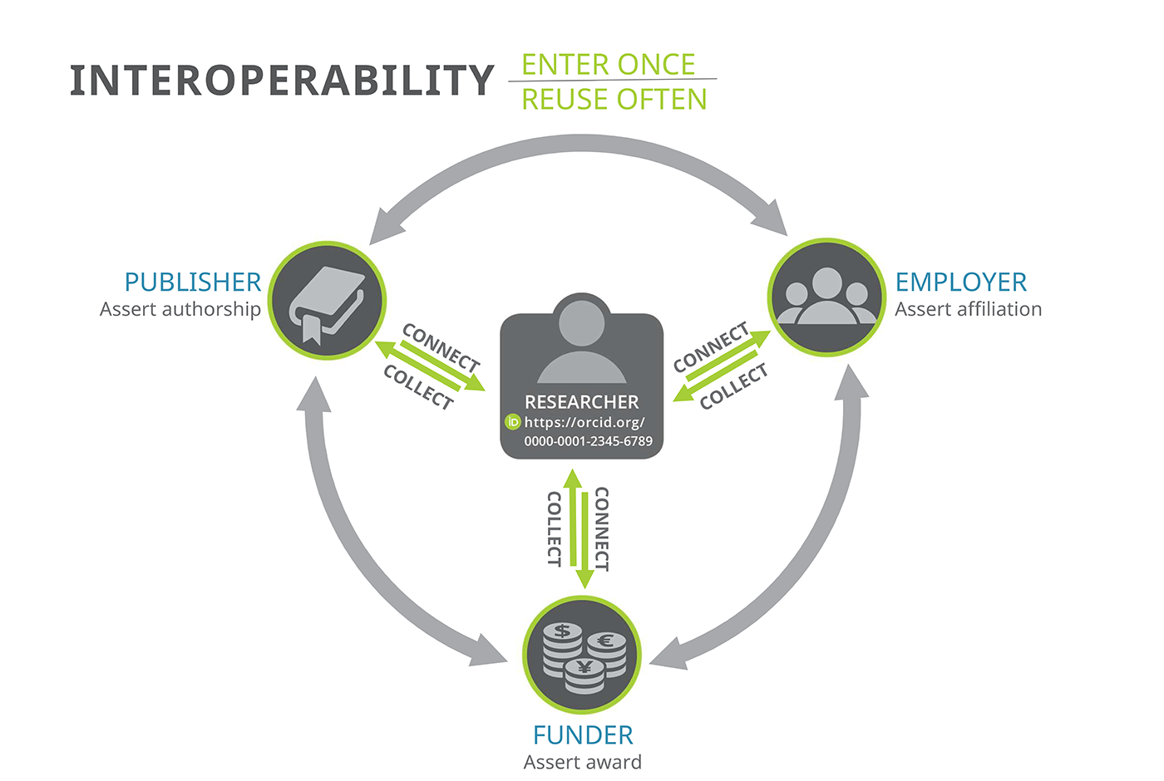
Why ORCID?

Slide 10
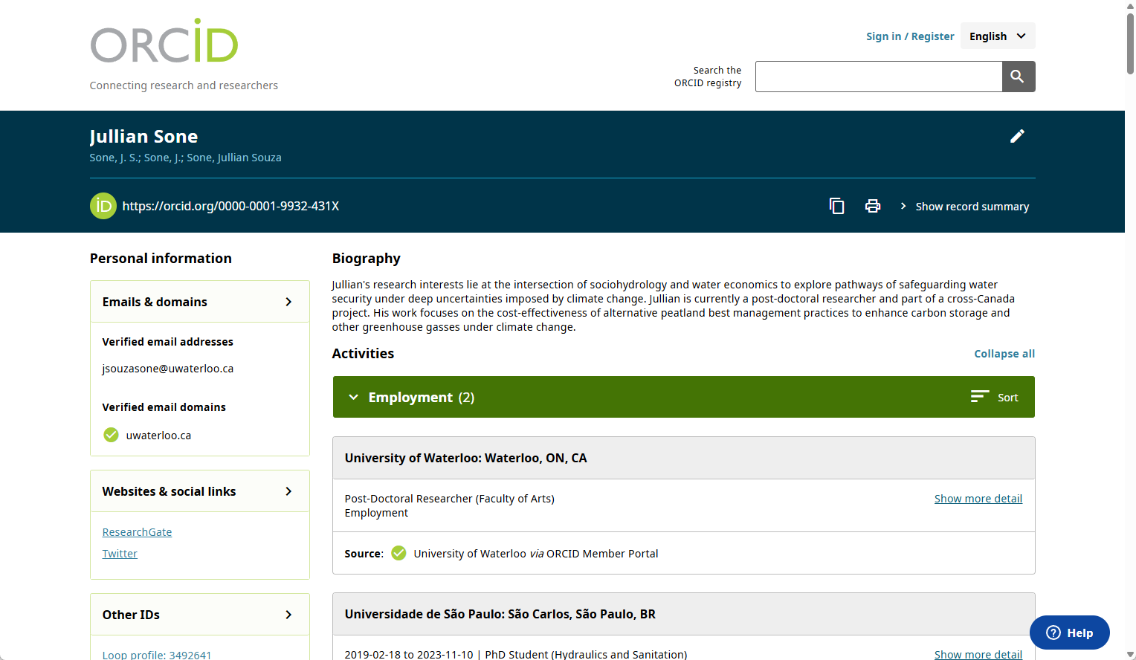
Notes:
Just in case you aren’t super familiar with the ORCID page.
This is what assertion with Affiliation Manager looks like
Green checkmark

Slide 11
ORCID Assertions
Notes:
Instead of the best for last, I am sharing the best first:
The outcomes!
How many PhD and Post-Docs asserted their affiliation?

Slide 12
Workflow/term
Centralized Data Lake Requests
Affiliation Manager
Mail Merge
1:1 Meetings
Notes:
Centralized Data Lake Requests
Post-doc data – HR data (Workday)
PhD data – Registrar
Affiliation Manager
Unique link
Mail Merge
Individual emails (automated)
1:1 Meetings
Questions/assistance

Slide 13
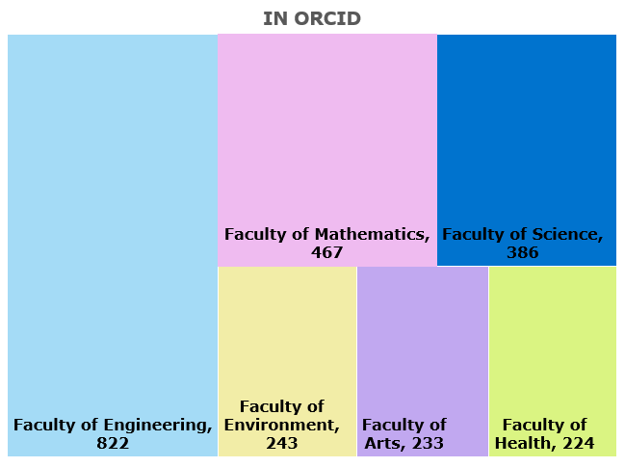
Total PhDs and Post-Doc in ORCID
= 2391

Slide 14
67% Uptake Achieved
PhD
Post-Doc

Slide 15
Notes:
Data breakdown by term:
F24
W25
S25
F25

Slide 17
Are they updating their profiles?

Slide 18
Project Outputs
Part of the Project Goals

Slide 19
Planning & Info Gathering
Project charter
Communication plan
Focus groups & test group analysis
Environmental scan
Literature review
Milestones
Promo materials
Website/Libguide: https://uwaterloo.ca/lib/orcid
Graduate impact report
Privacy FAQ document
Data sharing policy
Final Report
Library
Graduate Students and Post-Doctoral Affairs
Graduate Student Association
Waterloo Undergraduate Student Association

Slide 20
Focus Groups
The benefits that graduates students value the most.
ORCID acting like an online CV.
What they would like to see:
  Posters and media content about ORCID.
  Examples of use cases for graduate students early in their academic career.
  How ORCID compares to similar platforms.
Notes:
Ensure your work is recognized.
Controlling your academic identity.
Maintain all your key information in one place.
ORCID is free and easy to register and use.
Name disambiguation.
Highly recommend continued feedback. There might be room to do a survey or more focus groups in the future.

Slide 21
Milestones
Promo materials
Website/Libguide: https://uwaterloo.ca/lib/orcid
Graduate impact report
Privacy FAQ document
Data sharing policy
Final Report

Slide 22
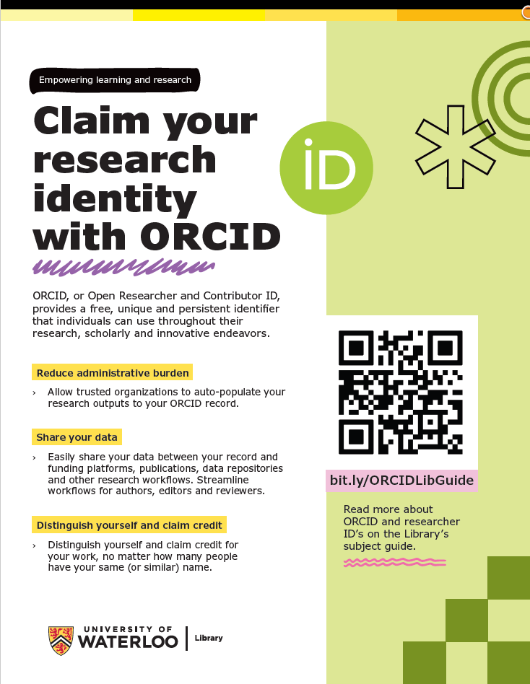
Notes:
Example of the printed poster distributed by WUSA Poster Run.

Slide 23
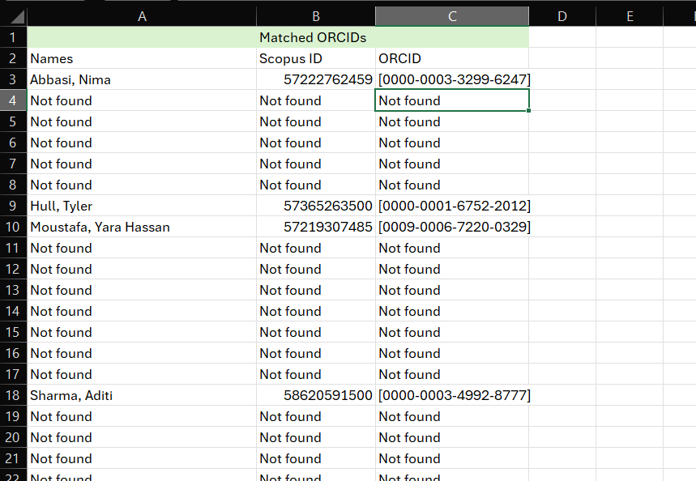

Slide 24
Graduate Impact Report 2025
Notes:
Preliminary data from Spring 2025
We need to update this but it give you a sense of the data that is available.
We could also do a %of total outputs but this takes a bit more data wrangling.

Slide 25
Engagement

Slide 26
Engagement
Library
Campus
External
UL Hours (2)
Library Newsletters
Research & Learning Dept.
Engineering Team
Cataloguing and Metadata Dept.
Library Executive
Graduate Operations Committee
Faculty and department meetings (many many)
Office of Research
Bibliometrics Working Group
Orientation Days
Daily Bulletin Newsletter
Graduate Newsletters
Graduate Senate Council
CRKN (2)
CARA - Canadian Association of Research Administrators Conference
BRIC - Bibliometrics and Research Impact Community Conference
CARL - Bibliometrics and Research Impact Community of Practice
Scholars Portal Days
Coming up: 2026 CRKN Virtual Conference; ORCID/Switchboard
Notes:
Just read the slide

Slide 27
Next Steps
Collaborations Across UWaterloo

Slide 28

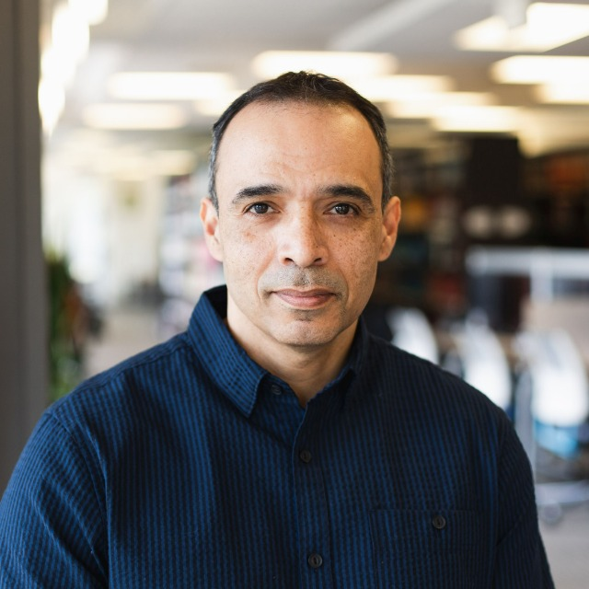
Faculty of Science Collaboration
Mirko Vucicevich,
Director, Digital Integration,
Science Computing
Israel Cefrin da Silva
Information Technology Specialist/Developer
Information Systems and Technology

Slide 29




Faculty of Science Integration
Integration into Performance Reviews
Data source, updated
from SCOPUS, self-management
Infrastructure for registration & API forwarding.
Holds the Keys
Faculty & ASU developers can consume the API directly for integrations
Auto Update
Faculty Profiles &
Research Pages
Independent metrics,
reporting, and
integrations
Notes:
Faculty of Science / Campus wide
The faculty of science reached out to us last summer about improving their performance review process
Goal to increase profile management using ORCID.
System pulls ORCID data via API internally that can then be distributed to other campus systems.
Full Campus ORCID Implementation
A system is one thing
The work is takes to build profiles is a whole other challenge
We hope that the IPG can support this work across campus
Library work
We also are trying to tie some of this work into ongoing roles.
How this works in the future is tbd.
More on the Science project:
Currently, faculty as updating their publications in Word and sending that data off to the folks reviewing it.
Once the review is completed that data goes no where, and the entire process is repeated next year
This is a huge drain on resources for both faculty members and staff, and it is clearly a process where part of it can be automated to help everyone involved
The faculty of science is looking to query these publications, instead of relying on faculty to send them.
In the future they hope to collect other data like grants won or special positions help, but for the time being they are only looking to collect publication information
The data they are querying needs to be a “single sources of truth”. This means a number of things.
One, faculty needs to be able to update their publication lists. They must have a say over what is included in their review.
This system needs to be set up so that the publication information is automatically pulled into the systems they’re using.
This data needs to be centralized and easily integrated into the systems
Overall, this needs to be a viable long-term strategy.
We’re investing some time and resources upfront to get this running, but in the long term this collaboration should help everyone
How this works is the Faculty of Science will ask all faculty members to affiliate with the University on ORCID and connect their ORCIDs to Scopus.
The library is manager of the ORCID membership, so we will essentially “hold the keys” to this data. Literally, we hold the access keys to everyone's account.
The Faculty and Academic Support Software Team, or FAST, will be able to consume the API directly for their integrations.
As I said before, the Faculty of Science wants to use this information to update their performance reviews. They’re hoping that they will be able to pull this data and put it directly into dashboards for each Faculty member.
There has also been discuss about possibly using this integration to update faculty profile pages. Some of you may know, that many of these profile pages are very outdated. The hope is to create a customized WCMS widget that will pull publication lists from ORCID, and paste that onto faculty profiles
Finally, other units or institutions will be able to pull metrics for their independent reporting
I think this is one of the most exciting this I’ve shared with you today. Obviously this is a collaboration specifically with the Faculty of Science, but this has the potential to impact how the entire campus collects data on their researchers.
So, this pilot is wrapping up as we near January 2026, but at the same time it’s expanding in a really promising way

Slide 30
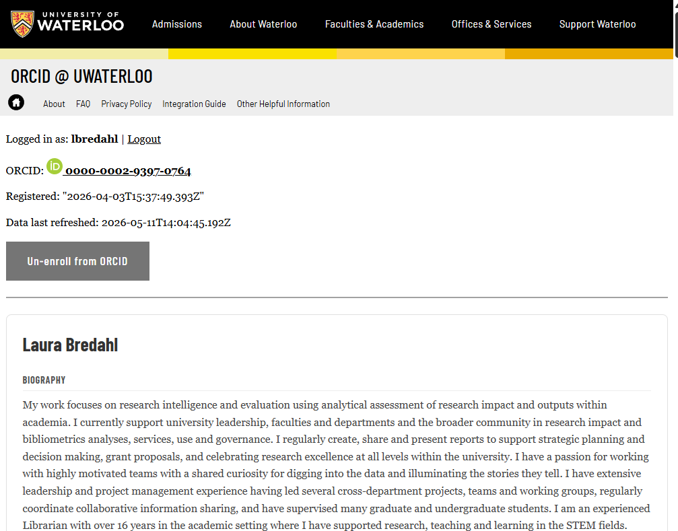
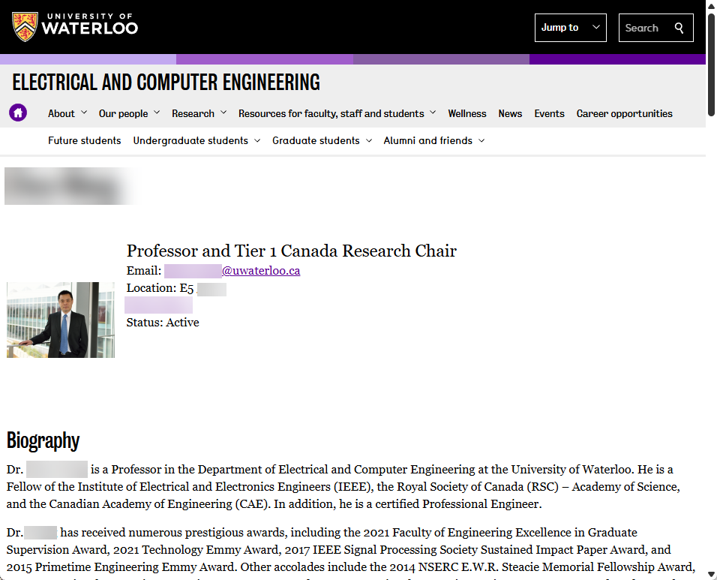
Image of ORCID @ Waterloo

Slide 31
Questions/Comments

Slide 32
Empowering learning and research

