Slide 1
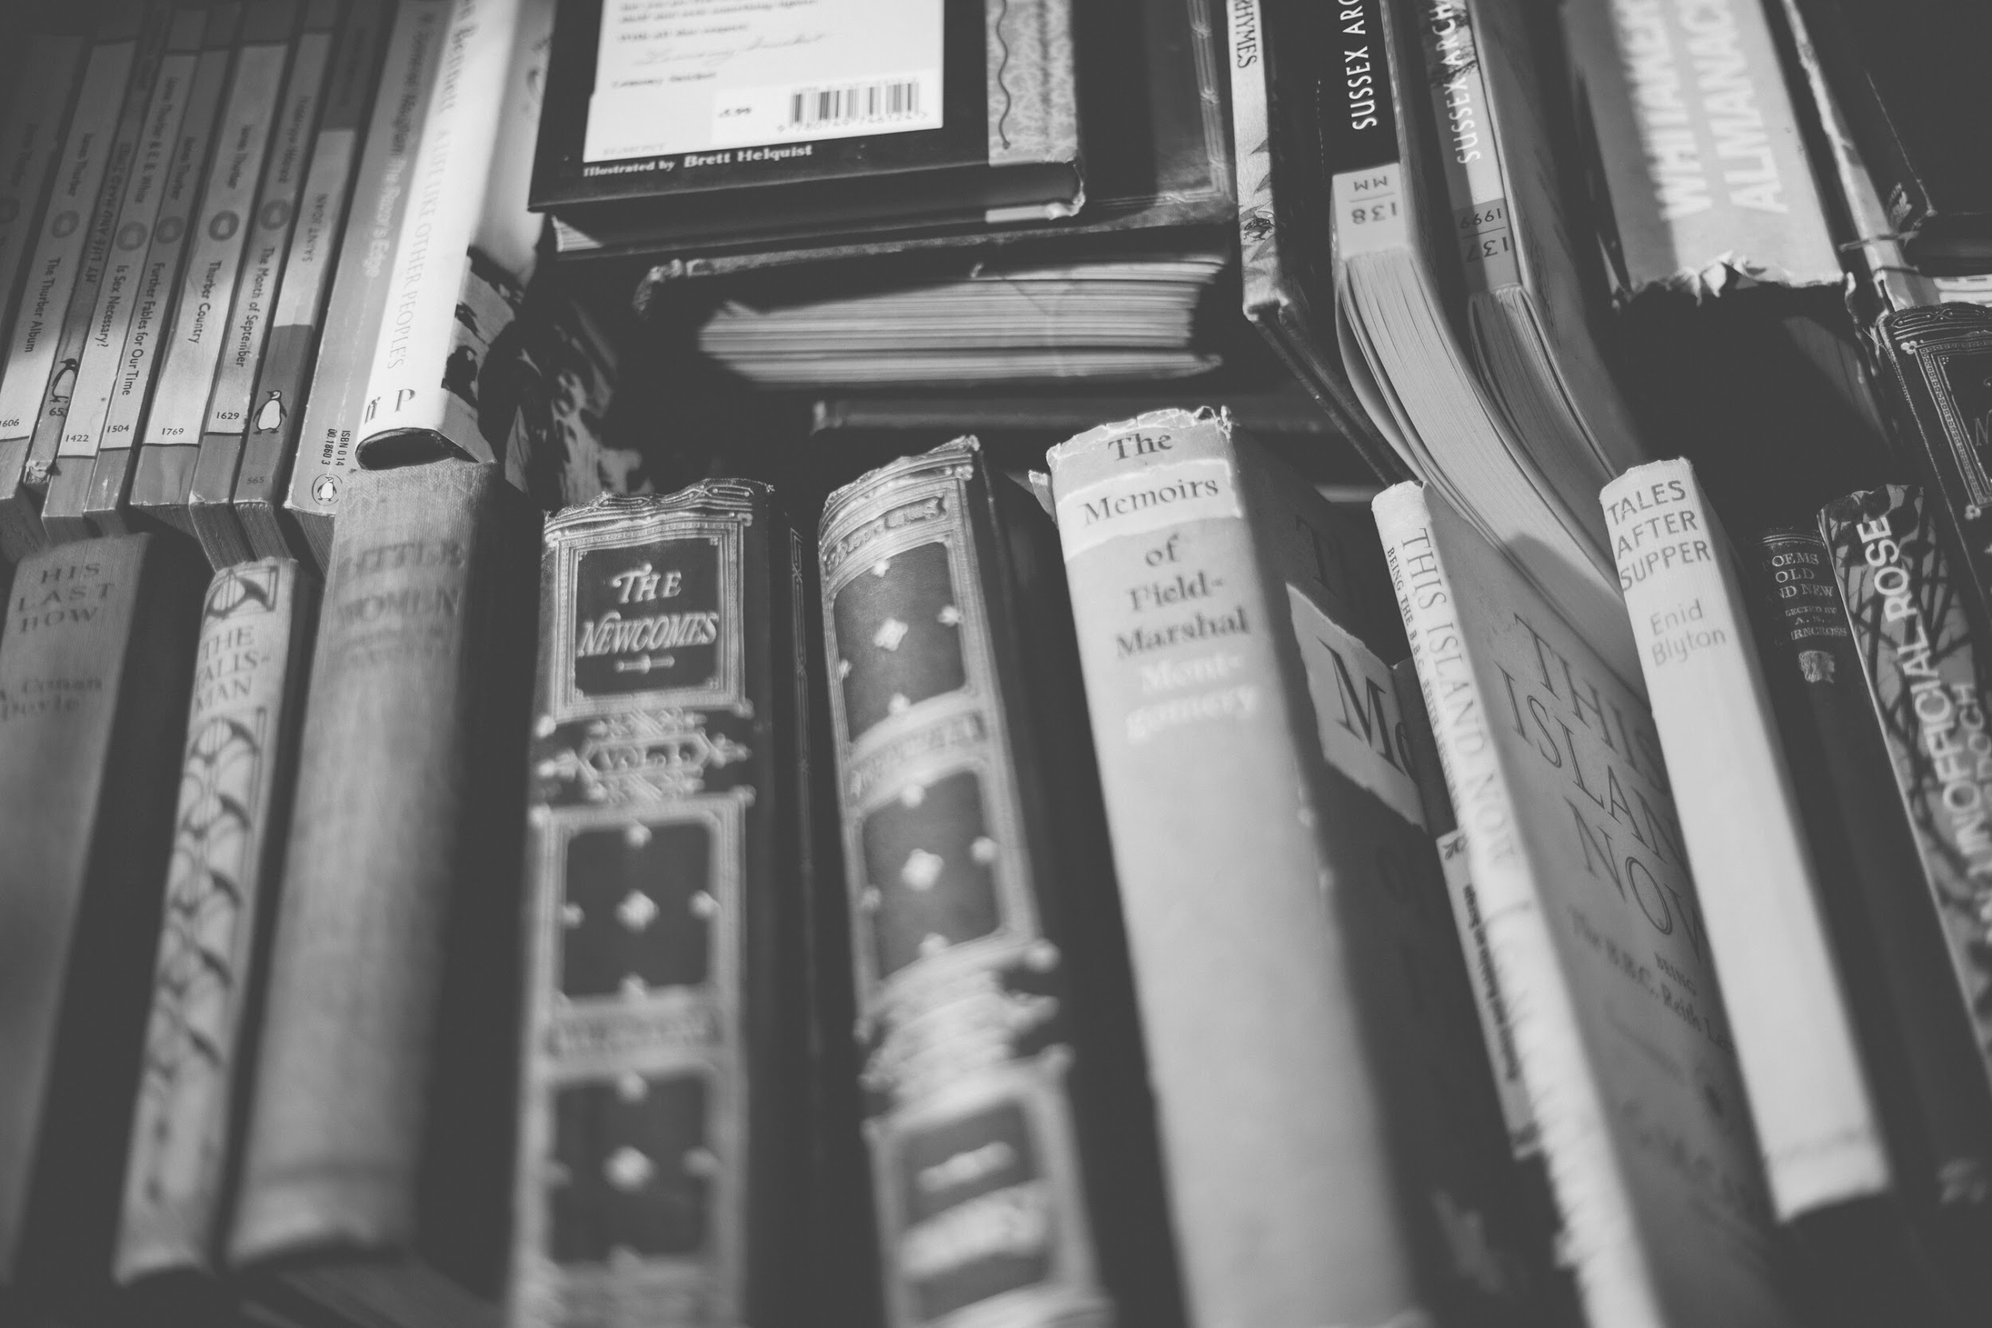
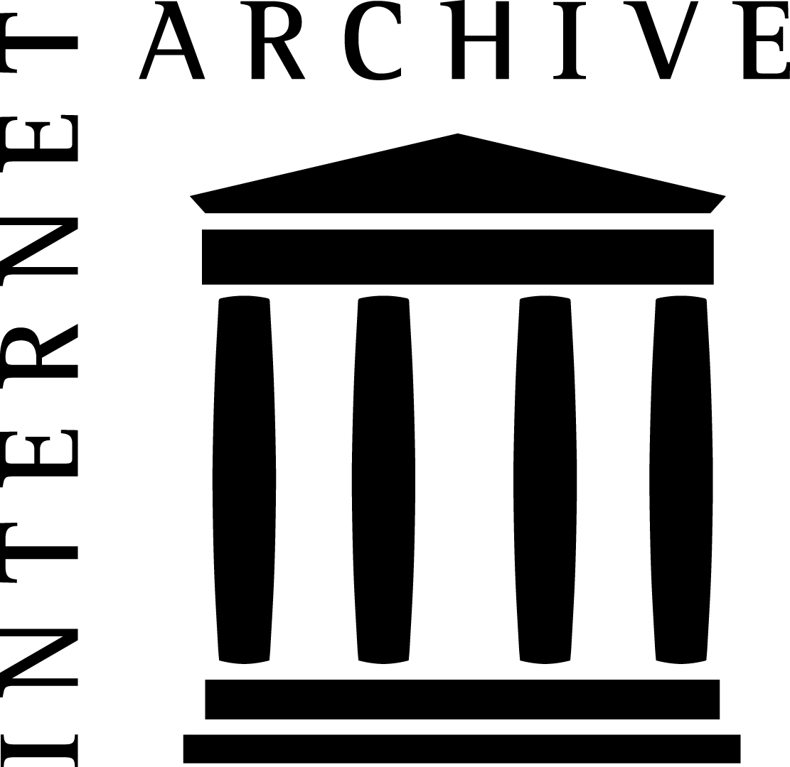
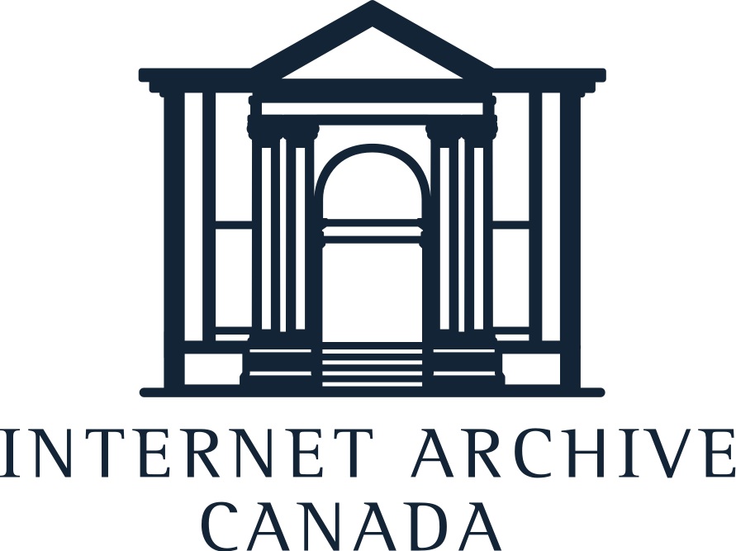
Community-Centred Digital Preservation with the Internet Archive
Julieann Mercer
Sarah Beth Seymore

Slide 2
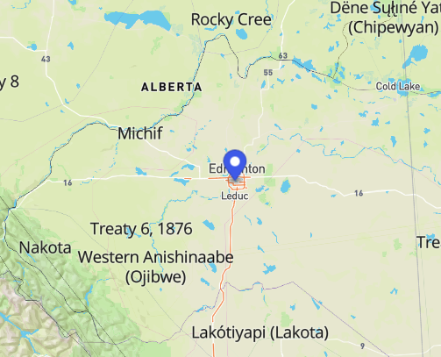
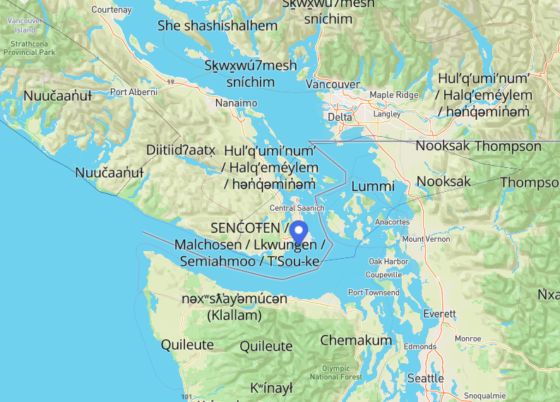
Land Acknowledgement
ᐊᒥᐢᑲᐧᒋᐋᐧᐢᑲᐦᐃᑲᐣ amiskwaciy-wâskahikan, translated as Beaver Hills House from Cree, is the area also known as Edmonton. It’s located on Treaty 6 Territory and home to many Inuit, Métis, and First Nations peoples, including the Néhiyaw (Cree), Dene, Nakota (Stoney), Anishinaabe (Ojibwe/Saulteaux), and Niitsitapi (Blackfoot).
This is the land of the lək̓ʷəŋən People, known today as the Esquimalt and Songhees Nations.
Maps: https://native-land.ca/

Slide 3
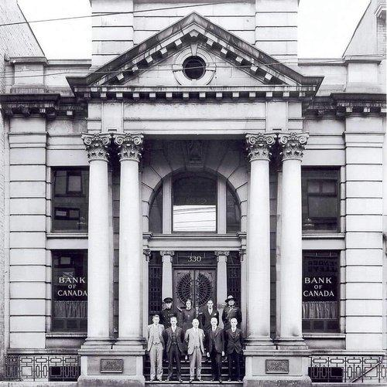
The Internet Archive is a non-profit digital library of Internet sites and other cultural artifacts in digital form. Like a paper library, we provide free access to researchers, historians, scholars, people with perceptual disabilities, and the general public.

Slide 4
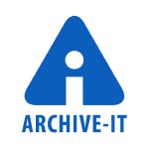

Internet Archive Services and Tools
Digitization
Interlibrary Loan
Controlled Digital Lending
Digital Preservation
Web Archiving
Custom Harvesting
Scholarly Preservation
Access Services
Archive-It - subscription web archiving service
Vault - digital preservation repository and storage system

Slide 5

Community Programs at the Internet Archive
Increase preservation of and access to underrepresented and/or under resourced knowledge
Strengthen memory worker and researcher communities (e.g., professional development, and stakeholder convening and action)
Create and contribute to open and interoperable knowledge infrastructures (e.g., persistent IDs, standards, preservation and access systems)
Community Programs empowers memory and research organizations around the world to expand universal access to all knowledge. We collaborate with partners to build sustainable programs that preserve and share their community's digital heritage.

Slide 6
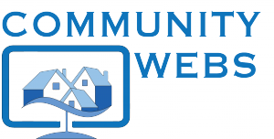
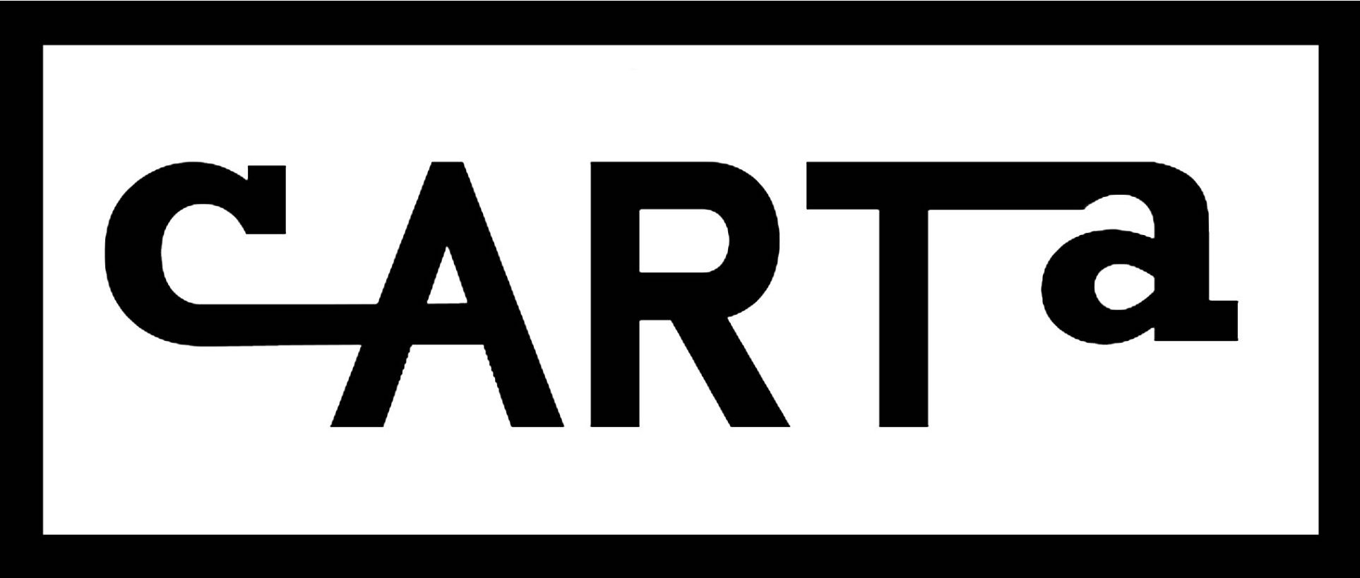
Community Programs at the Internet Archive

Slide 7
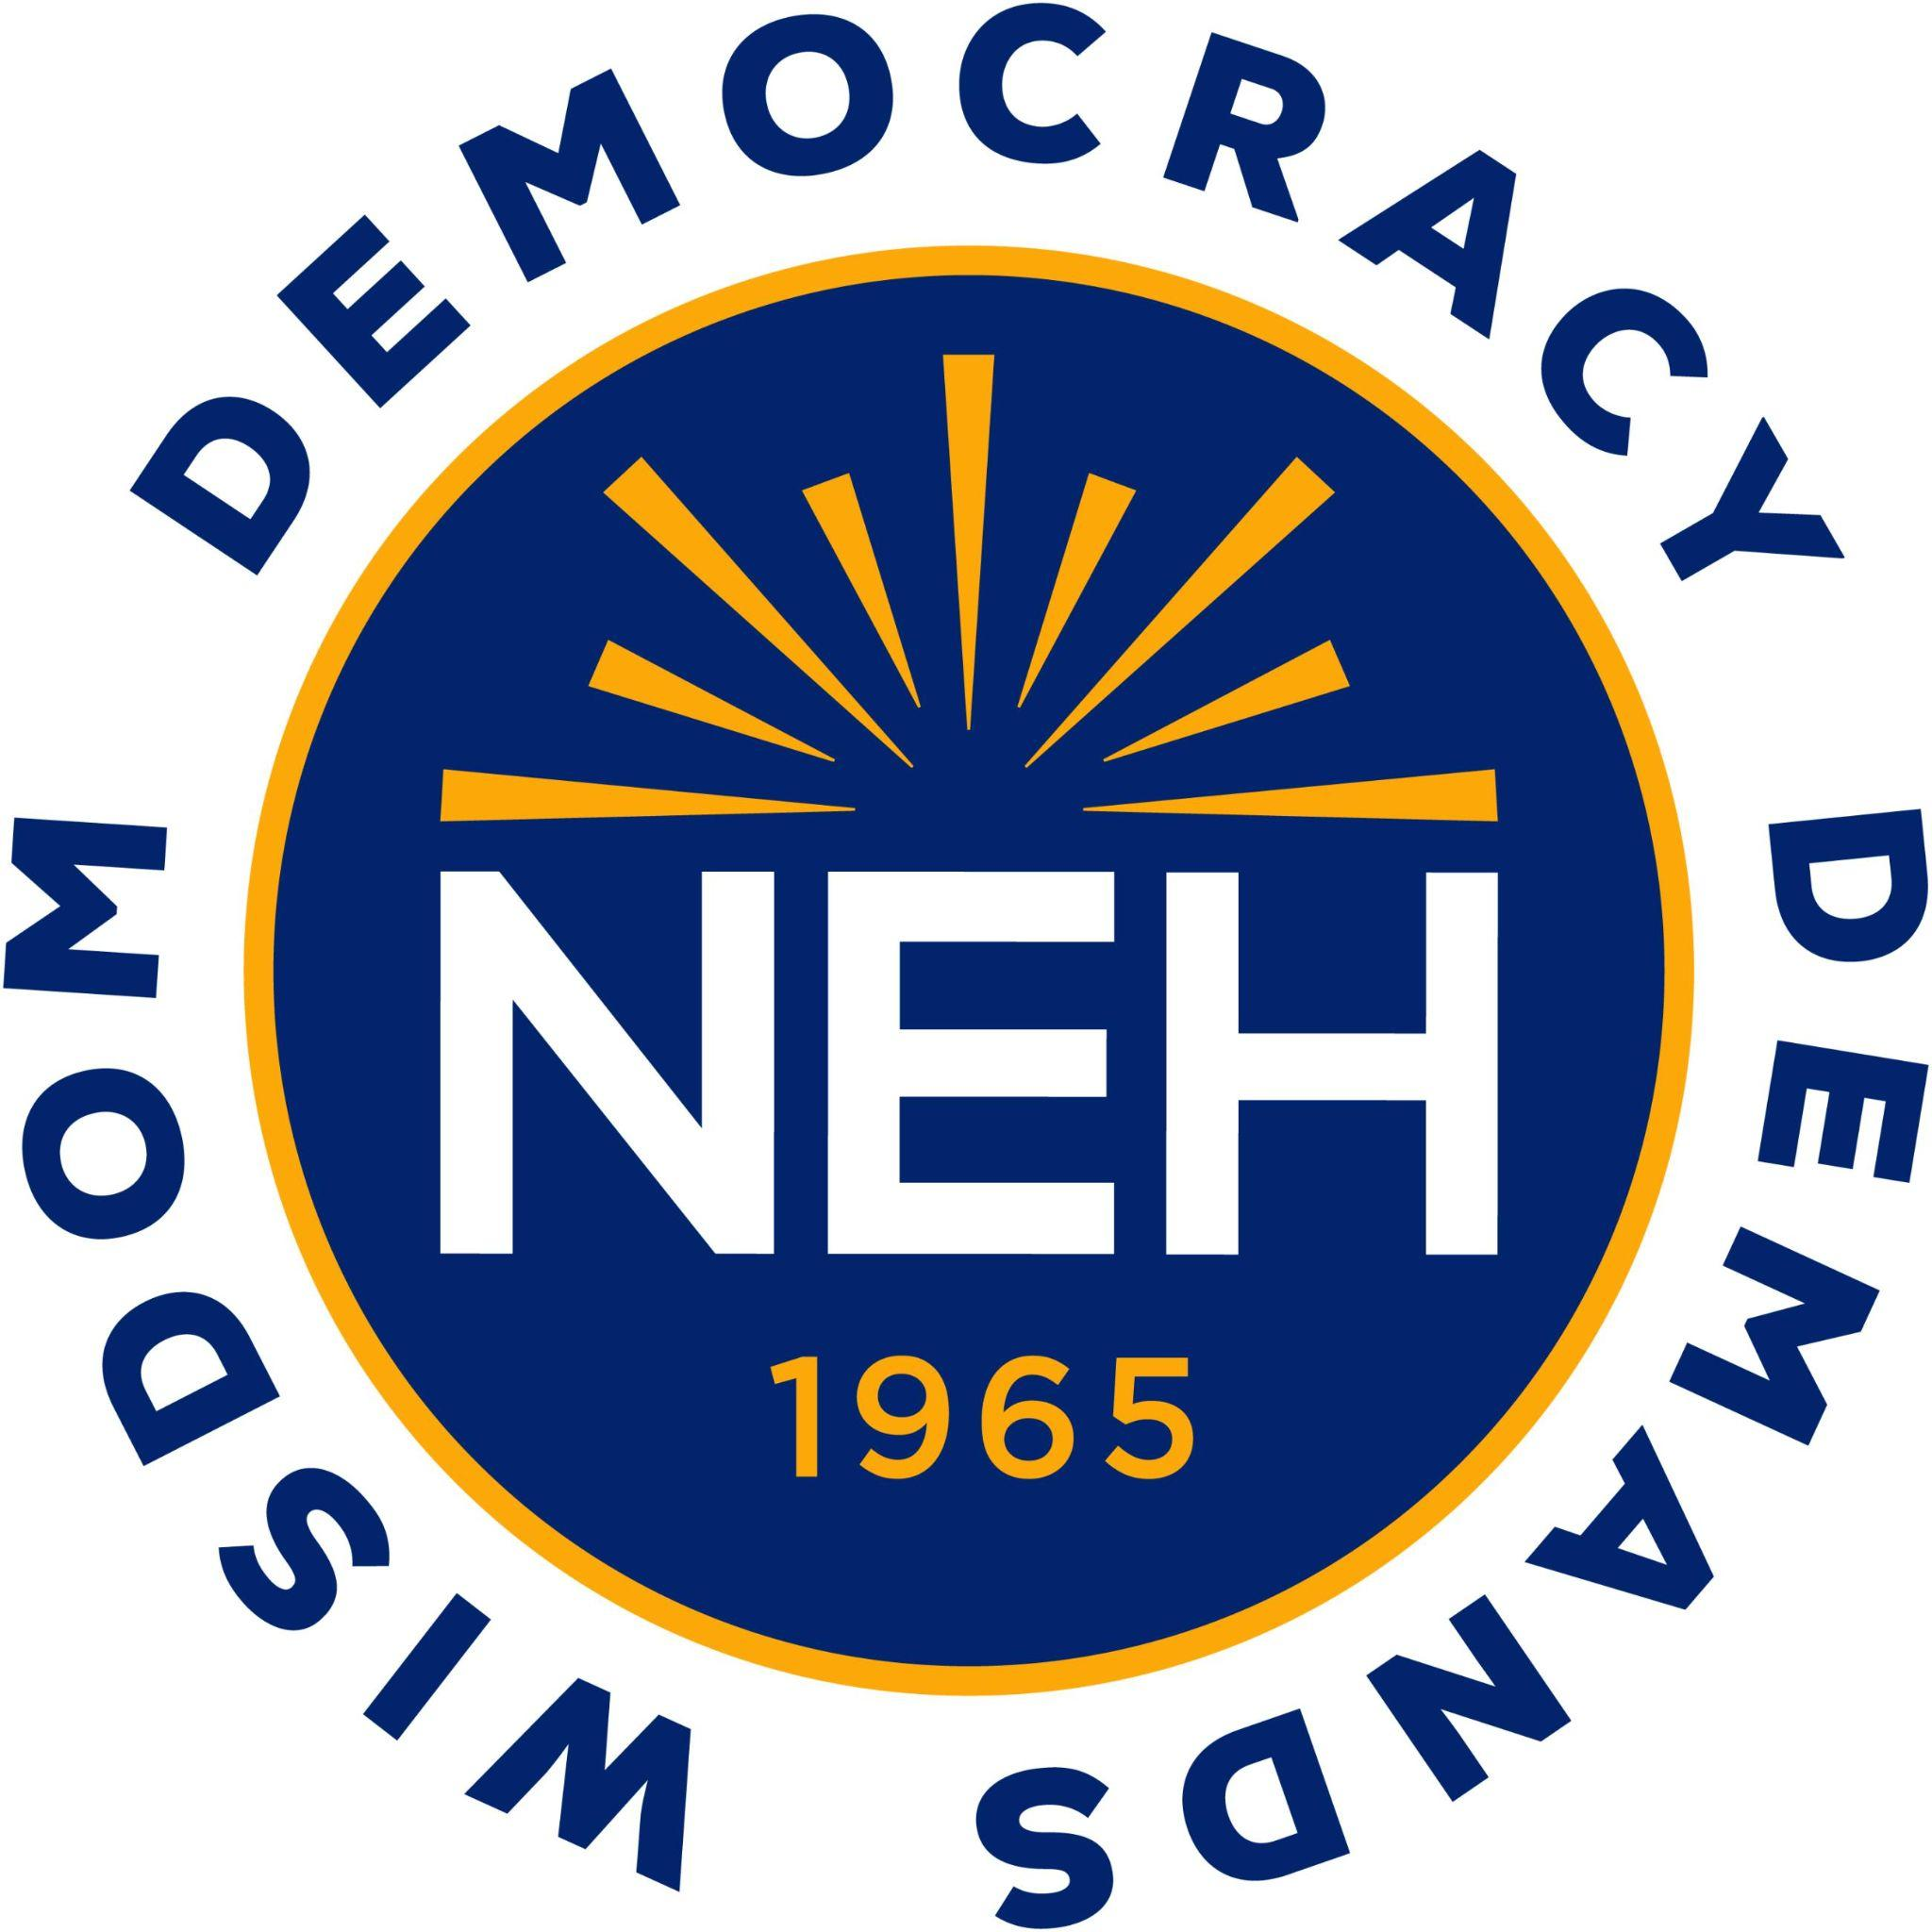
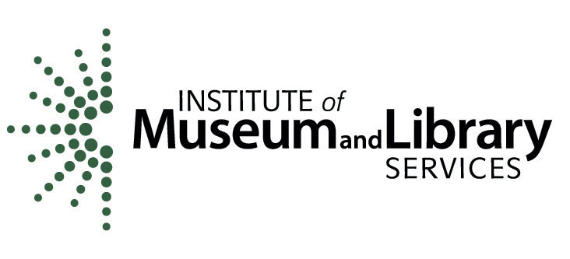

Collaborative ART Archive (CARTA)
Community formation and growth
Member recruitment, collaborative meetings and discussions
Collection building
Creating collections, preserving content, adding metadata
Facilitating access and research
CARTA access portal (https://carta.archive-it.org/), datathons and promotion of use with end users/researchers

Slide 8
CARTA Participants to Date:
41 participating organizations so far:
Museum of Contemporary Art Chicago
Museum of Contemporary Art of Georgia (MOCA GA)
National Gallery of Art Library
National Gallery of Canada
New York Art Resources Consortium (NYARC)
Oklahoma State University
Philadelphia Museum of Art
Rhode Island School of Design
Rungh Cultural Society
San Francisco Museum of Modern Art (SF MOMA)
Smithsonian Libraries and Archives
Smithsonian Institution - Archives of American Art
Sterling and Francine Clark Art Institute Library
The Clyfford Still Museum
The Corning Museum of Glass
The Menil Collection
The Metropolitan Museum of Art
The Nelson-Atkins Museum of Art, Spencer Reference Library
University of Hawaii at Manoa, Hamilton Library
University of North Carolina, Greensboro
Walker Art Center
American Craft Council
American Folk Art Museum
Amon Carter Museum of American Art
ART | library deco
Art Gallery of Ontario
Art Institute of Chicago
Artexte
Bibliothèque et Archives nationales du Québec (BAnQ)
Birmingham Museum of Art
Cleveland Museum of Art
Detroit Institute of Arts
Emily Carr University of Art + Design
Fashion Institute of Technology - SUNY
Getty Research Institute (Getty Library)
Harvard University - Fine Arts Library
Harvard University - Graduate School of Design
Indianapolis Museum of Art at Newfields
Leonardo / ISAST
Los Angeles County Museum of Art (LACMA)
Maryland Institute College of Art (MICA)

Slide 9
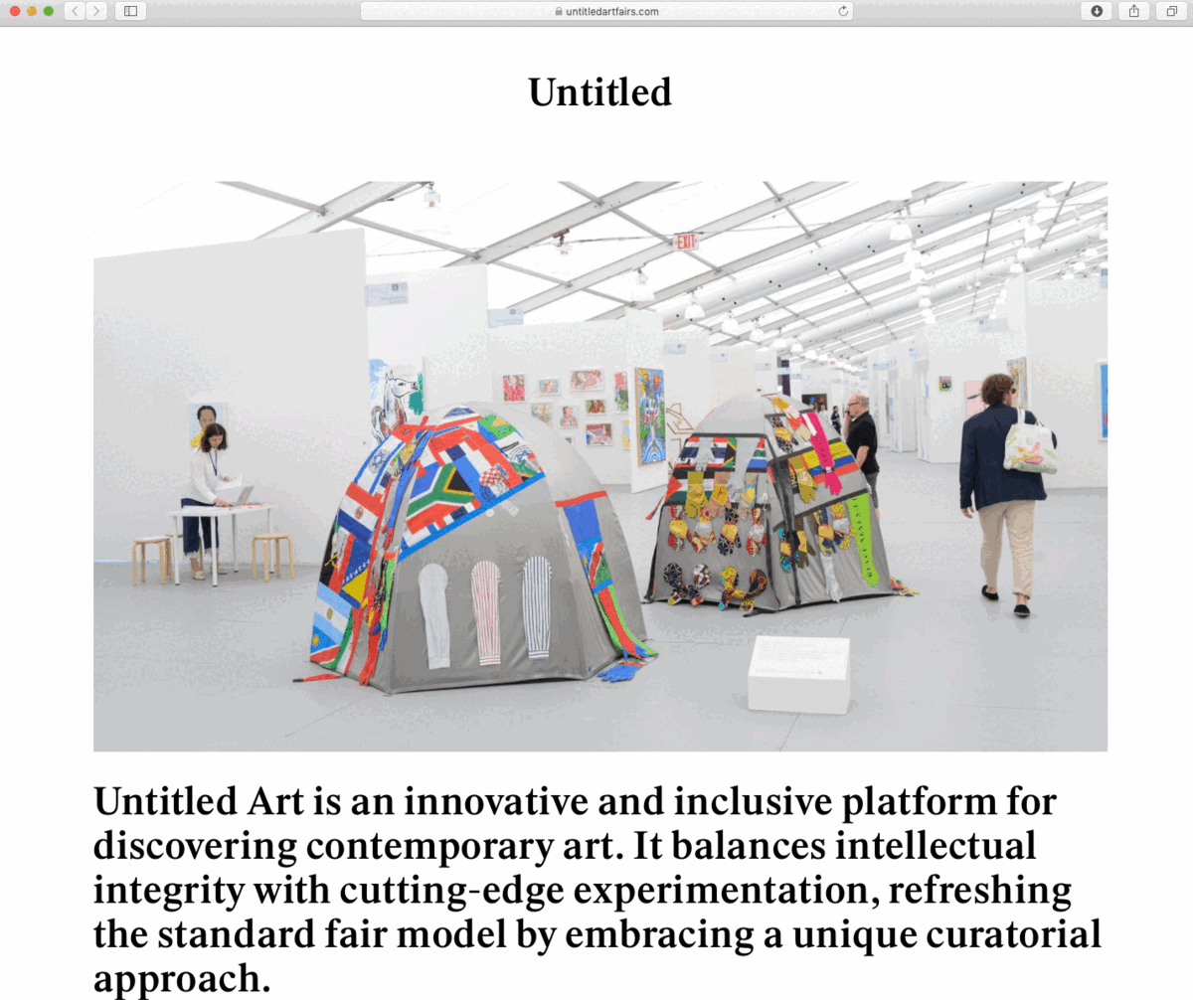
Collection Topics
Collection Name | Description
Art Criticism | Web-based content and blogs providing critical discussion and evaluation of works of art.
Art Fairs and Events | International fairs and events specializing in the exhibition and sale of art.
Art Galleries | Art galleries, gallery exhibitions, and art dealers.
Art History/Scholarship | Web resources and documentation related to the study of art and scholarship in art history.
Artists Websites | Websites created by individual artists and/or estates to showcase their artworks and biographies.
Arts Education | Web-based educational materials and programs for artists.
Arts Organizations | Organizations, museums, and artist-run centers that focus on community arts and empowerment.
Auction Houses | Auction houses and catalogs that specialize in arts.

Slide 10
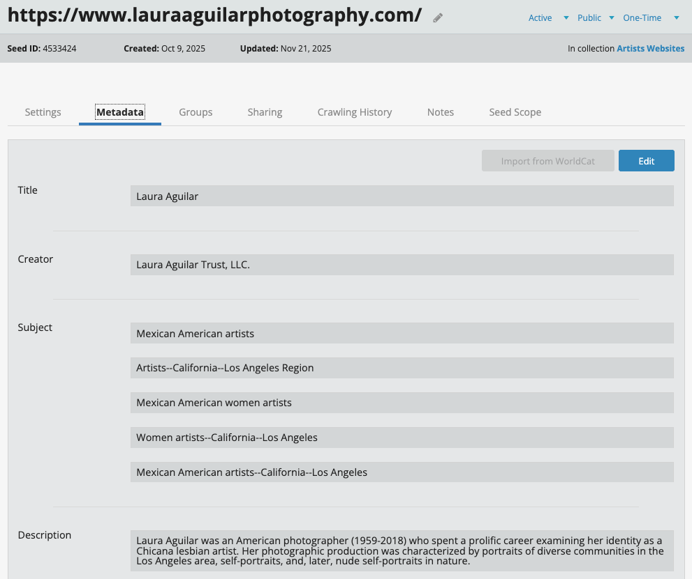
Metadata Remediation Project
Enhance the discoverability of preserved CARTA websites
Metadata updates include website descriptions, subject terms, and geographic information
Internships: over 300 websites updated so far!

Slide 11
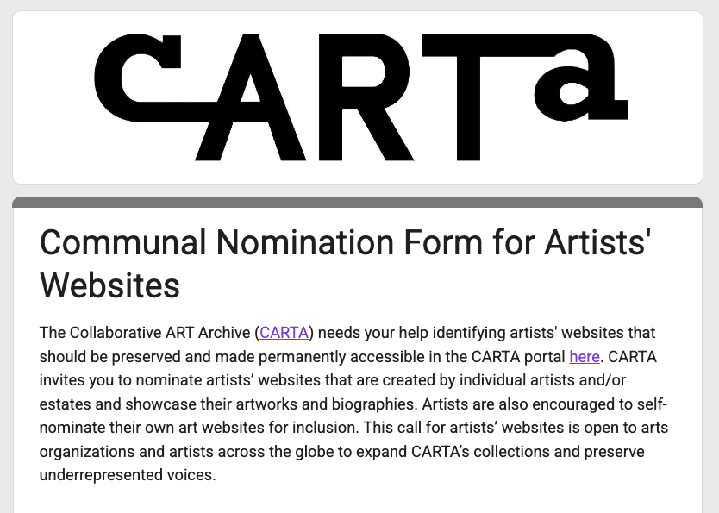
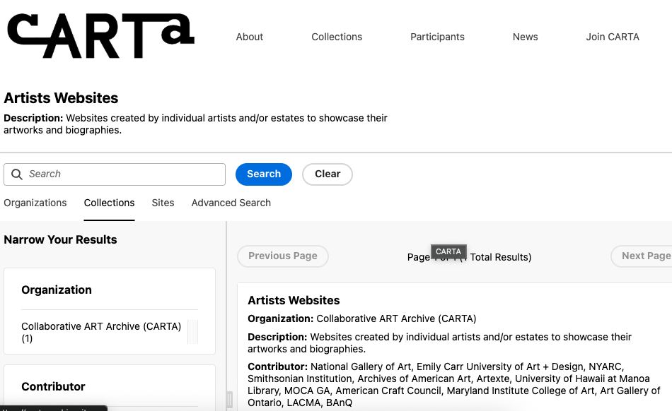
Communal Nomination Process

Slide 12
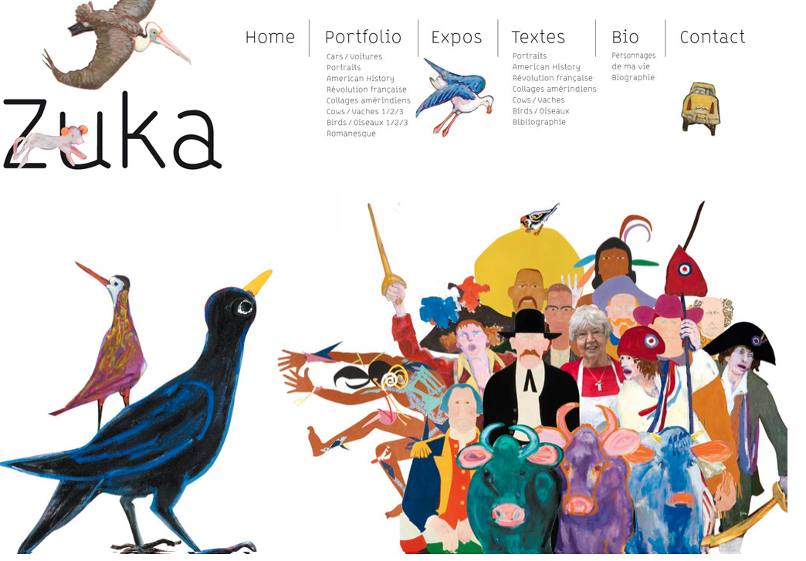
“I fear this website was built long ago and may soon be nonfunctional”
“We had a website melt down some years ago and lost everything”
“This could not come at a better time as I start to work on my artist legacy and I’m thinking of ways that my website can live on once I pass and won’t be able to pay the fees after a while. My website is an extremely important tool that I have used since 2005 when it was uploaded. “
https://zuka.fr/index.html

Slide 13
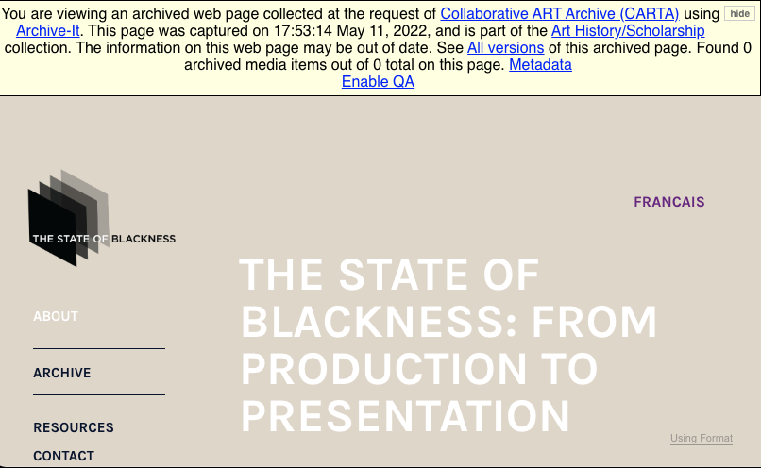
National Gallery of Canada
“Given the quantity of digital material being created by artists today--and their increasing efforts to make work available online--website preservation has become a growing priority for us. This helps ensure that we capture not only digital outputs, which can be elusive and fragile, but also a record of an artists' public-facing, curated body of work which has long-term research value.”

Slide 14
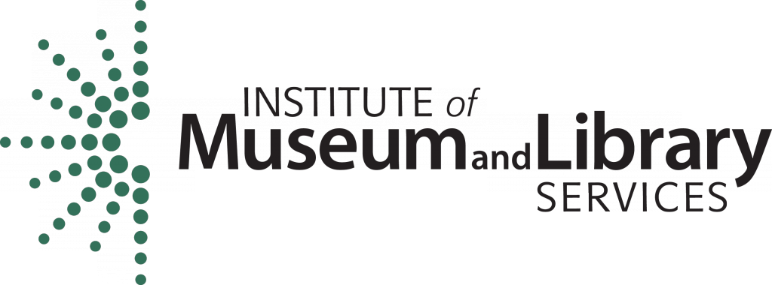

Community Webs advances the capacity for public libraries
and other cultural heritage organizations to document the
digital heritage of their communities through web archiving,
digital preservation, and community archiving. The program
provides professional training, technology services, and
support for networking and multi-institutional collaboration.

Slide 15
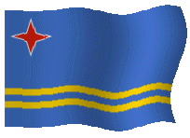

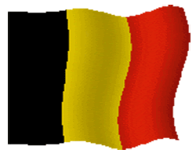



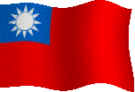
Community Webs includes…
Expanding a national cohort of librarians, community organizers, who are building a vast, inclusive digital archive that prioritizes underrepresented voices through skills development and digital library services
300+ Member Organizations in:
11 Countries
46 US States and Territories
7 Canadian Provinces

Slide 16
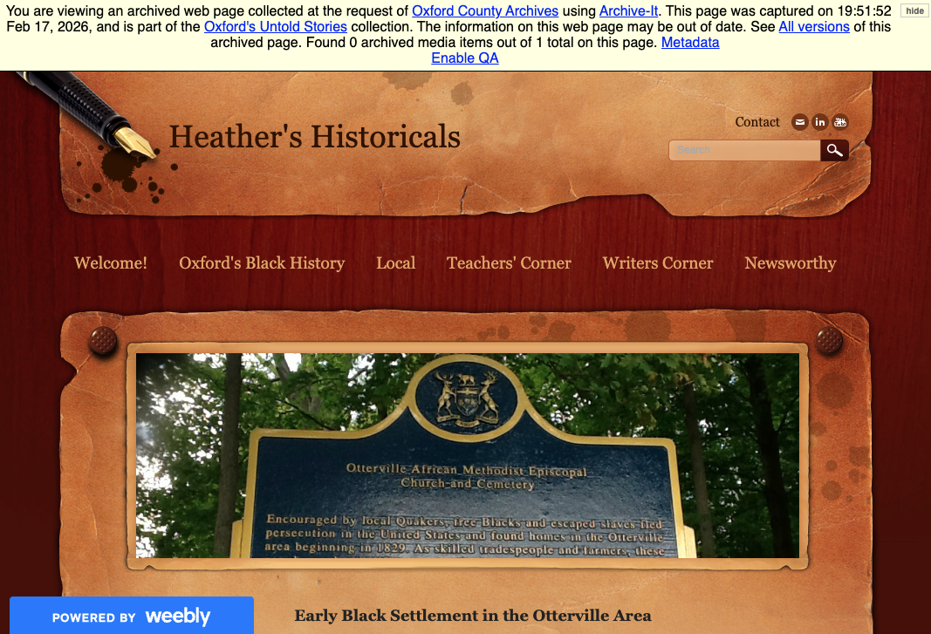
Oxford County Archive’s Untold Stories
“As a starting point, we began brainstorming ways in which we could connect with local community groups, organizations, and associations related to Oxford’s underrepresented populations, in a way that was also convenient and safe for them. We began our research into what community groups were out there, and quickly found that not only were there many, but most of these groups had a massive amount of online content on websites and social media pages. These websites contain event updates, local stories, photographs, videos, interviews, and much more – records that are invaluable to telling these communities’ stories.”

Slide 17
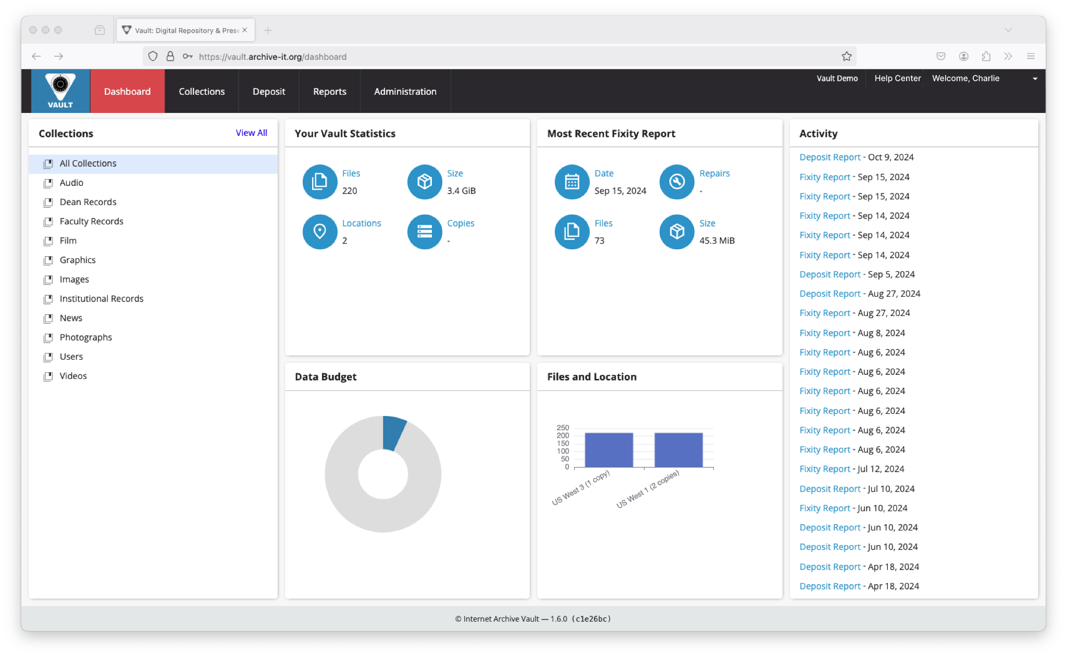

Digital Preservation Discussion Series

Slide 18
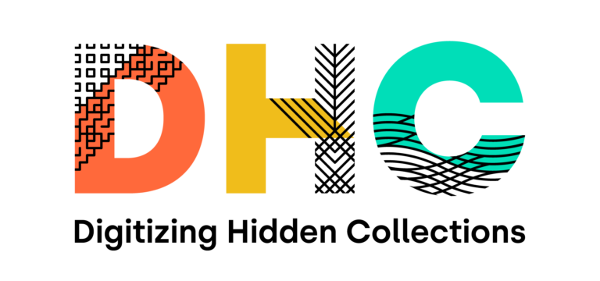
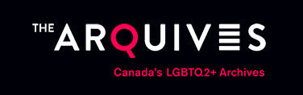
Digitization Project: Amplifying LGBTQIA+ Activism in Local History Archives
Digitize ~182 linear feet of mixed archival collections and photographs over two years at Internet Archive scanning centres in Canada and the United States
Partnership with six memory institutions in Canada and the United States, including The ArQuives (Toronto, Ontario)
The ArQuives: digitizing three collections - James Egan, Jearld Moldenhauer, and Gerald Hannon fonds

Slide 19
Thank you!
You are welcome to reach out to us at:
sarahbeth@archive.org & julieann@archive.org

